Slide 1
Chapter 1: Introduction
Notes:
Note to instructors:
This PowerPoint, and those that follow for subsequent chapters, contains the most important information from the chapter as well as supplemental examples.
Questions for students are in bold.
(Side notes and supplemental information for instructors are in parentheses.)

Slide 2
Questions to Explore Today:
What is Geography?
How can we describe the location of a place?
What do geographers study?
Notes:
This chapter is a bit different from the regional chapters that follow. It is the foundational information that we’ll use for the rest of the course. (Encourage students to ask questions if they don’t understand a particular concept or idea.)

Slide 3
What is Geography?
Notes:
Question: Who has never taken a geography class before? How would you define it? (Write on the board)
Question: Who has taken a geography class before? How would you define it? (Write it on the board)
(Compare these answers and demonstrate how much variation there is. Encourage students that even if they’ve never taken a geography class before, they likely know a lot more about geography than they think!)

Slide 4
What is Geography?
One way of thinking about it is the “where and the why”
Notes:
Explain that we almost exclusively focus on the where but not the why at the middle and high school levels, with map quizzes etc. And yet surveys show that American young adults score very poorly on tests of where places are.
Most geography books take an approach that emphasizes the where, but this textbook focuses much more on the why.
(Give examples, such as where a particular landform is and why it formed there, or where major population centers are and why people live there.)

Slide 5
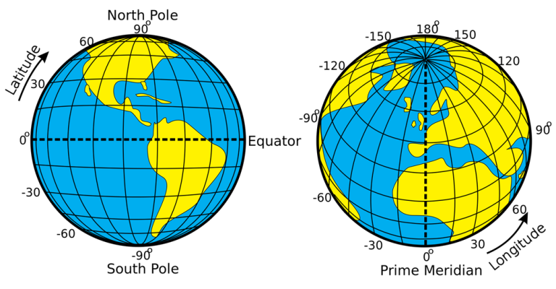
The Spatial Perspective
From https://pressbooks.pub/worldgeo/chapter/chapter-1/
Lines of Latitude and Longitude (© Djexplo, Wikipedia Commons, CC0 1.0)
Notes:
We said that geographers are focused on “where,” right? Well, there are lots of different ways we can tell where something is, and the book talks about two different kinds of location.
Question: What are the two different types of location? (Answer: Relative and Absolute).
Relative – relative to other places
Absolute – often using Latitude and Longitude
How to remember the difference between them – Latitude lines run laterally
(Give examples using your own campus. How would you describe the relative location on your academic building? How would you describe the absolute location of campus?)

Slide 6
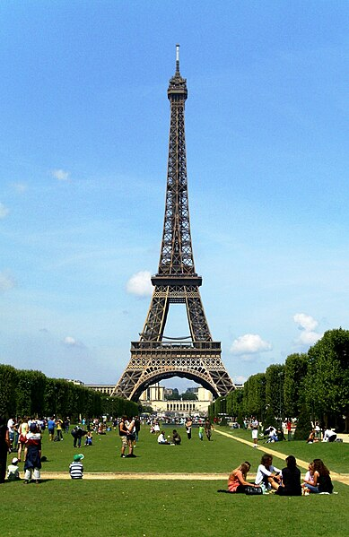
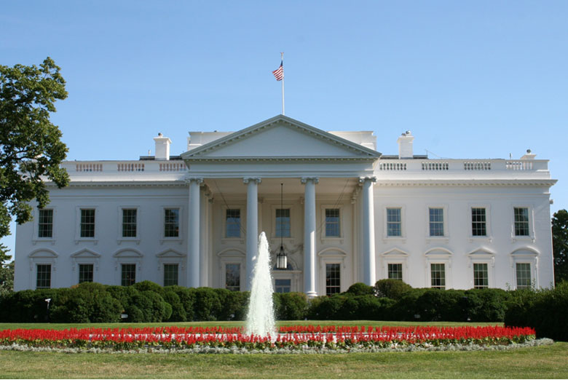
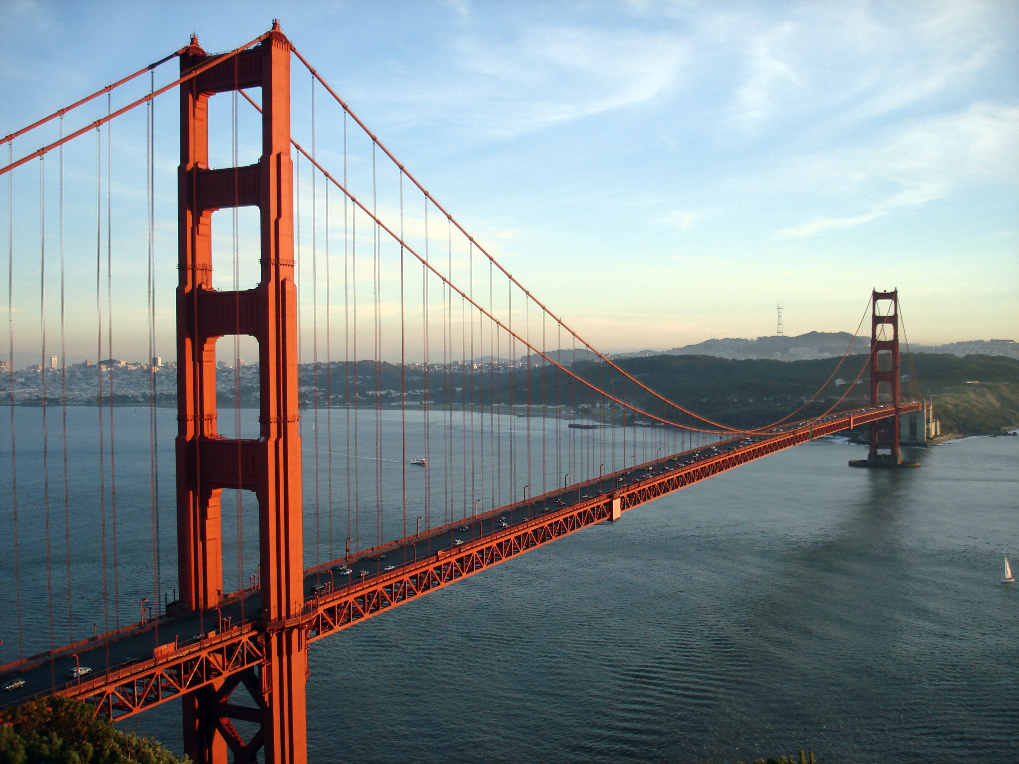
The Spatial Perspective
Flickr, Public Domain
https://upload.wikimedia.org/wikipedia/commons/3/3b/Eiffel_Tower_Paris_01.JPG
From https://en.wikipedia.org/wiki/Golden_Gate_Bridge
Notes:
Practice as a class (have students work in pairs or small groups) and see if they can describe the relative location of one of these places.
Talk about their answers as a class.
How would we find its absolute location?
(Show students how to find a landmark on Google Maps and then right click to show the latitude and longitude)
Eiffel tower is 48.8584° N, 2.2945° E
White House is 38.8977° N, 77.0365° W
Question: Any other way to describe absolute location for white house? 1600 Pennsylvania Ave. Addresses are another form of absolute location.
Golden Gate Bridge is 37.8199° N, 122.4786° W

Slide 7
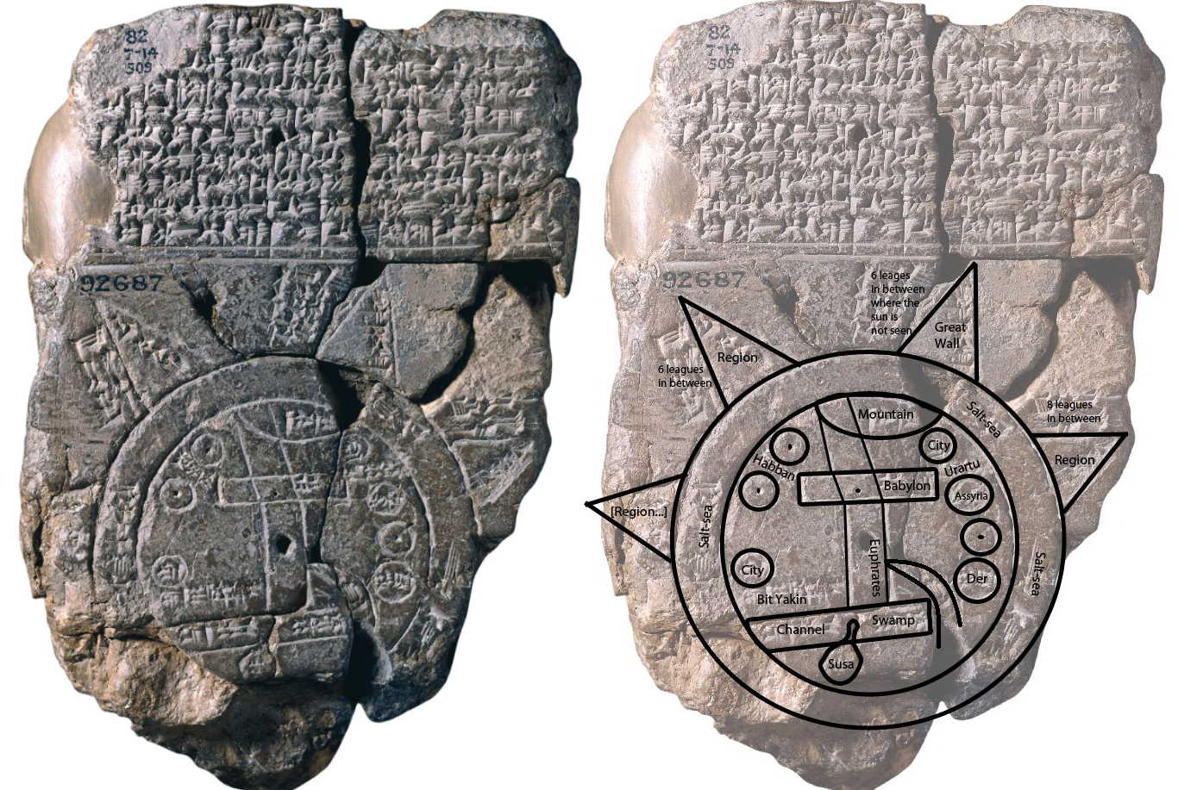
Maps and Mapmaking
From https://www.khanacademy.org/humanities/ancient-art-civilizations/ancient-near-east1/the-ancient-near-east-an-introduction/a/cuneiform
Notes:
Even though we’re focused on both the where and the why in our course, the where is critically important, and thus maps are important tools geographers use.
On the left is the earliest known map. (I usually joke about how terrible the map is – and then point out that it was made in 5 BCE so perhaps we can let it slide.) Look at how many details are actually depicted on the map – actually quite impressive for the time period!
(If students ask, the locations on the map are mountains, a swamp, a canal, three unnamed cities, the cities of Urartu, Assyria, Der, Elam, Bit Yakin, Habban, Babylon, and an unknown location. Parallel lines below the marked city of Babylon are thought to represent the southern marshes of present day Iraq and another curved line, the Zagros Mountains which would have been visible close to the city.)
Question: Why are so many ancient maps circular in shape with the civilization making the map in the center? (Encourage students to think about how limited travel was and how essentially you’d have your own little bubble of the world.)

Slide 8
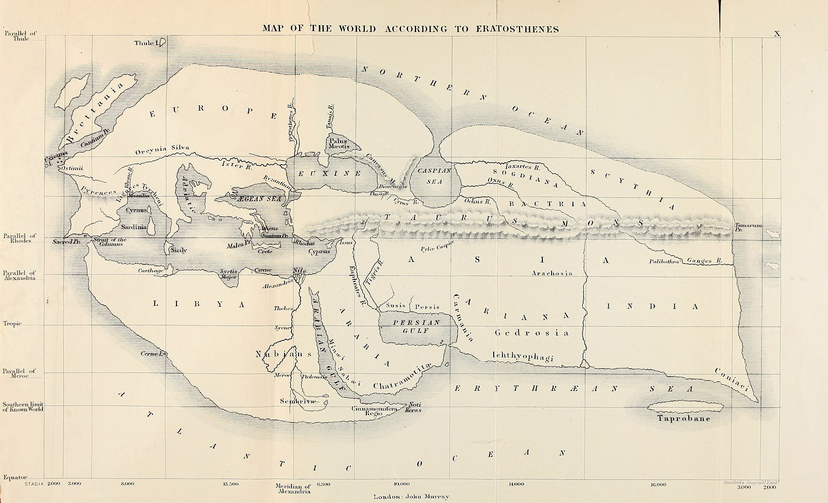
Maps and Mapmaking
From https://en.wikipedia.org/wiki/Eratosthenes#/media/File:Mappa_di_Eratostene.jpg
Notes:
The first map of the known world was made by the ancient Greek scholar Eratosthenes c. 194 BC.

Slide 9
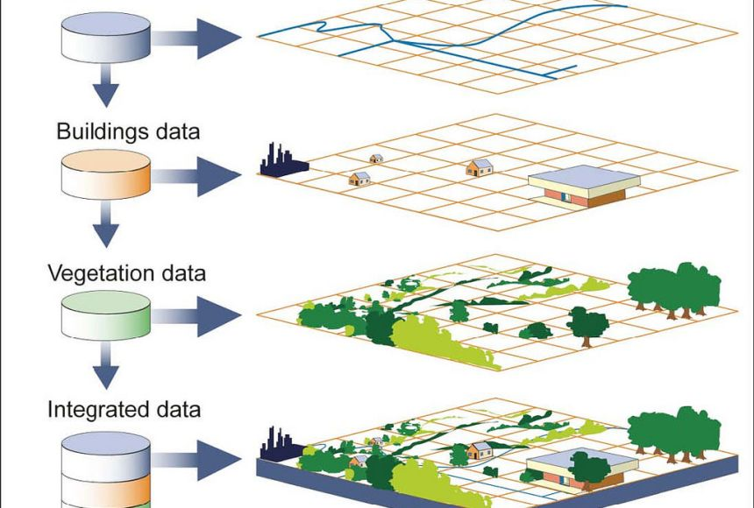
Maps and Mapmaking
Illustration courtesy of U.S. Government Accountability Office
Notes:
Today, of course, we have lots of modern tools and technology at our disposal.
Modern geographers generally make maps using GIS, meaning Geographic Information Systems.
GIS is one of the fastest growing industries for jobs, particularly GIS programming.
With GIS, we layer information so we can analyze it. Imagine, for example, that you were an urban planner trying to find the best location for a new fire station. You might layer housing information with a road network map along with a map of existing fire stations and find that there’s an area of your city that could use additional support.

Slide 10
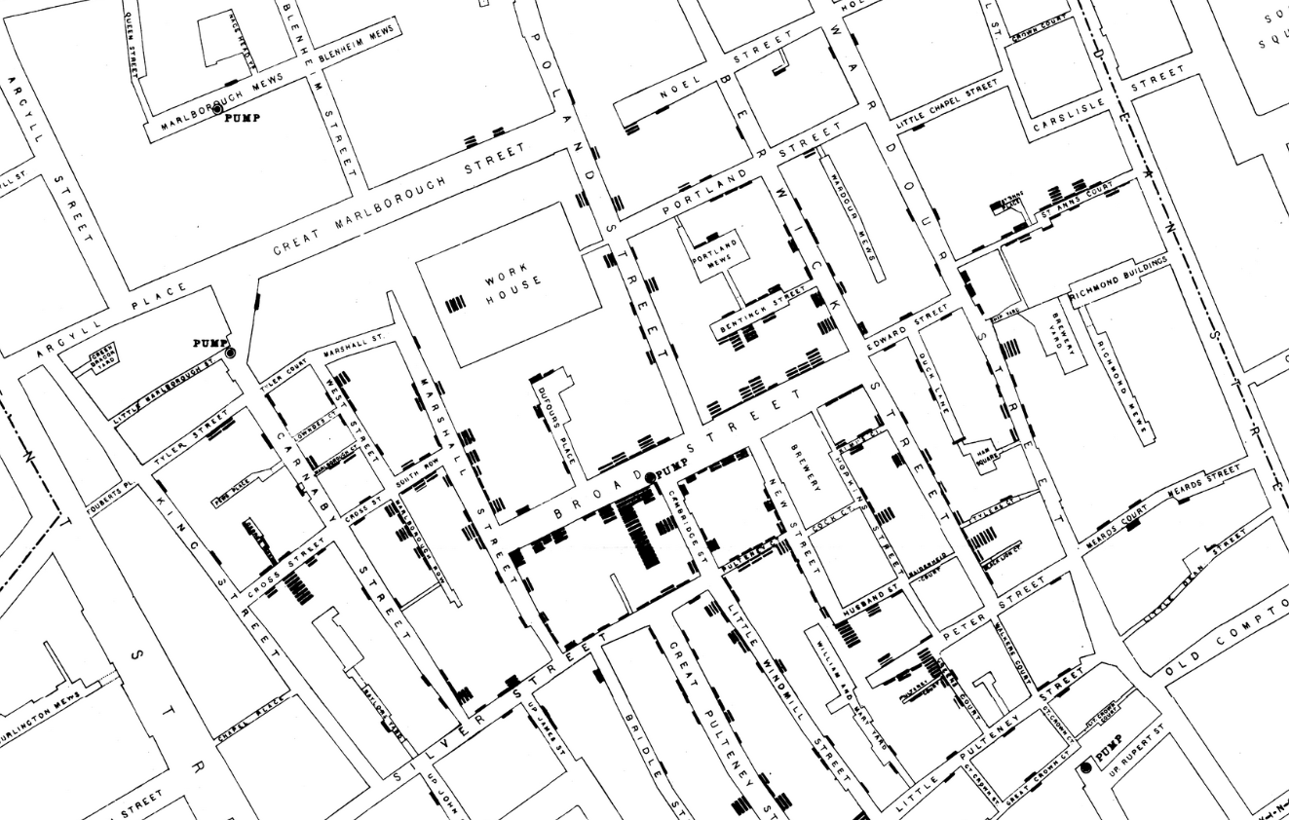
Maps and Mapmaking
From https://upload.wikimedia.org/wikipedia/commons/2/27/Snow-cholera-map-1.jpg
Notes:
Possibly the earliest use of GIS was in 1854. John Snow (I usually make a joke about how he’s not that Jon Snow) depicted a cholera outbreak in London using points to represent the locations of some individual cases. His study of the distribution of cholera led to the source of the disease, a contaminated water pump within the heart of the cholera outbreak.

Slide 11
Maps and Mapmaking
Mini Quiz:
Why are maps distorted?
What are map projections?
Notes:
Maps are all distorted in some way because you’re taking something round and making it flat. So you have to distort one or more of the following things: sizes, angles, distances, and directions
A map projection is a method for representing the curved surface of the earth on a flat surface.
No projection can perfectly represent all aspects of the earth's surface; each has its strengths and weaknesses.

Slide 12
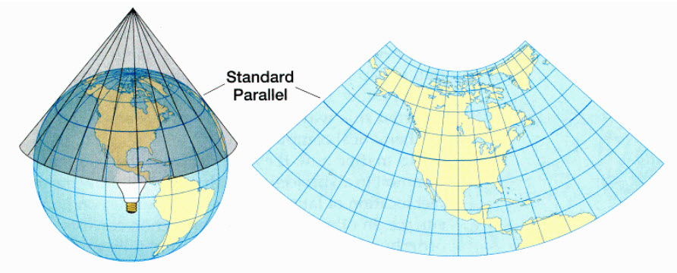
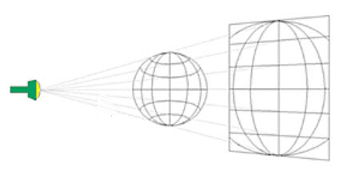
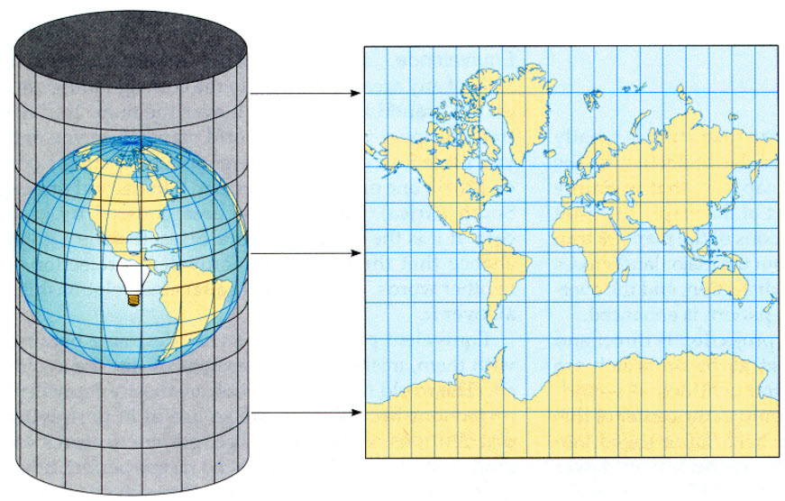
Maps and Mapmaking
From https://ubc-library-rc.github.io/map-projections/content/proj-family.html
Notes:
Map projections are so-called because the term comes from the concept of projecting a light source through the earth's surface onto a two-dimensional surface (a map).

Slide 13
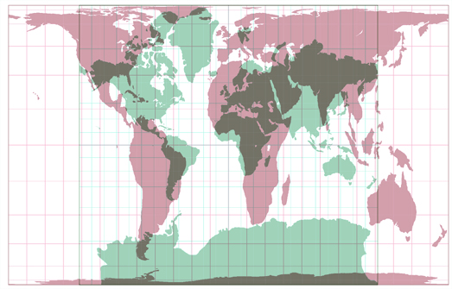
Maps and Mapmaking
https://map-projections.net/compare.php?p1=winkel-tripel&p2=mercator-84&sps=1
Notes:
(Spend a little time exploring map projections and comparing their relative sizes.)
(If you click on “Single View” on the website, there are TONS of projections.)
Question: Which projection is best? (Answer: That depends.)
Mercator Projection: Ideal for navigation because it preserves angles and directions.
However, it distorts the size of objects as the latitude increases. Greenland and Africa are a classic example, where Greenland appears much larger than it is.
Gall-Peters Projection: Attempts to represent areas more accurately than the Mercator.
Useful for educational and thematic maps where area representation is important, but it distorts shapes.
Robinson Projection: Balances size and shape, leading to a more 'visually pleasing' map.
Often used in classrooms for world maps.
Winkel Tripel Projection: Balances size, shape, and distance, minimizing overall distortion.
Adopted by National Geographic for general world maps.
(Highlight that each projection tells a different 'story' of the world, emphasizing certain aspects while downplaying others.)

Slide 14
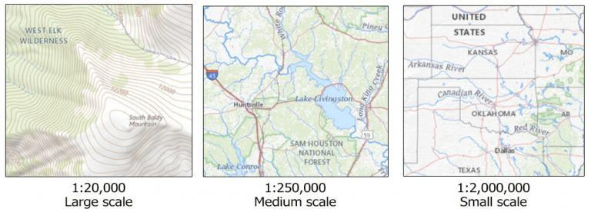
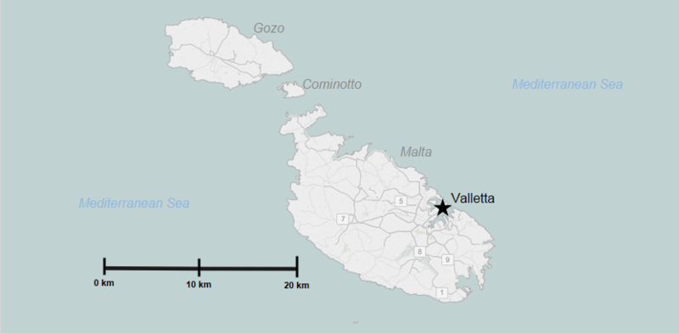
Map Scale
From https://gisgeography.com/map-scale/
Notes:
Another key feature of maps is scale
Different ways to list scale. One is a ratio
The other is a scale bar. You’d literally measure the distance on the bar and that corresponds to the distance on a map
(Pull up Google Maps and see if they can find the scale bar. Zoom in and out a bit.)
Like with projections, the best scale really depends on what you need it for.
Now, as we zoom out, we lose detail. Can you see that happening as we zoom in and out?
Question: Why wouldn’t we just want a 1:1 scale and then we wouldn’t lose anything? Because it would be as big as this room!

Slide 15
Core and Periphery
From https://pressbooks.pub/worldgeo/chapter/chapter-1/
The Core and the Hinterland (Figure by author, Images courtesy of Espresso Addict, Wikimedia Commons; Mike – Flickr; Pam Brophy – Wikimedia Commons; CC BY-SA)
Notes:
Now, we’ve already talked about relative location, but when we talk about where places are, another way to think of that is where they are relative to other cities and countries and how it interacts with them.
Question: What is a hinterland?
Let’s imagine (insert your college town here) is the central city. Where is our hinterland?
Question: How do we interact with the hinterland? (Encourage students to think about where farmlands are around your institution. Consider where farmers who sell at local farmers markets grow their crops.)

Slide 16
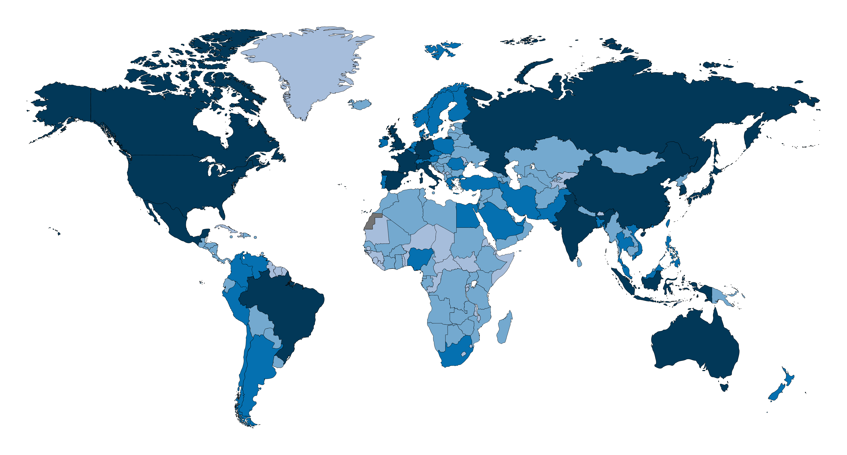
Core and Periphery
From https://en.wikipedia.org/wiki/List_of_continents_by_GDP#/media/File:World_map_showing_nominal_GDP_of_countries_for_the_year_2017_according_to_the_IMF.png
Notes:
We can extend that model globally.
Question: What areas of the world would you consider to be the global core?
Why?
Are these interactions balanced? Why or why not?
There’s the idea that a rising tide lifts all boats, but there’s a question of whether or not the global wealth generated lifts everyone equitably.

Slide 17
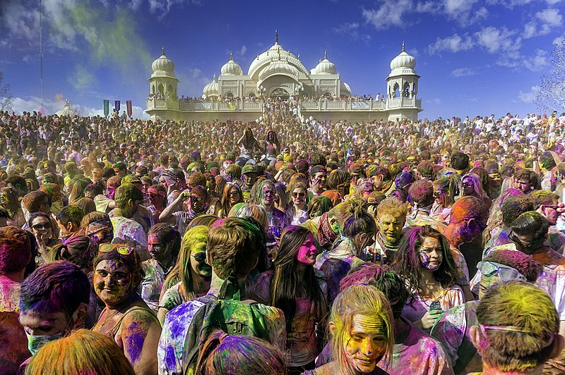
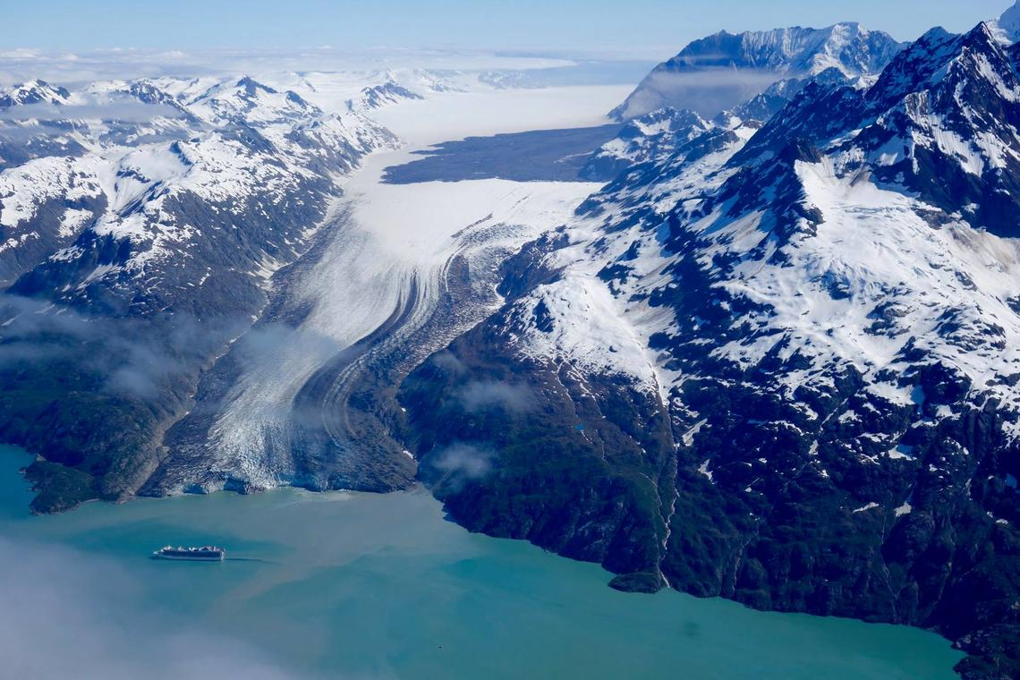
What kinds of things do Geographers study?
HUMAN GEOGRAPHY
Culture
Economics
Politics
Urbanization
PHYSICAL GEOGRAPHY
Landforms
Climate
Natural Disasters
Natural Resources
Holi Festival, Sri Radha Krishna Temple
Spanish Fork, Utah, United States. From https://commons.wikimedia.org/wiki/File:Holi_Festival_of_Colors_Utah,_United_States_2013.jpg
Lamplugh Glacier, Glacier Bay National Park, Alaska. From https://www.flickr.com/photos/usinterior/51240527421/
Notes:
Now that we’ve got the basics and understand a bit about how geographers look at the world, let’s look at what geographers actually study.
There are two main branches: physical and human.
How are we different from geology or astronomy? We’re basically everything in between.
But even this is not great because is there an overlap between the two?
And where does GIS belong?
So let’s consider these branches and some core concepts we’ll explore throughout the semester.

Slide 18
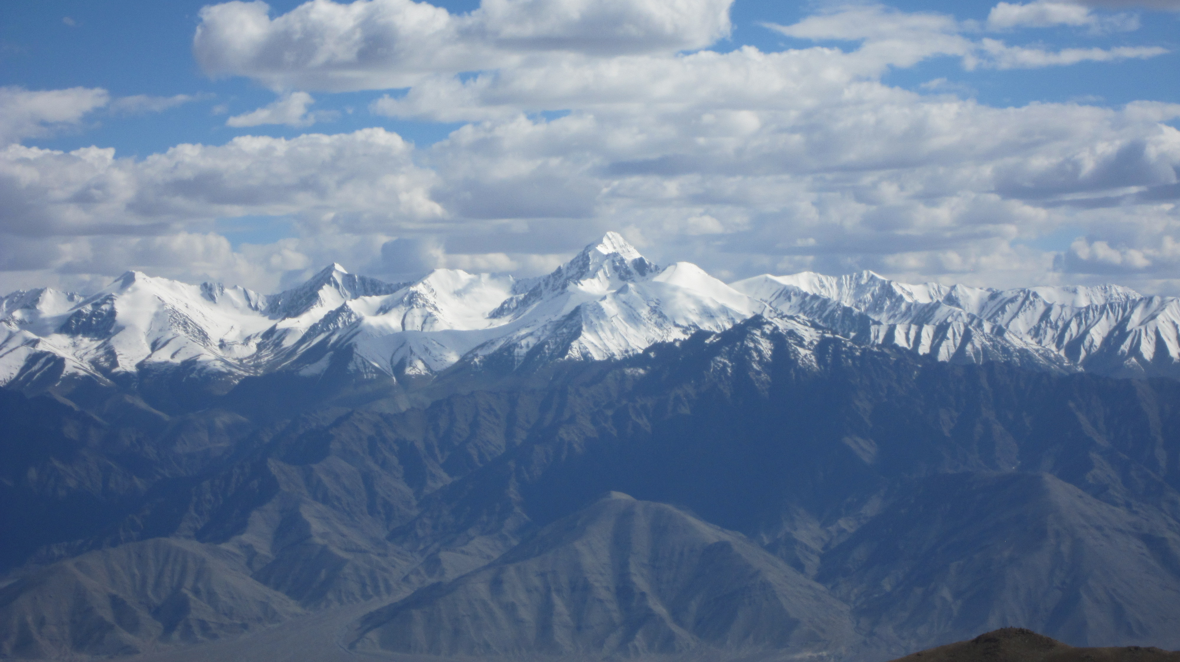
Physical Geography
From https://commons.wikimedia.org/wiki/File:High_mountain_range.jpg
Notes:
One basic question we can ask about the where and the why of physical features are why are there certain landforms like mountains and volcanoes?
(Picture is Zanskar range in India)

Slide 19
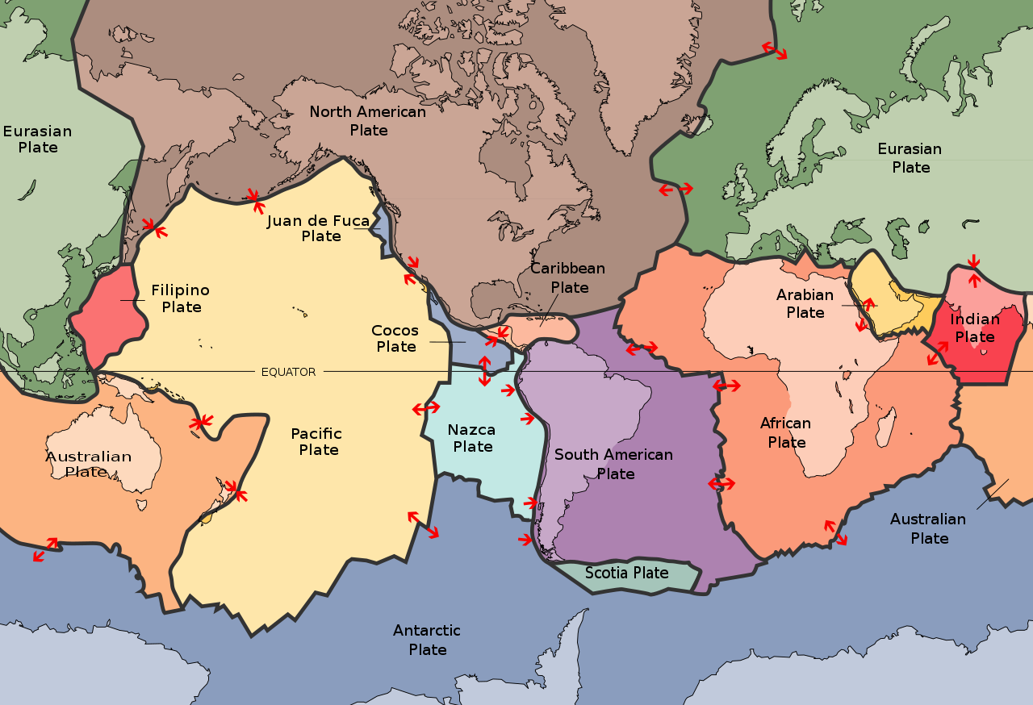
Physical Geography
From https://pressbooks.pub/worldgeo/chapter/chapter-1/ Map of Global Tectonic Plate Boundaries (United States Geological Survey, Public Domain)
Notes:
Much of Earth’s physical landscape, from mountains to volcanoes to earthquakes to valleys, has resulted from the movement of tectonic plates.
Look at New Zealand and Japan

Slide 20
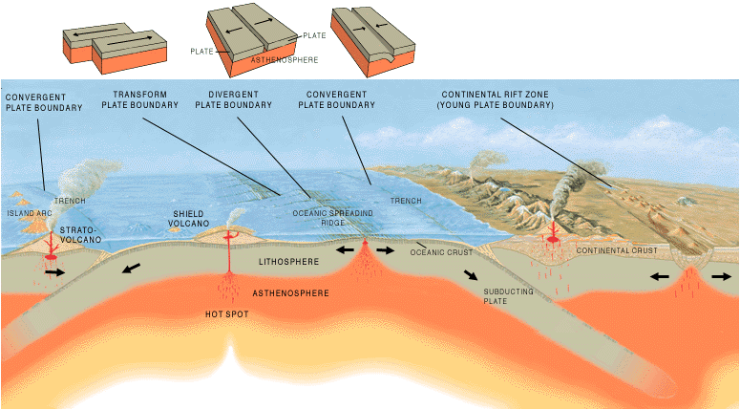
Physical Geography
From https://pressbooks.pub/worldgeo/chapter/chapter-1/
Types of Tectonic Plate Boundaries (United States Geological Survey, Public Domain)
Notes:
(Talk about types of plate movement. I usually have my students use their hands and pretend they’re tectonic plates. It’s also a good way to talk through stick-slip friction, since sometimes their hands will catch on a knuckle. They build up energy and eventually slip past, causing an earthquake.)

Slide 21
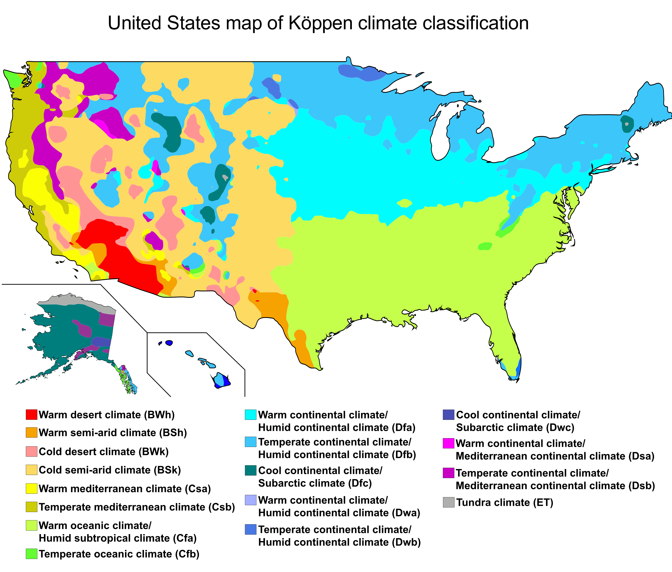
Physical Geography
From https://commons.wikimedia.org/wiki/File:USA_map_of_K%C3%B6ppen_climate_classification.svg
Notes:
Another key area of physical geography is weather and climate
Quetion: What is the difference? Weather is what you’re wearing today. Climate is all the clothes in your closet.
Geographers study natural hazards as well.
And of course part of this discussion is our changing climate, which we’ll cover more about in Chapter 10

Slide 22
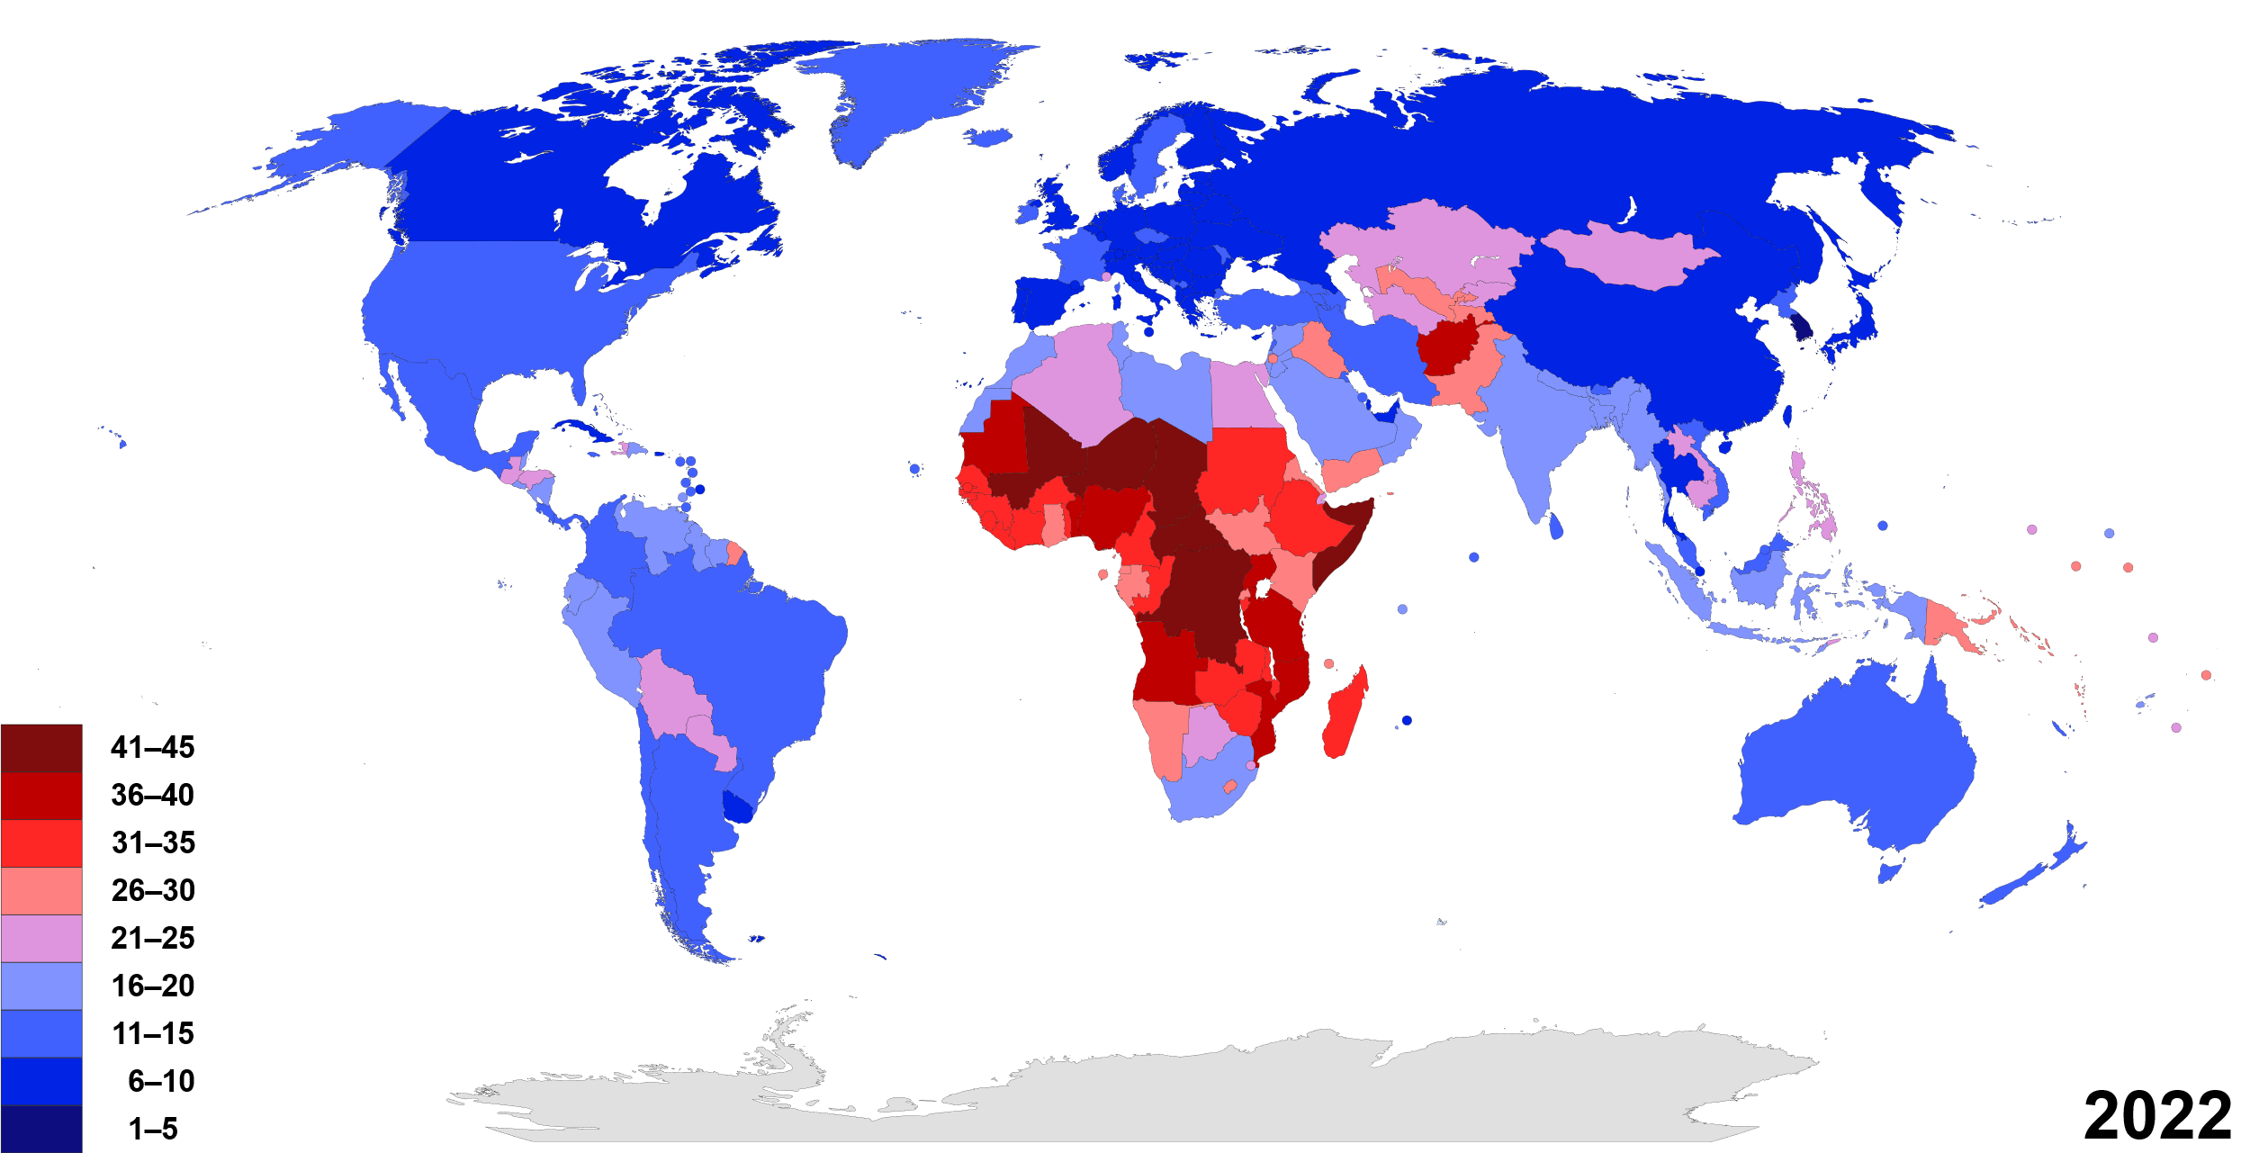
Human Geography
From https://en.wikipedia.org/wiki/Birth_rate
Notes:
If we shift to human geography, a fundamental concern for human geographers is our population.
At the basic level, there are several statistical measures we can use to describe a population. These are NIR and TFR.
What are the two statistics we need to know the natural increase rate? In other words, what are the two components that go into whether a population is growing, declining, or staying the same?
Birth and Death. So BR and DR
BR-DR=NIR
(You could practice with a few countries.
USA Birth rate is 11 per 1,000. Death rate is 10.4 per 1,000
What is the NIR? 0.6 – Then convert to a percentage 0.6/1000 which is 0.0006%
Nigeria is 37 per 1000. Death rate is 13. NIR is 24/1000 or 2.4%)
Total Fertility Rate is another key measure. This is the average number of children a woman will have during her childbearing years
(Google this for examples – Google will give you a chart of the TFR of your selected country and several others)
Question: What factors go into the TFR? (You could take a straw poll and see how many kids your students would like to have and talk through why they answered the way they did.)

Slide 23
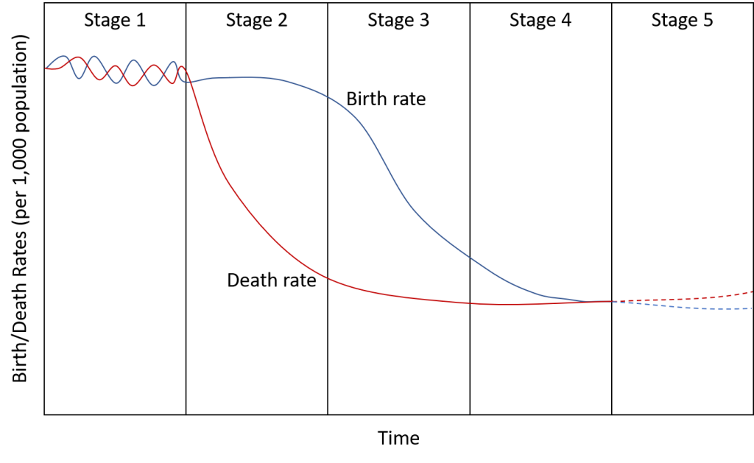
Human Geography
From https://pressbooks.pub/worldgeo/chapter/chapter-1/ Figure by Caitlin Finlayson
Notes:
We can graph the changes we see in birth and death rates in a country over time using the Demographic Transition Model.
(I think it’s easier to learn this if we just chart it piece by piece, so perhaps you might draw a blank chart of 5 stages on the board and have students work through each stage together.)
(Explain why the birth rate and death rate changes in each stage.)
One of two things could happen in stage 5 – you might have births become so low, they slip below the death rate. Or you might have births remain fairly steady, but we see diseases of affluence cause the death rate to increase (things like obesity-related illness, alcoholism, etc.)
Question: How could a country lower its birth rate? How could a country raise it? (Some countries, like Russia, have implemented direct payments)

Slide 24
Understanding Regions
Mini Quiz:
What are the three types of regions?
Notes:
(Three types of regions are formal, functional, and vernacular)

Slide 25
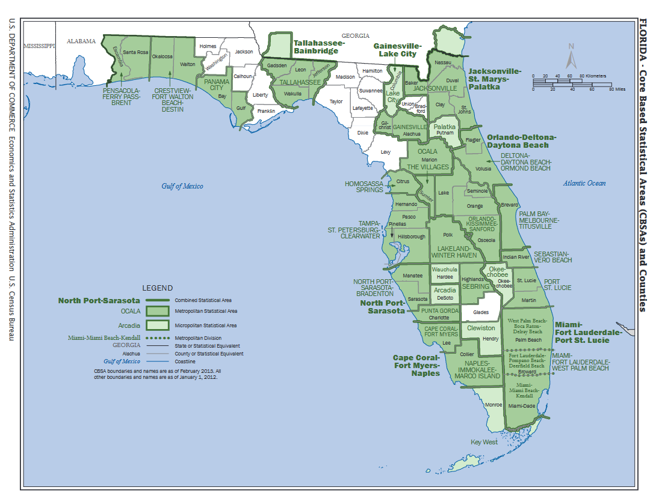
Notes:
What is this type of region? Functional, as are all metro areas. Other examples of functional regions? Radio station listening areas. In general, functional regions are usually united by their economic function.

Slide 26
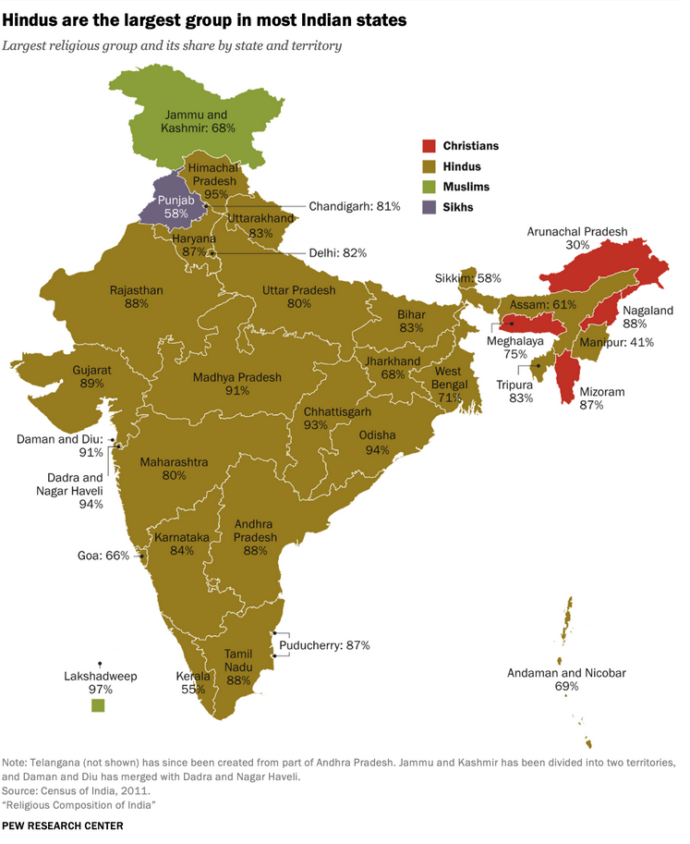
From https://www.pewresearch.org/religion/2021/09/21/religious-demography-of-indian-states-and-territories/
Notes:
Question: What about this one? What are some other formal region maps we could create?

Slide 27
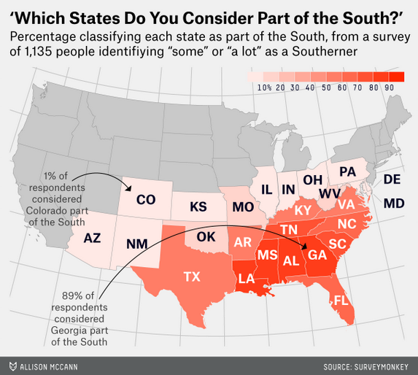
From https://fivethirtyeight.com/features/which-states-are-in-the-south/
Notes:
Question: If we made a map of the “South,” what kind of map would that be?
(This kind of map itself is formal though, right? Since it’s categorizing respondents.)
(Discuss vernacular regions that exist around your institution)

Slide 28
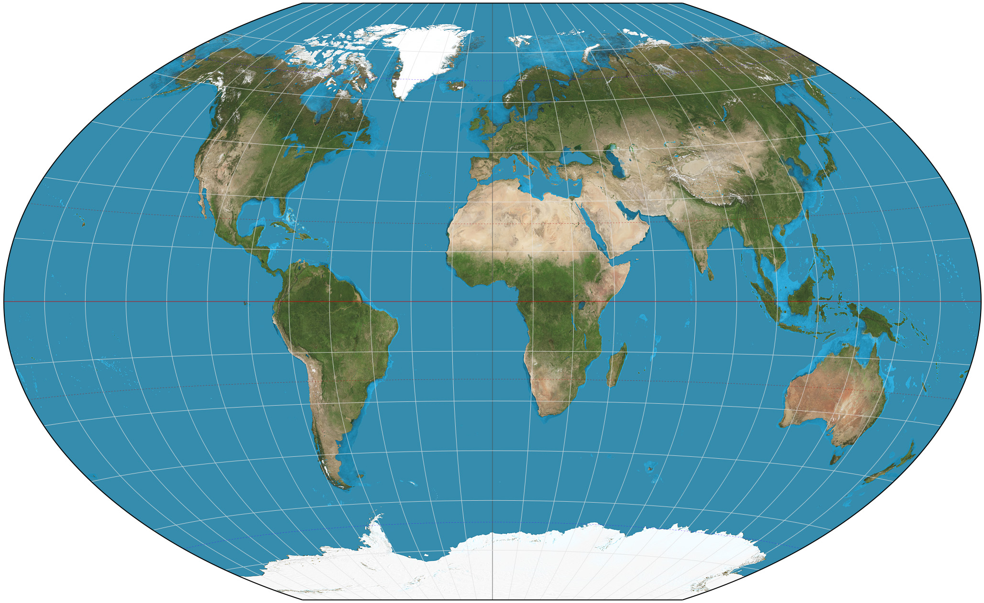
From https://en.wikipedia.org/wiki/World_map
Notes:
Question: What about a map of the continents? Could this be seen as vernacular? (They might be considered formal regions if you base them solely off of tectonic plate boundaries, but in many ways they’re vernacular)
Question: How many continents are there? Most sources say 7 (incl. Antarctica.) But could just as easily be 6. And where are the borders?

Slide 29
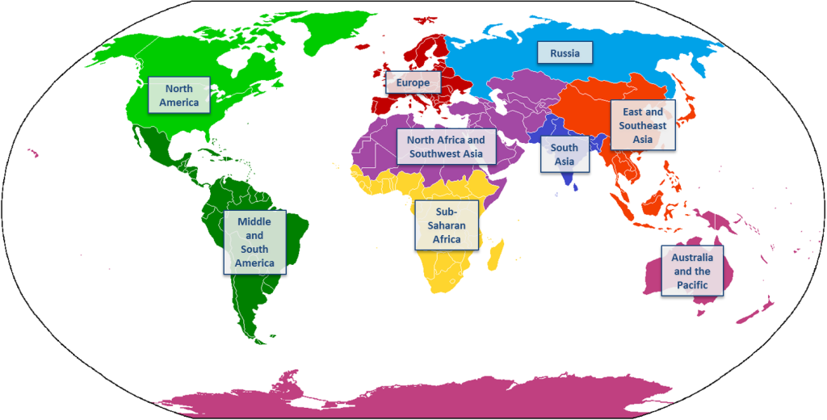
From https://pressbooks.pub/worldgeo/chapter/chapter-1/
Map of World Regions (Image adapted from Cogito ergo sumo, Wikimedia Commons)
Notes:
Here’s how we’ll divide it for our class. So we’ll use the basic building blocks of the continents but will then add physical geography, culture, and history.
Are there stark divides from one region to the next? In some places, we might have a clear physical border…

Slide 30
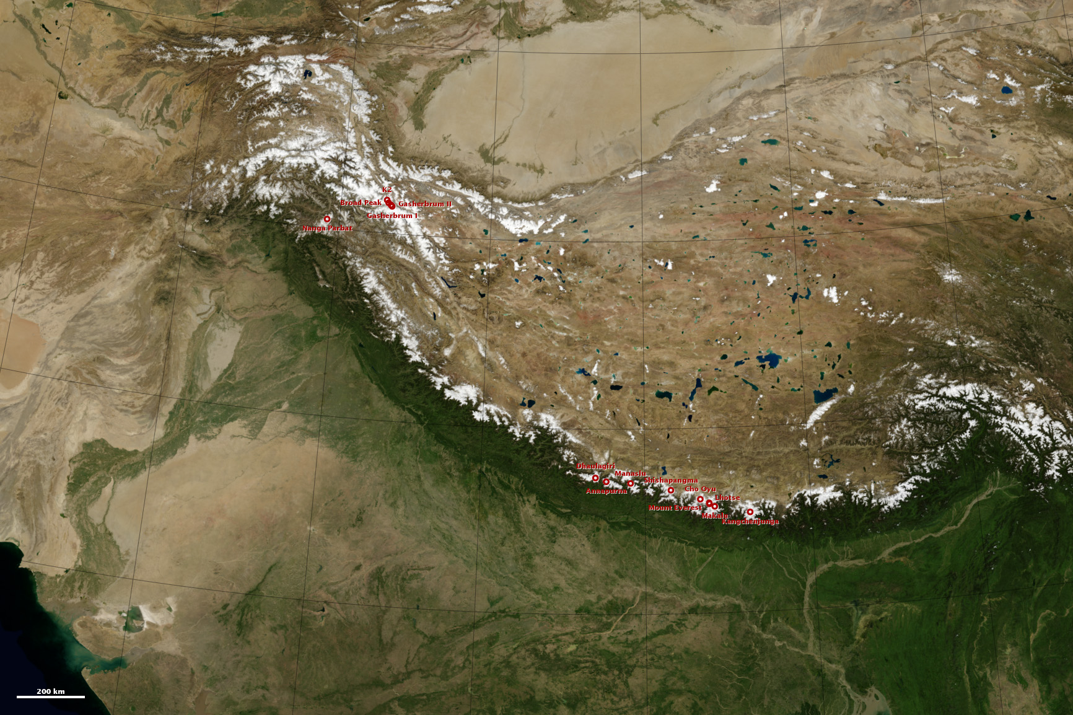
From https://visibleearth.nasa.gov/images/82581/8000-meter-peaks-of-the-himalaya-and-karakoram/82583l
Notes:
Here’s the border of South Asia for example. Very clear and formidable barrier.

Slide 31
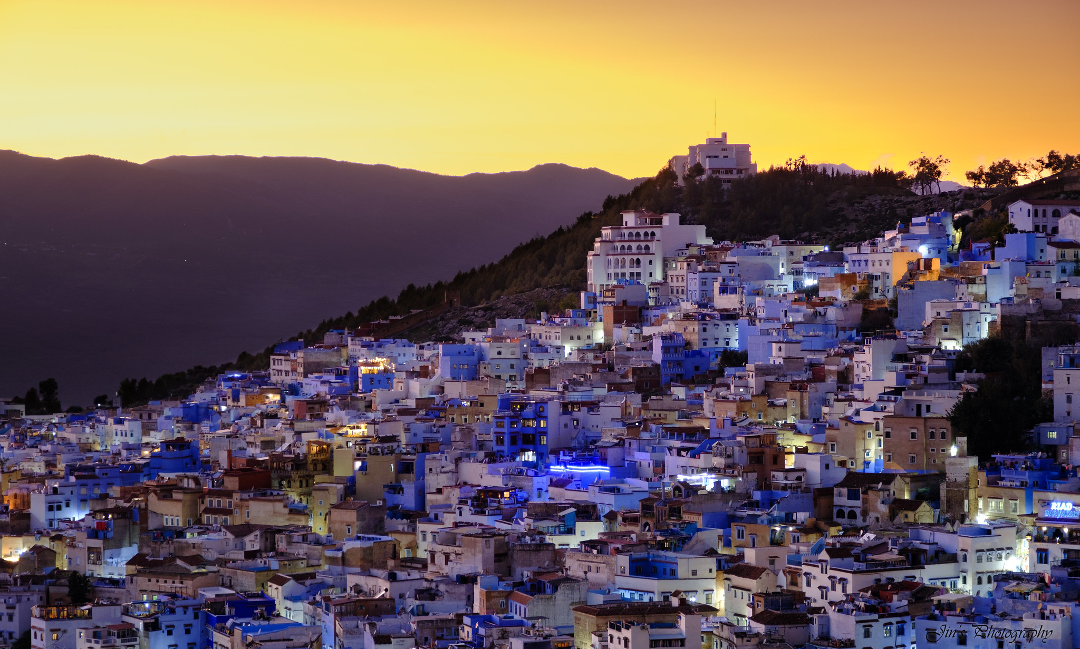
Chefchaouen, Morocco
Photo by Ning Tranquiligold Jin, CC BY-NC-SA 2.0
From https://www.flickr.com/photos/9766401@N03/53644058817
Notes:
This is a city in Northern Morocco. Doesn’t it look European?

Slide 32
How many countries are there?
UN: 193 member states plus two non-member observer states
US: 195 (all UN member states plus Vatican City and Kosovo)
Russia: Recognizes Abkhazia and South Ossetia (regions in Georgia)
Notes:
Now, if we can’t agree on how many continents there are, surely we can agree on how many countries there are. Right?
UN says 193 sovereign states plus Holy See and Palestine

Slide 33
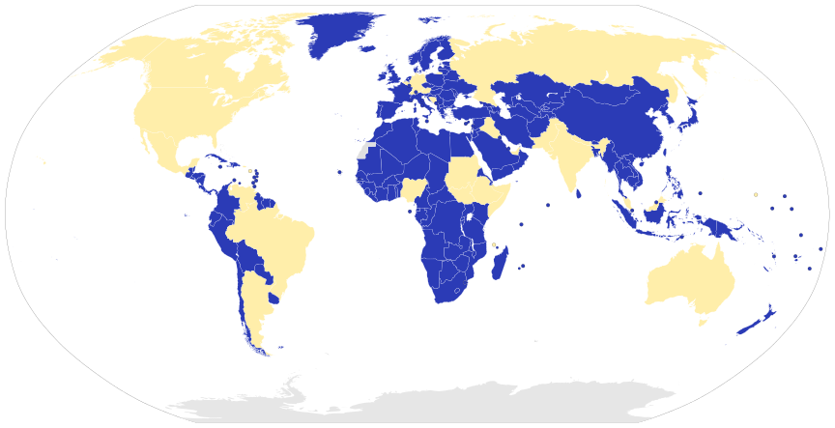
How do countries govern themselves?
Map of Federal States (in yellow) and Unitary States (in blue)
https://pressbooks.pub/worldgeo/chapter/chapter-1/
(Derivative work from original by Lokal_Profil, Wikimedia Commons)
Notes:
One key area of study for political geographers is how countries govern themselves.
In a unitary state, the central government has the most power. Sometimes local or regional governments have limited decision-making power, but only at the command of the central government. Most of the states of the world have unitary systems.
A federal state, like the United States, has numerous regional governments or self-governing states in addition to a national government.

Slide 34
Globalization and Inequality
How do you define globalization?
What are some features of globalization?
Notes:
Underpinning our entire book are the ideas of globalization and inequality.
Question: How would you define globalization?
(I generally have them answer these questions with a partner and then list all of them on the board)

Slide 35
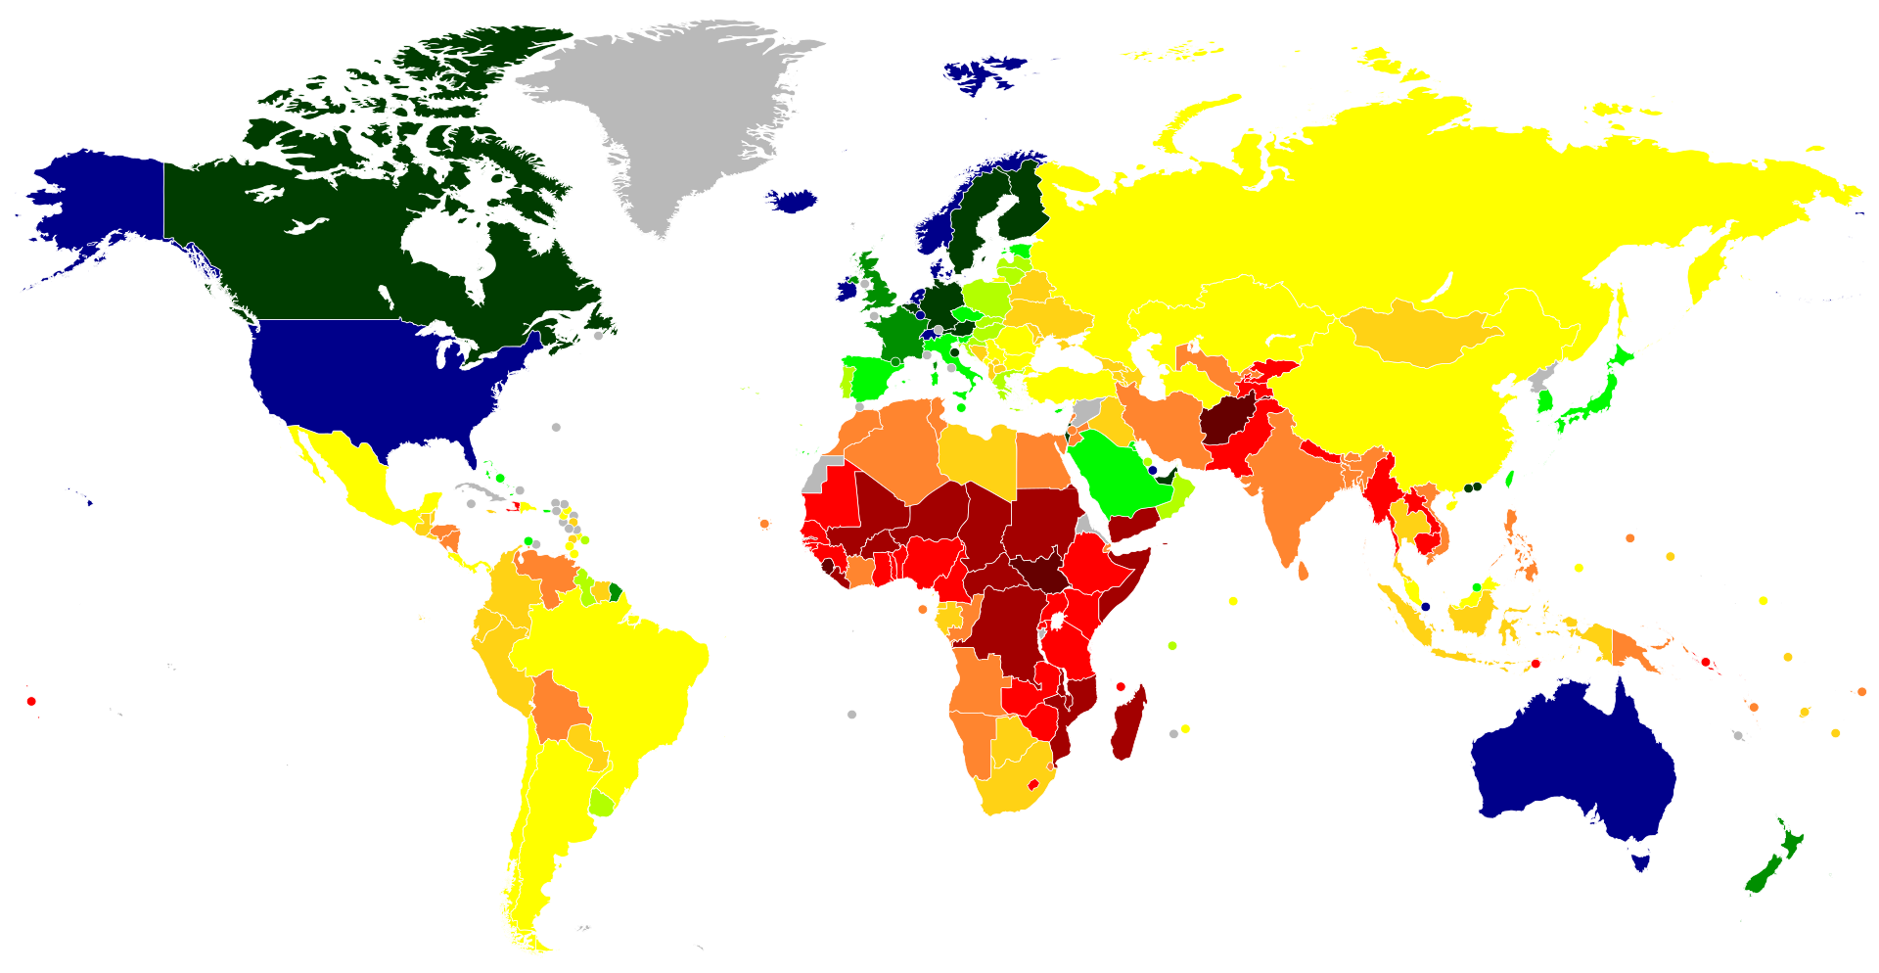
Globalization and Inequality
From https://en.wikipedia.org/wiki/List_of_countries_by_GDP_%28nominal%29_per_capita#/media/File:Map_of_countries_by_GDP_(nominal)_per_capita_in_2023.svg
Notes:
Now think about how you would define inequality, and how we might measure that as geographers.
We see there are tremendous differences between countries and even within countries. And we’ll explore why that is throughout the semester.

Slide 36
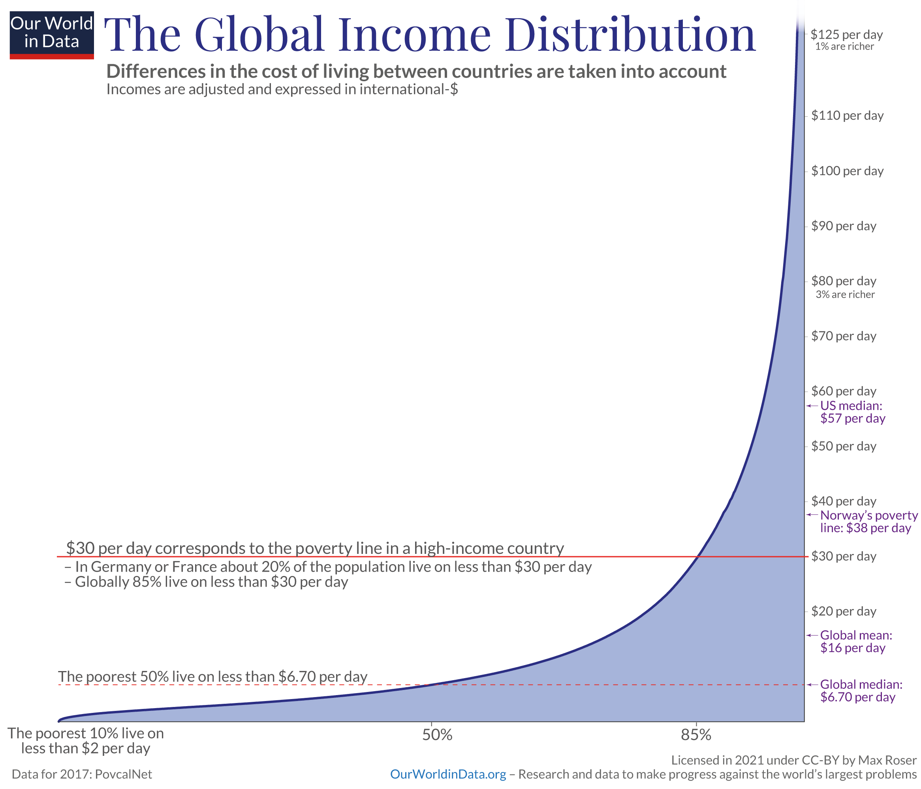
Notes:
Question: What do you notice about this graph?
(Call attention to the global mean vs US median and to the Norway poverty line)

Slide 37
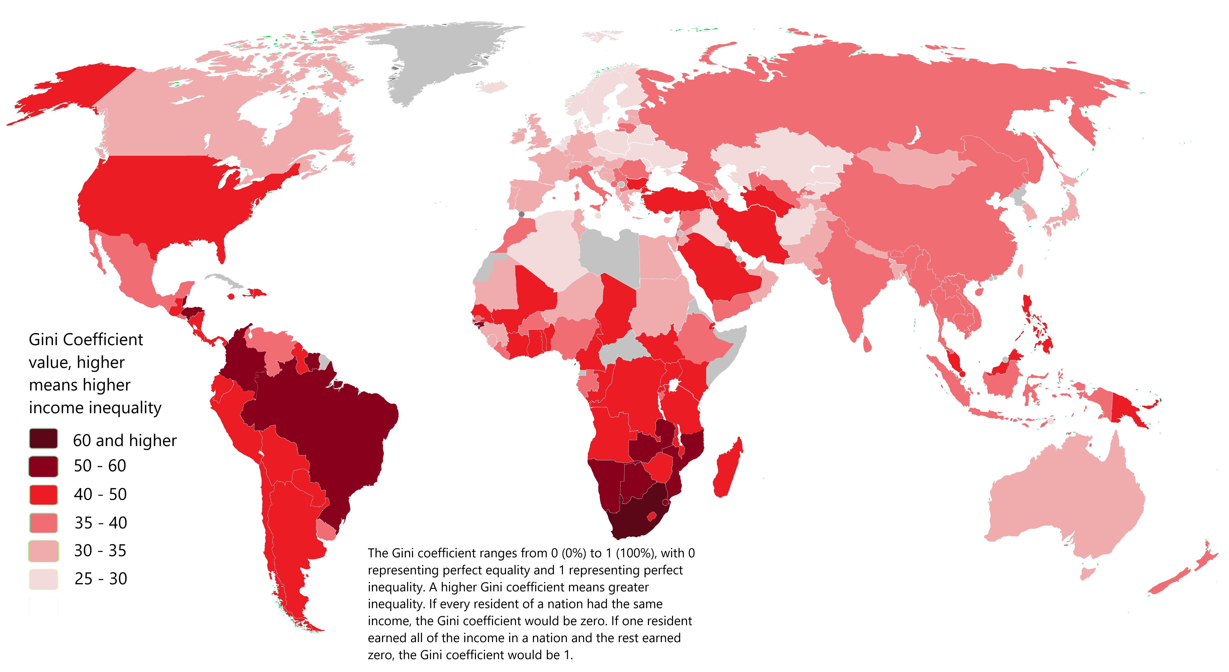
Globalization and Inequality
Image from Reddit
Notes:
The Gini coefficient measures the inequality among the values of a frequency distribution, such as levels of income. A Gini coefficient of 0 reflects perfect equality, where all income or wealth values are the same, while a Gini coefficient of 1 (or 100%) reflects maximal inequality among values, a situation where a single individual has all the income while all others have none.
U.S. is .47 (was at .43 in 1990)
Canada is .288
Brazil .529

Slide 38
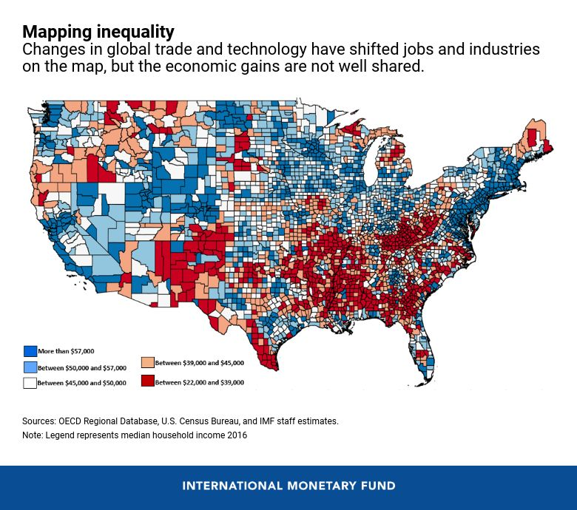
Globalization and Inequality
From https://www.imf.org/en/Blogs/Articles/2019/11/06/a-map-of-inequality-in-countries
Notes:
We can explore inequality within a country as well.
Question: Where do we see the lowest income levels in the United States. Why is that the case?

