Slide 1
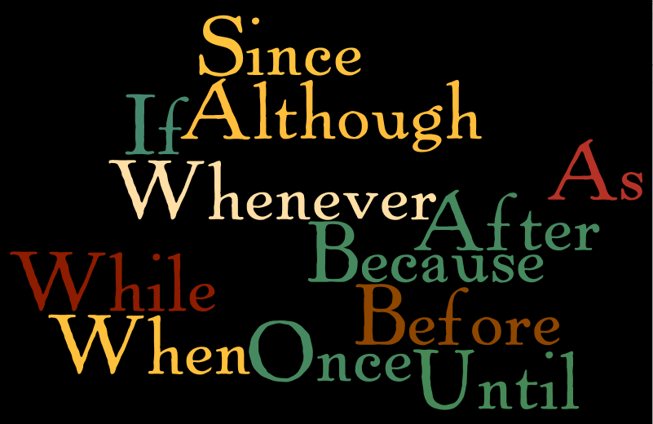
ADVERB (SUBORDINATE) CLAUSES:
BOBUB IS WA WA WA

Slide 2
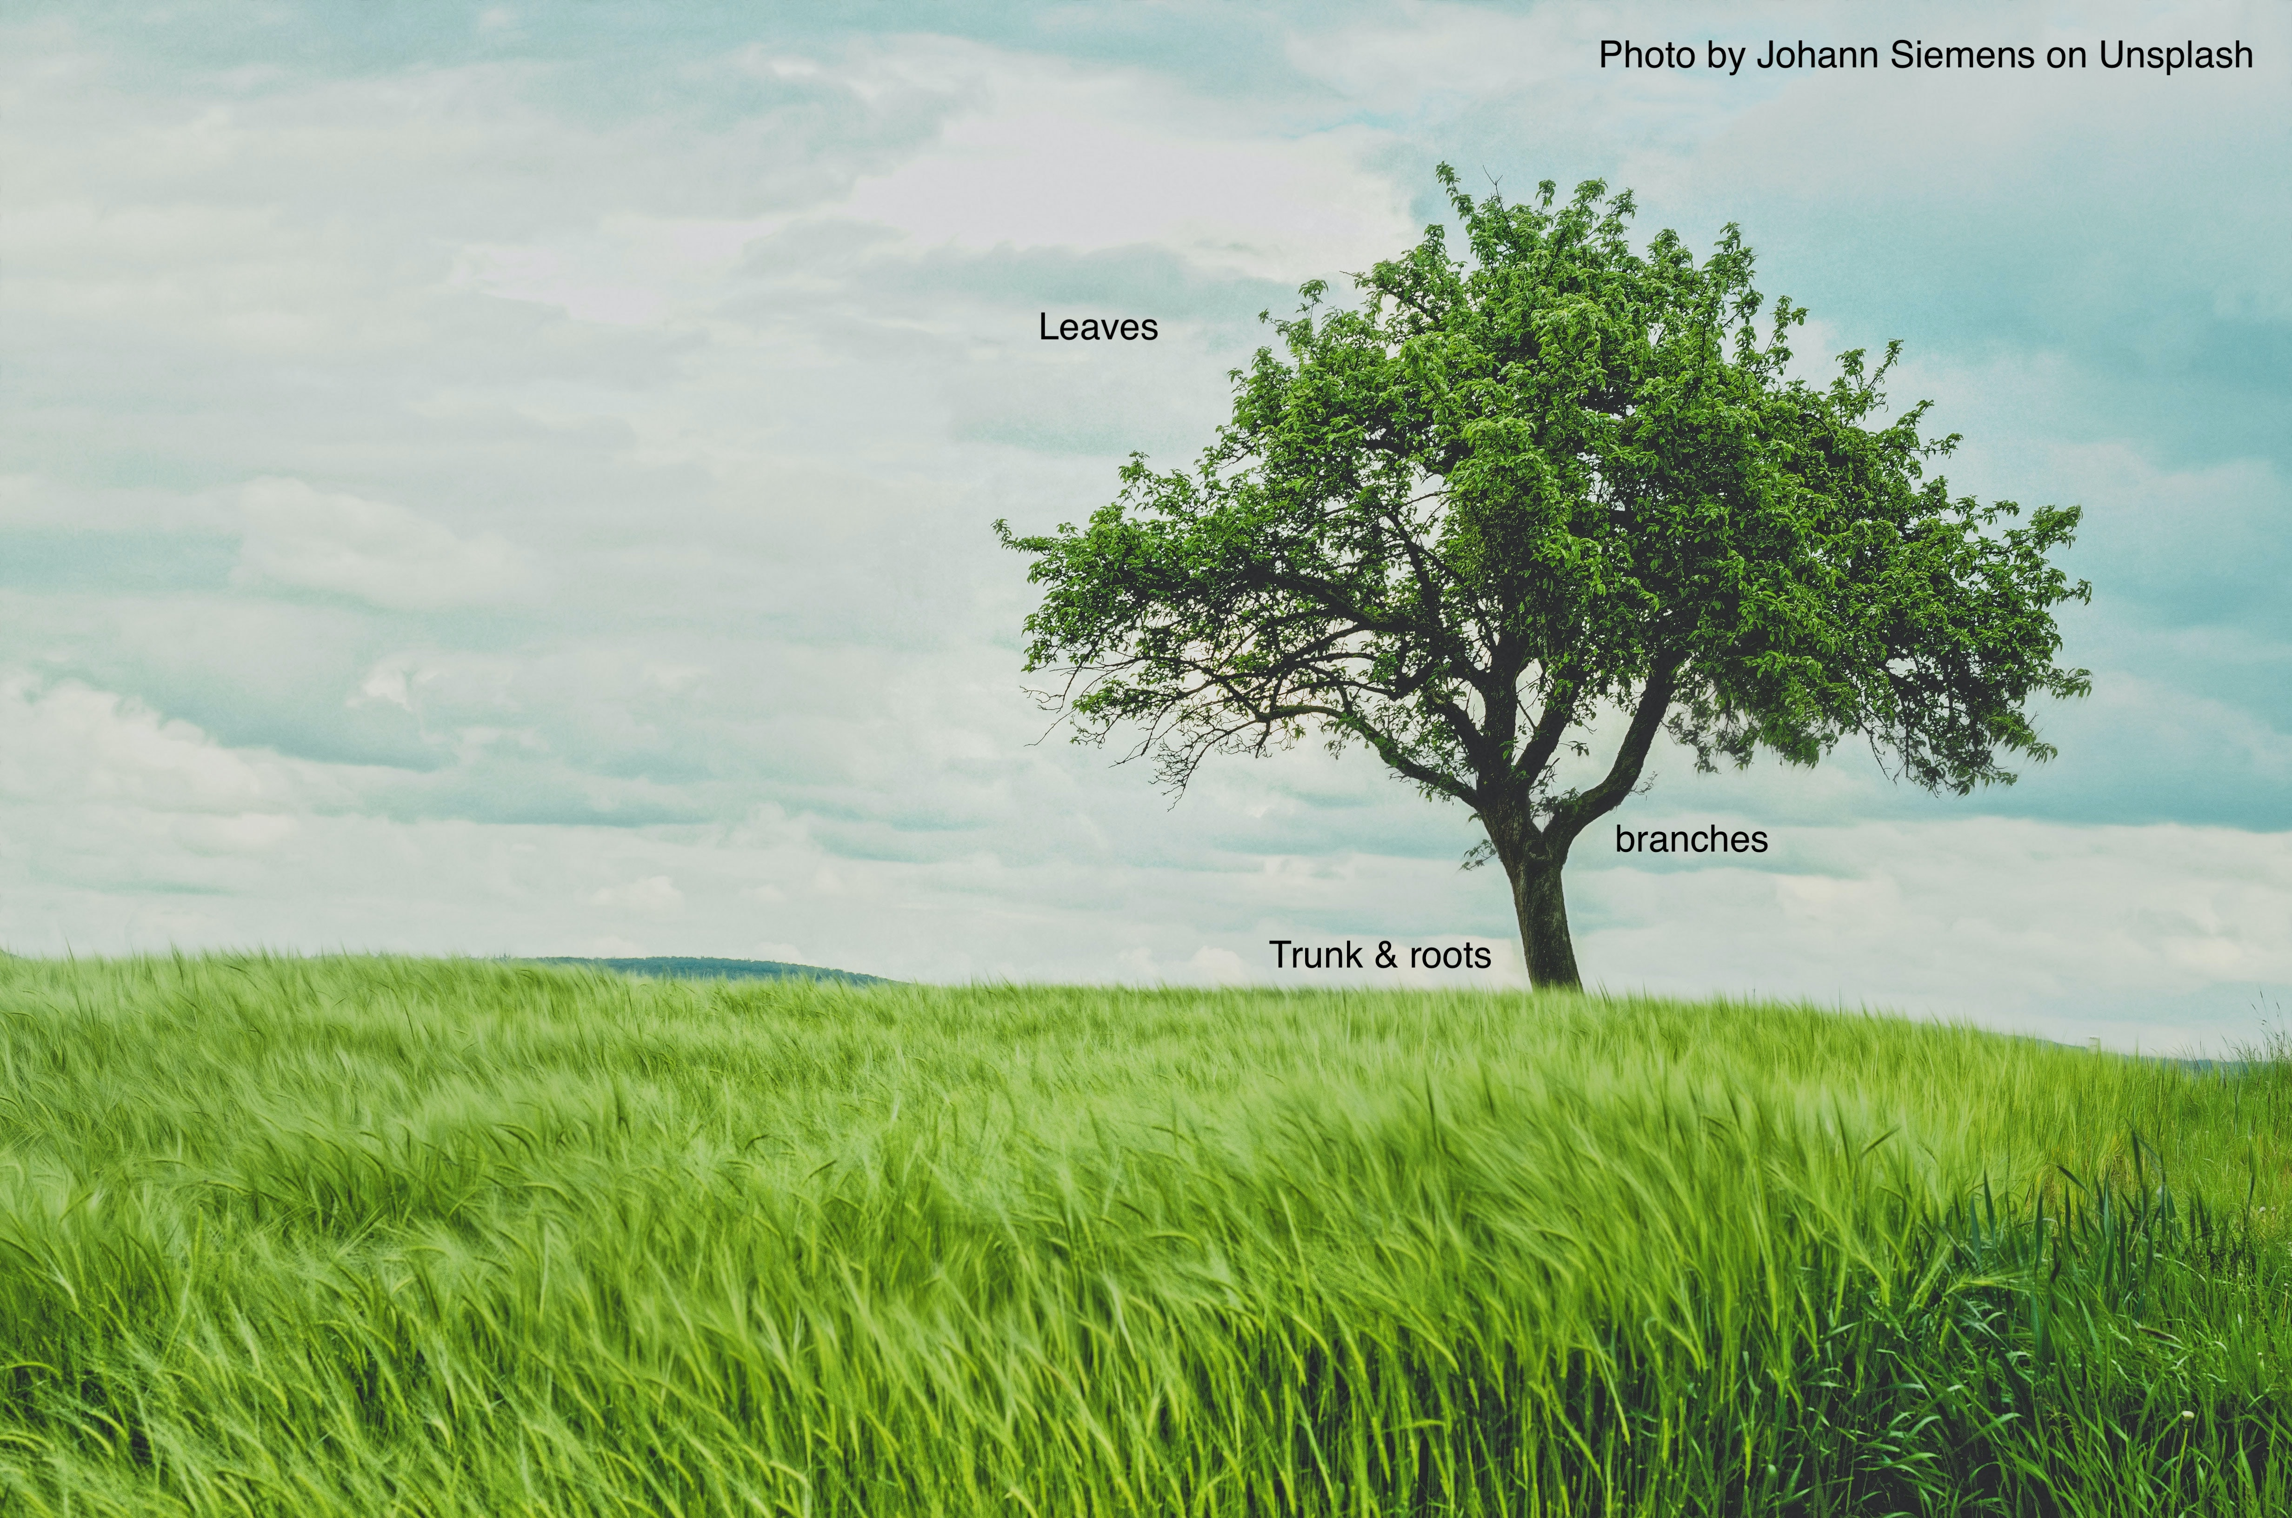
Before we talk about adverb clauses, we need to understand how sentences go together.
Every English sentence is like a tree.

Slide 3

Every tree has a trunk; every sentence has an independent clause.
Without a trunk and roots, you cannot have a living tree.
Without an independent clause, you cannot begin to build a complete sentence.

Slide 4

What is an independent clause?
An independent clause is a group of words that:
  Contains a subject and a verb
  Expresses a complete idea and can stand alone because there are no marker words attached to it

Slide 5
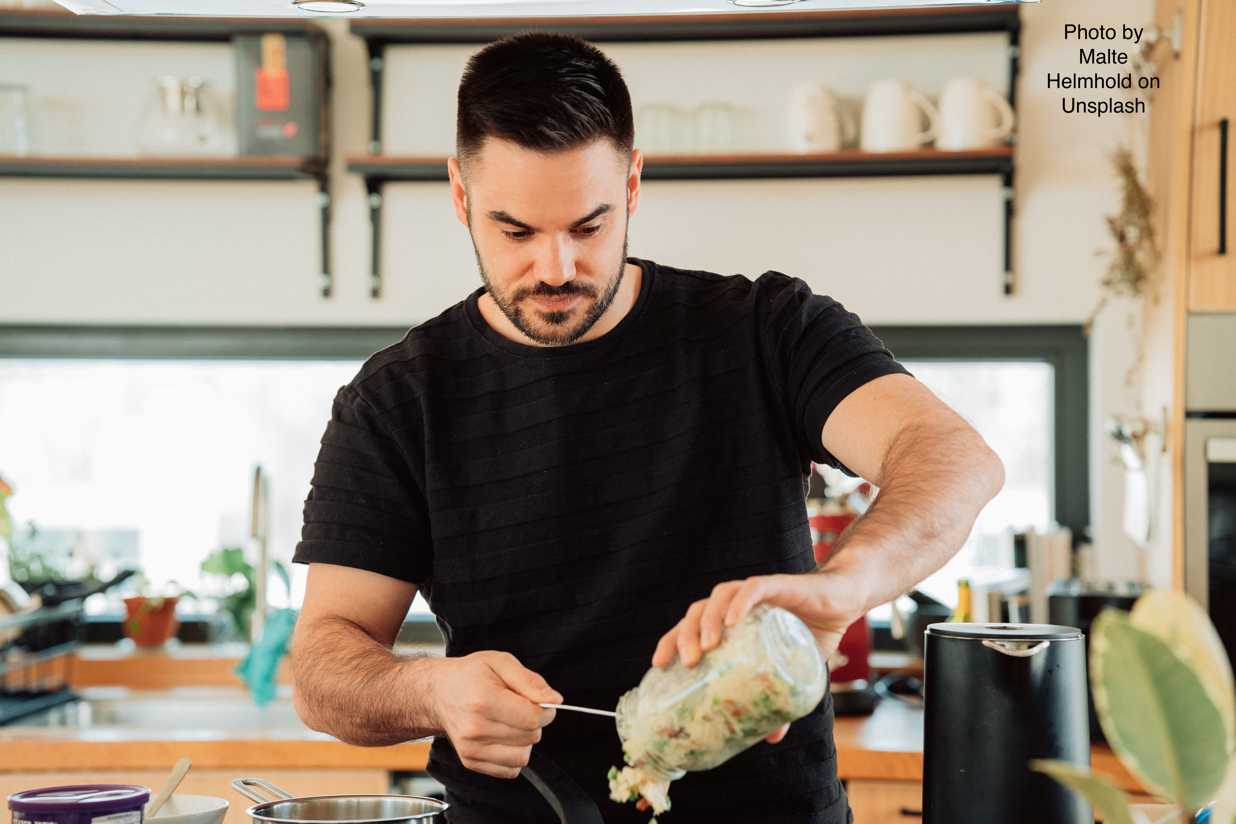
This is an independent clause:
Tom makes lunch.
Subject verb
It expresses a complete idea, does not have any marker words at the front, and it finishes with a period.

Slide 6
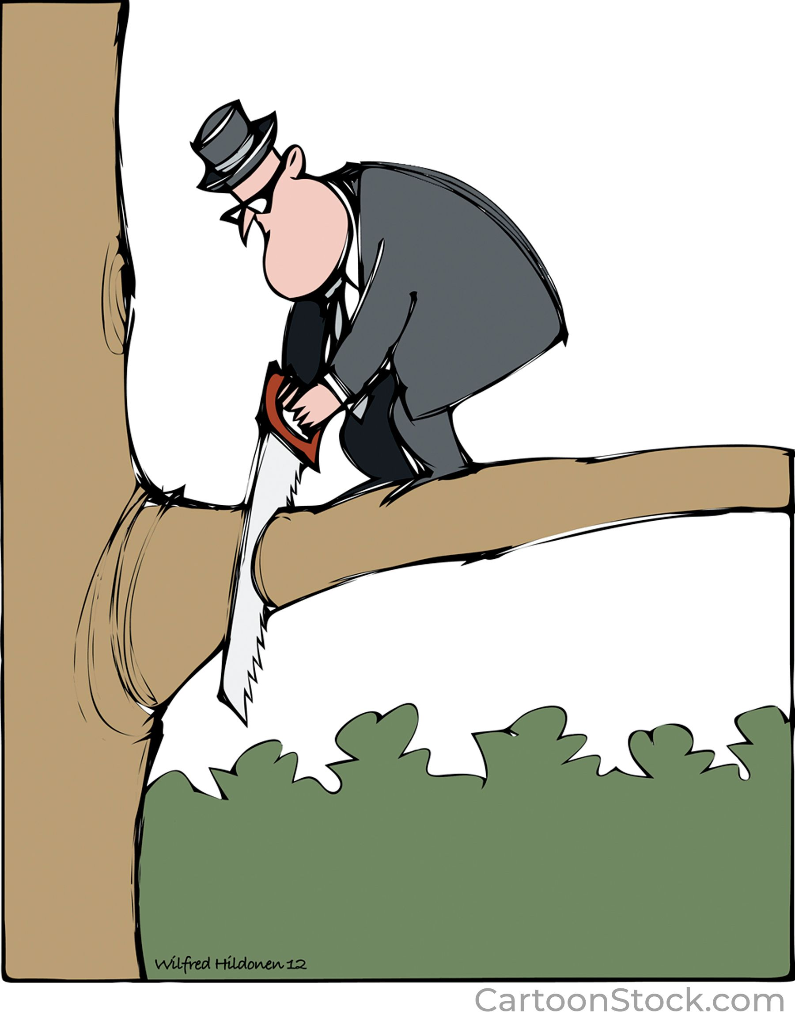
What is a dependent clause?
A dependent clause is a group of words that:
  Contains a subject and a verb
  Cannot stand alone; it must stay connected to an independent clause
  Uses a marker word at the front to show where the clause begins

Slide 7
These are examples of adverb dependent clauses
after he cut the branch
because he cut the branch
when he cut the branch
since he cut the branch
once he cut the branch
All of these need to be attached to an independent clause because they begin with the adverb clause marker words.
he fell to the ground.

Slide 8
BOBUB IS WA WA WA
Each kind of dependent clause has its own marker words and punctuation rules. You can remember Adverb Clause Markers and their punctuation with BOBUB IS WA WA WA.
Before
Once
Because
Until
By the time
If
Since
When
After
While
As (These two are together because they both take progressive – ING verbs)
Whenever (represents ALL -ever words: whatever, whenever, etc.)
Although (represents ALL though words: even though, though)

Slide 9
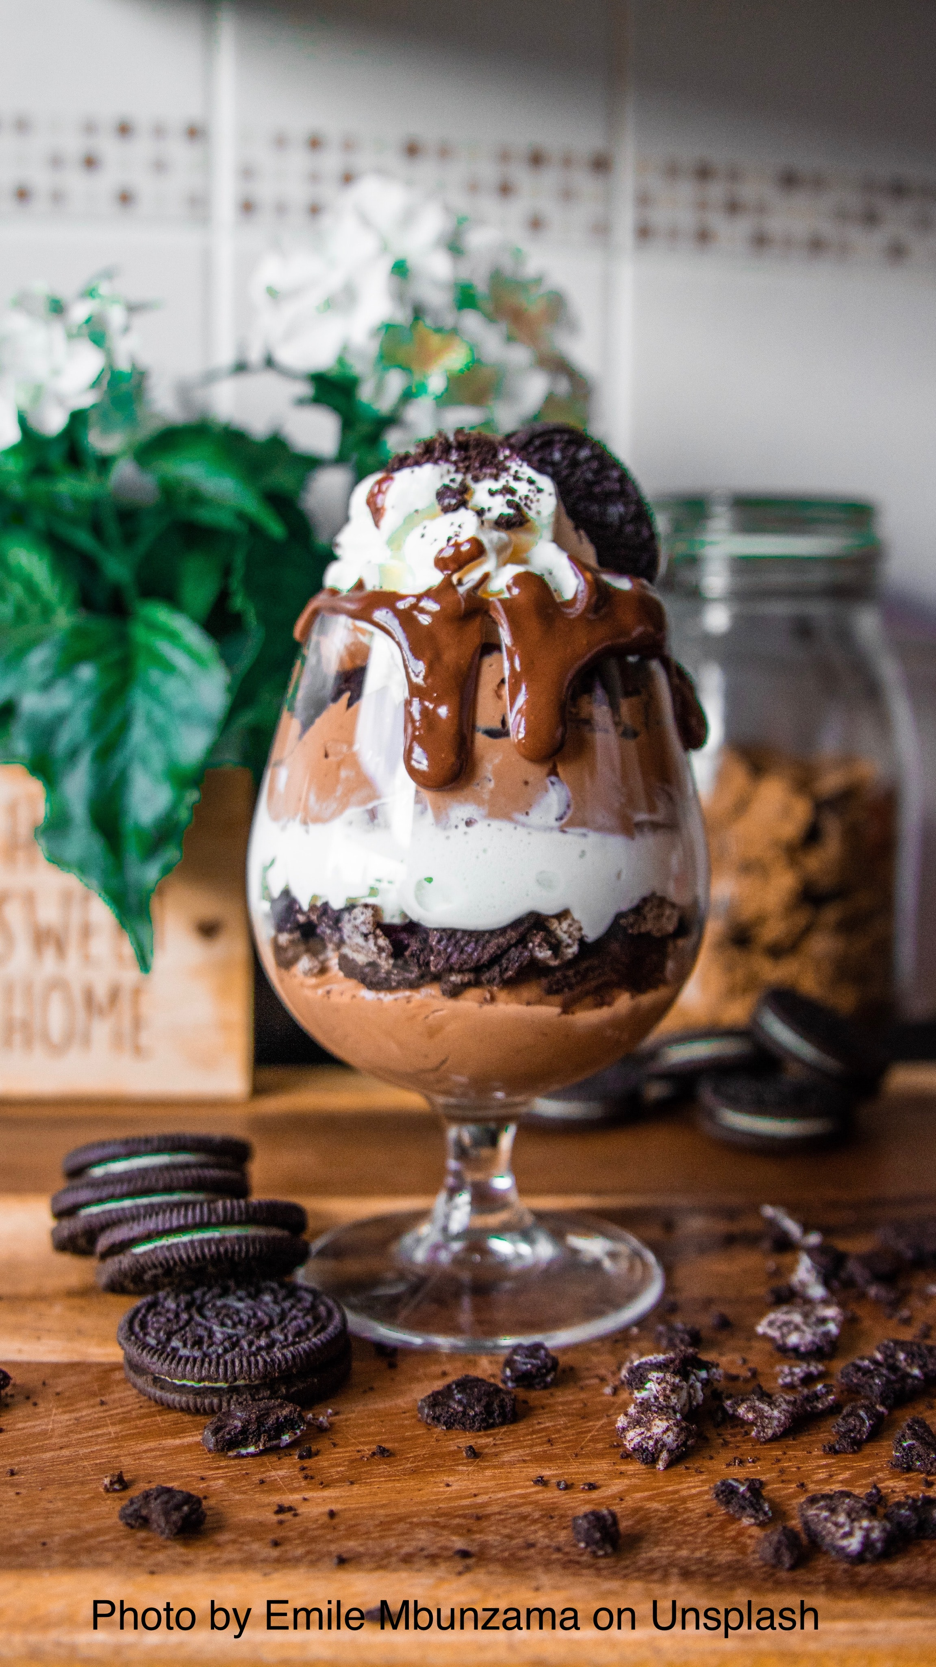
This is a sentence with an adverb (BOBUB) clause:
* After he makes
marker subject verb
lunch, Tom has dessert.
or
* Tom has dessert after
marker
he makes lunch.
subject verb

Slide 10
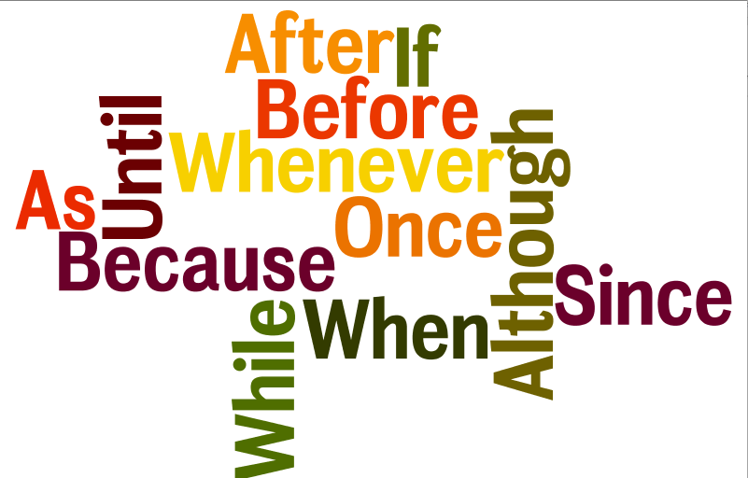
Three points to remember about adverb clauses
BOBUB IS WA WA WA
Before
Once
Because
Until
By the time
If
Since
When
After
While
As
Whenever
Although

Slide 11
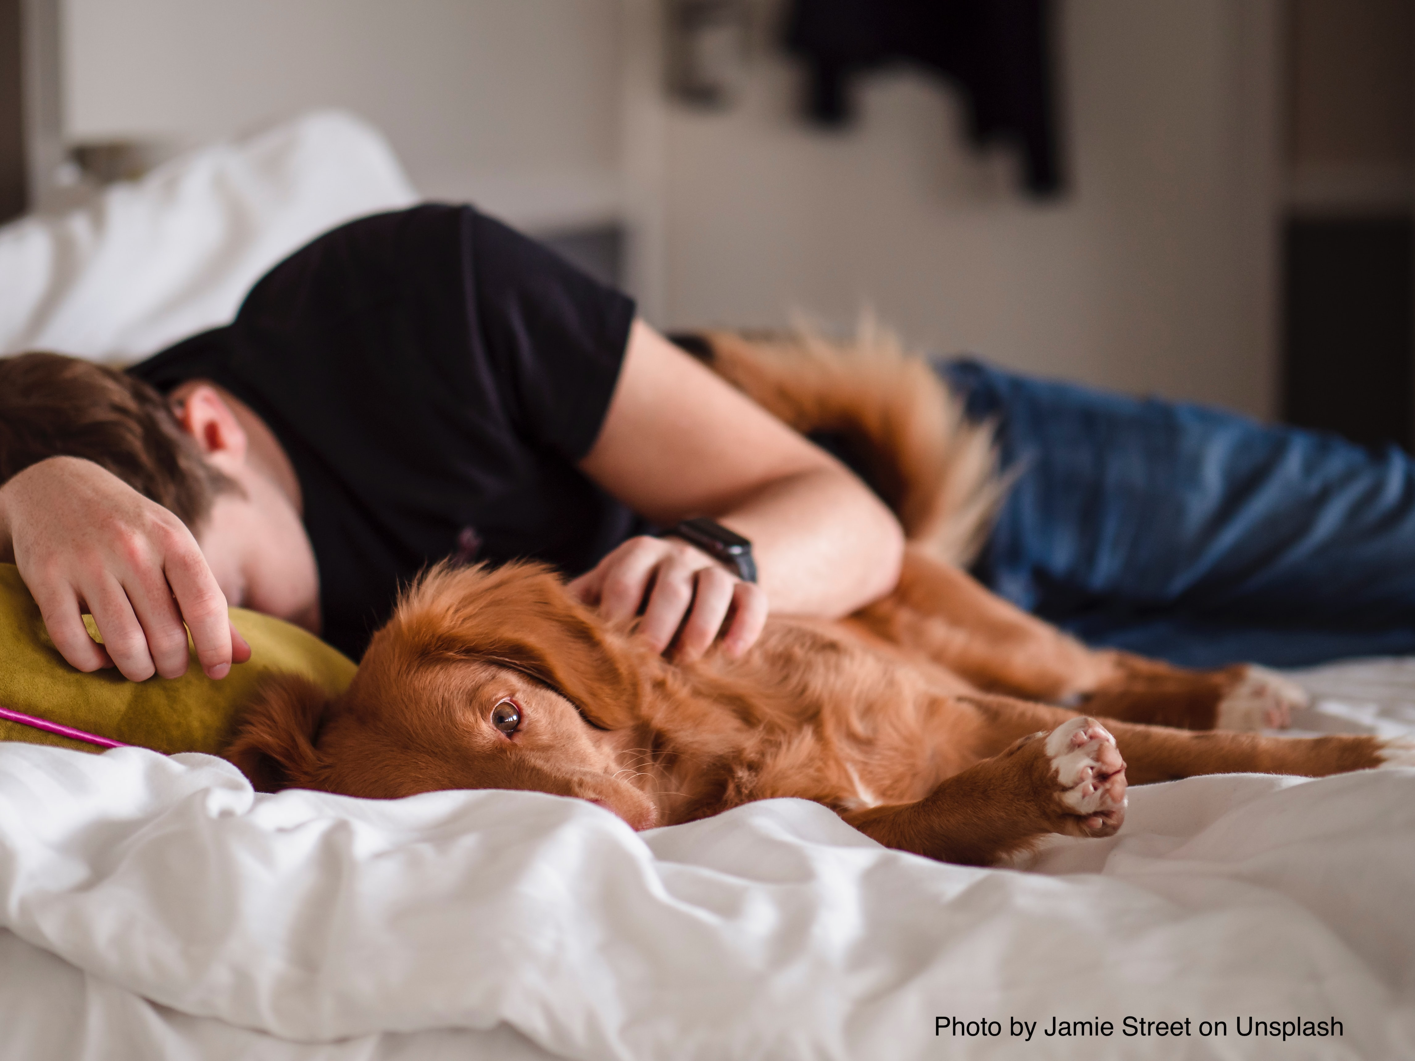
(1)There will ALWAYS be two subjects and two verbs in a sentence with an adverb clause, even if the subject is the same in both parts.
Because I was tired, I took a nap.
subject verb subject verb

Slide 12

(2) An adverb clause must ALWAYS be connected to an independent clause. It can’t stand by itself.
(This is called a fragment.) You can recognize an adverb clause because it begins with a marker word.
INCORRECT: Because it was cold. My son
wore a warm hat and wrapped a blanket around himself.
CORRECT: Because it was cold, my son wore a warm hat and wrapped a blanket around himself.

Slide 13
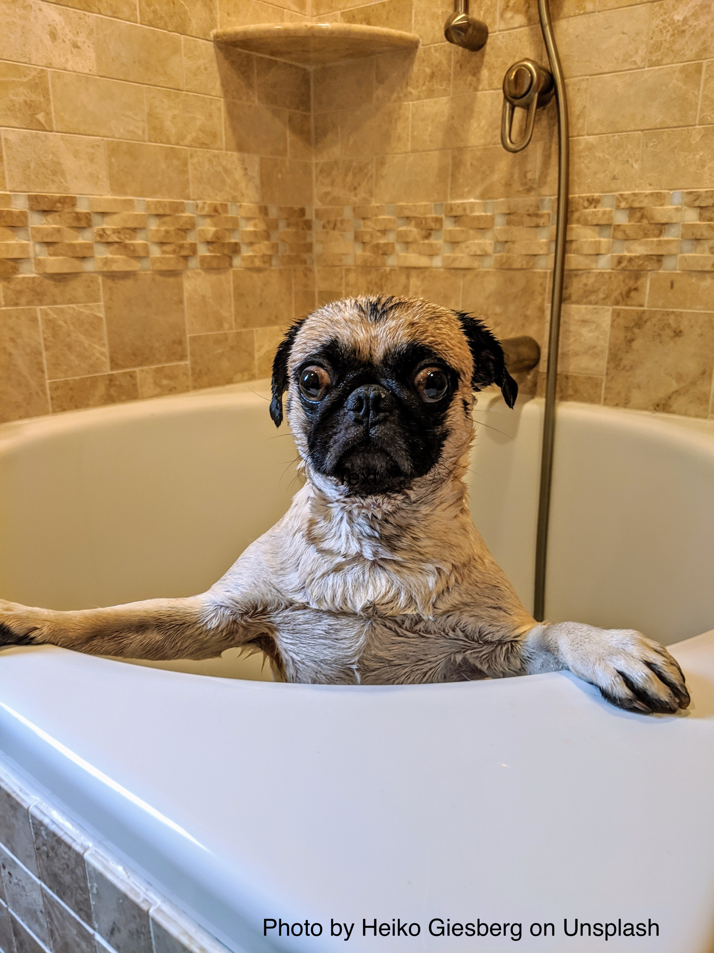
(3) An adverb clause can come before or after the independent clause.
* The punctuation is different for each position, but the meaning is the same.
* Although Buddy hates water, I
marker in front comma
had to give him a bath.
(AC first → comma at the end of the clause)
***************************
I had to give Buddy a bath
although he hates water.
marker in the middle
(AC second → No comma)

Slide 14
In summary:
Adverb clauses are dependent clauses; they cannot stand alone.
You will always have two subjects and two verbs when using an adverb clause
An adverb clause can come before or after the independent clause, but the punctuation is different for each position.
  BOBUB in front = use a comma at the end of the adverb clause
  BOBUB in the middle = no comma
You can remember this group with BOBUB IS WA WA WA

