Slide 1

Analyzing and Answering Questions with Multiple Parts

Slide 2
Reading carefully and analyzing a question or directions before you answer helps you:
Understand what the teacher is asking you to do
Identify key words in the question to help you find the answer in the reading more quickly
Make sure you answer a question fully
Make sure you don’t forget to answer all parts of a question

Slide 3
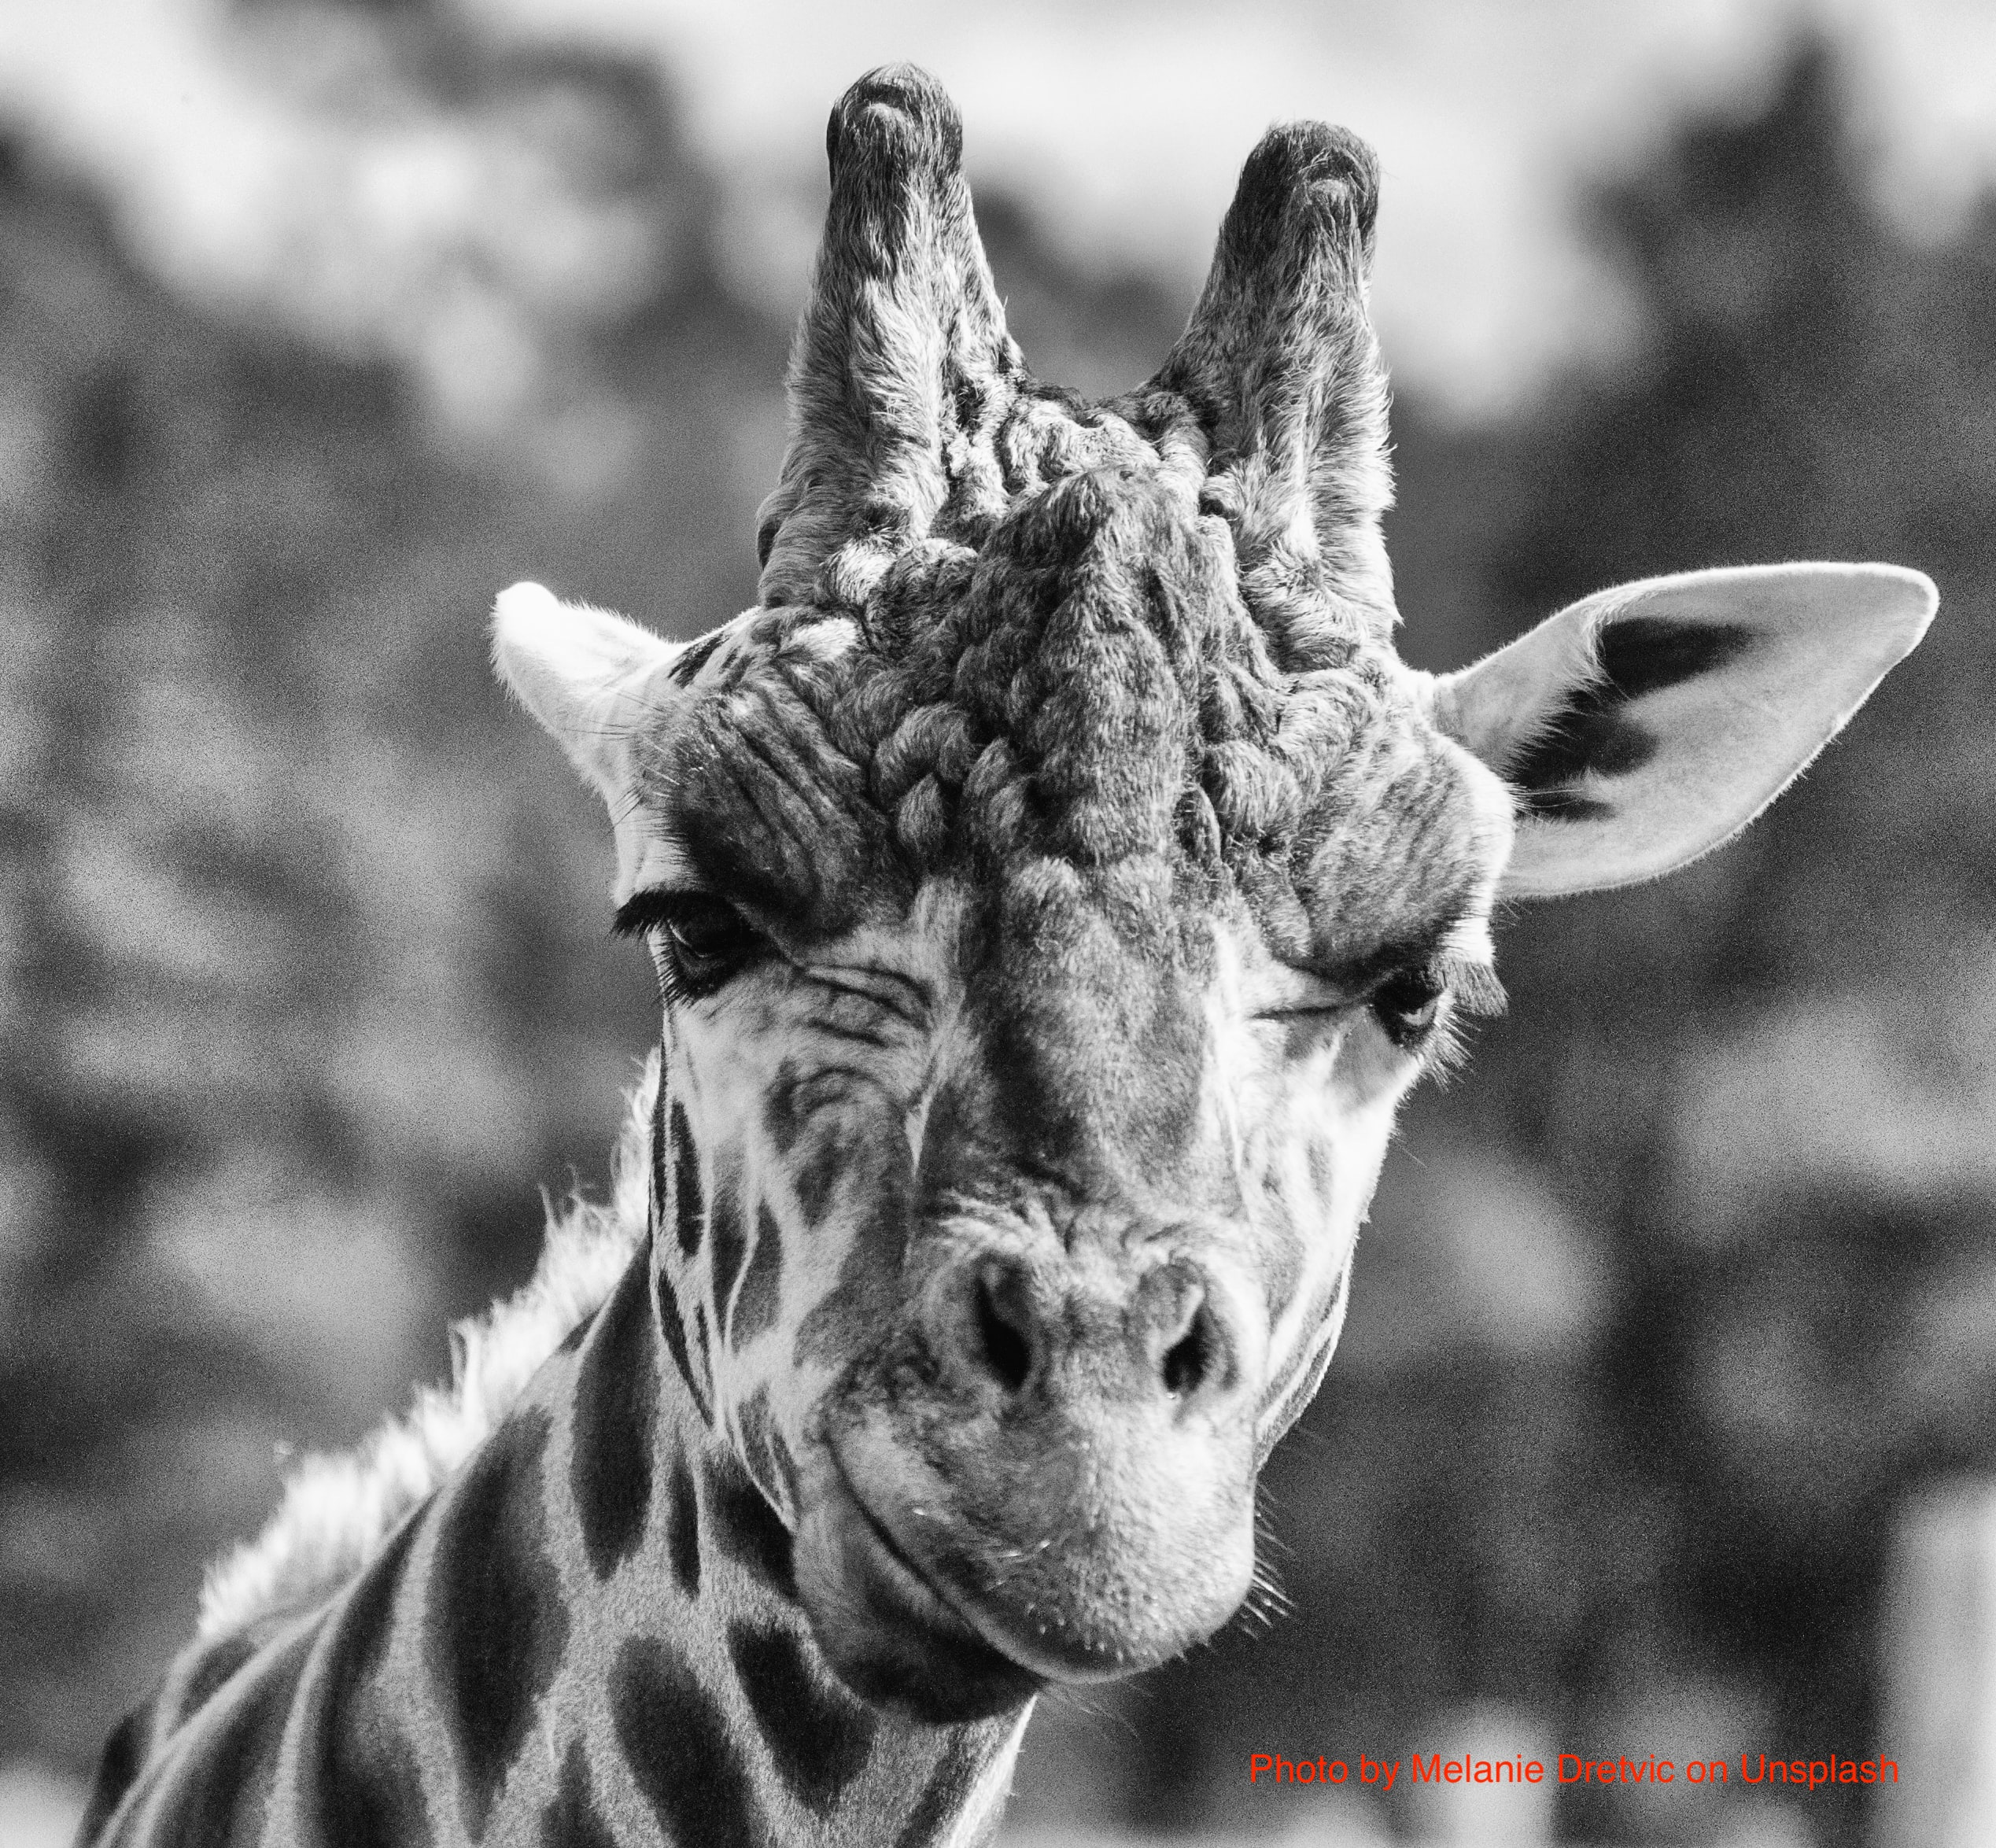
How do I do it?

Slide 4
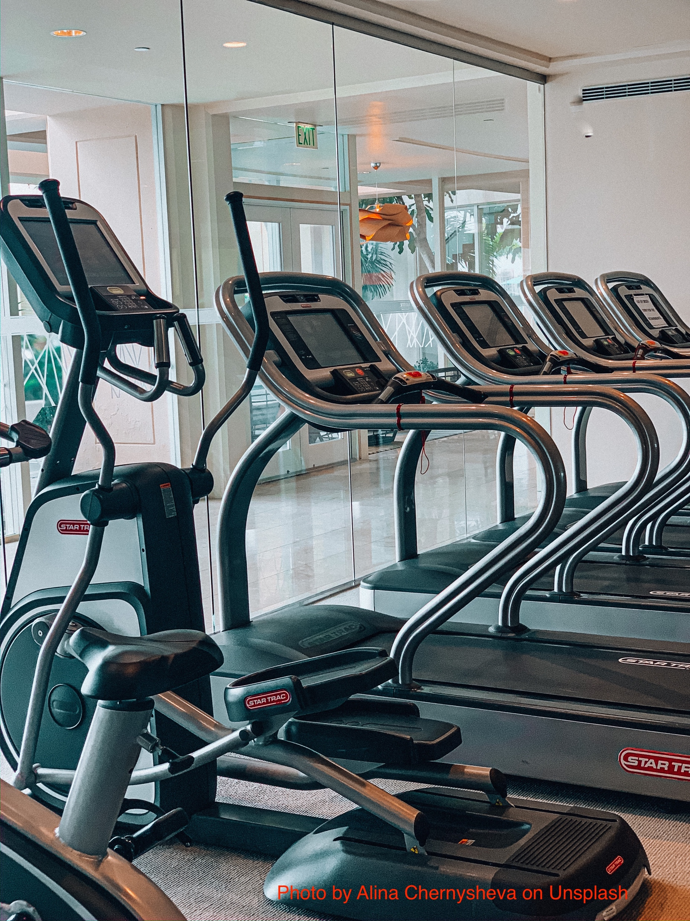
First, read the entire question as a whole
In the article, the author describes three different types of people who go to the gym. Using complete sentences, identify the three types and explain them. Which type are you?

Slide 5
Second, identify what the instructor wants you to do by ANNOTATING THE QUESTION (highlighting or underlining important parts)
In the article, the author describes three different types of people who go to the gym. Using complete sentences, identify the three types and explain them. Which type are you?

Slide 6
Your instructor wants three things here:
1. Identify the three types
2. Explain the three types
3.Which type are you?
She has also asked for
COMPLETE SENTENCES

Slide 7
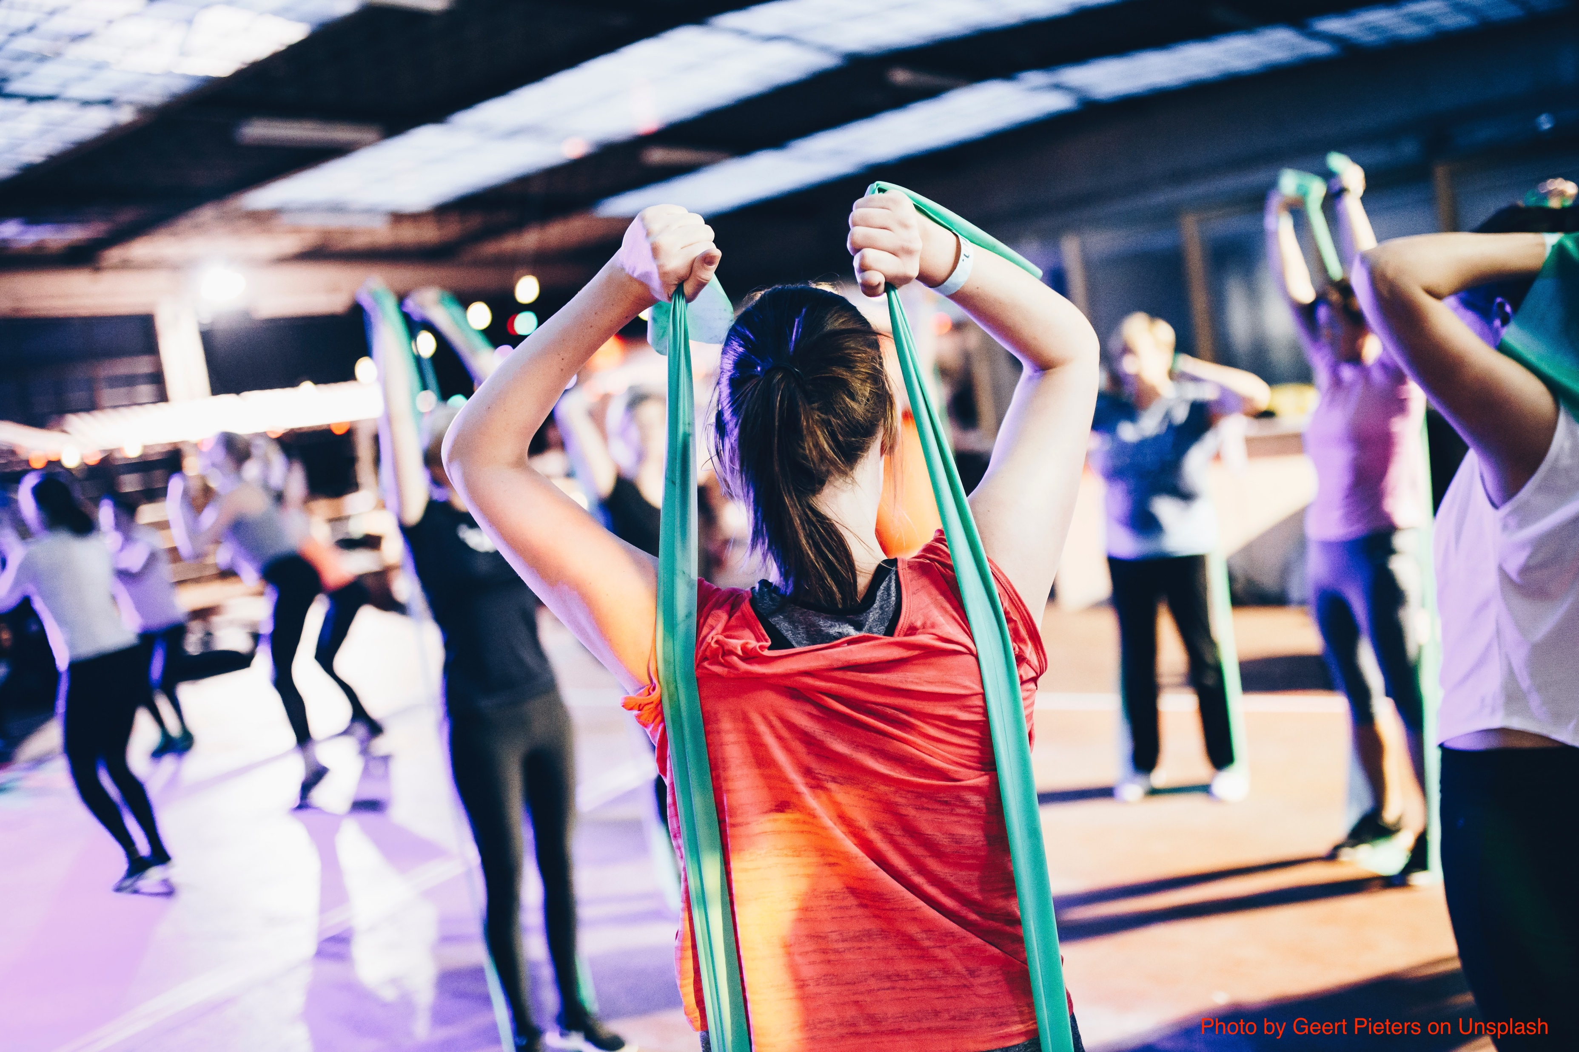
Third, label your answer clearly so that both you and your instructor know that you have met the requirements
In the article, the author describes three different types of people who go to the gym. Using complete sentences, identify the three types and explain them. Which type are you?
Connect your answer to the question using key words from the question.
1. The first type of person who goes to the gym is “the no-nonsense exerciser.” According to the article, this is a person who is only at the gym to exercise; being social or looking a certain way is not important.

Slide 8
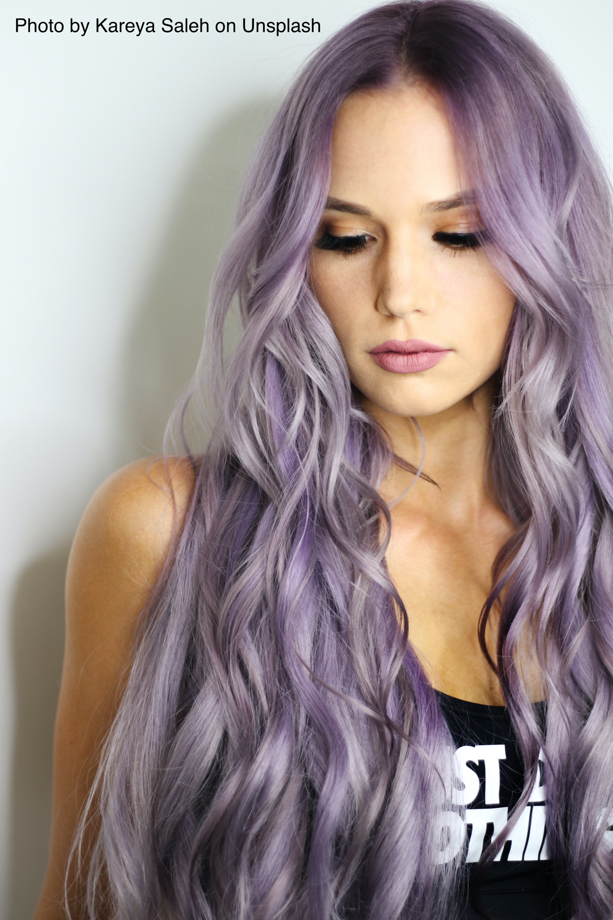
Label your answer clearly so that both you and your instructor know that you have met the requirements
In the article, the author describes three different types of people who go to the gym. Using complete sentences, identify the three types and explain them. Which type are you?
Connect your answer to the question using key words from the question.
2. The second type of person who goes to the gym is the “social butterfly.” This is a person who looks as cute as possible; makeup, hair, and gym outfit are always perfect. Exercising too hard is not the goal because sweating does not look good.

Slide 9
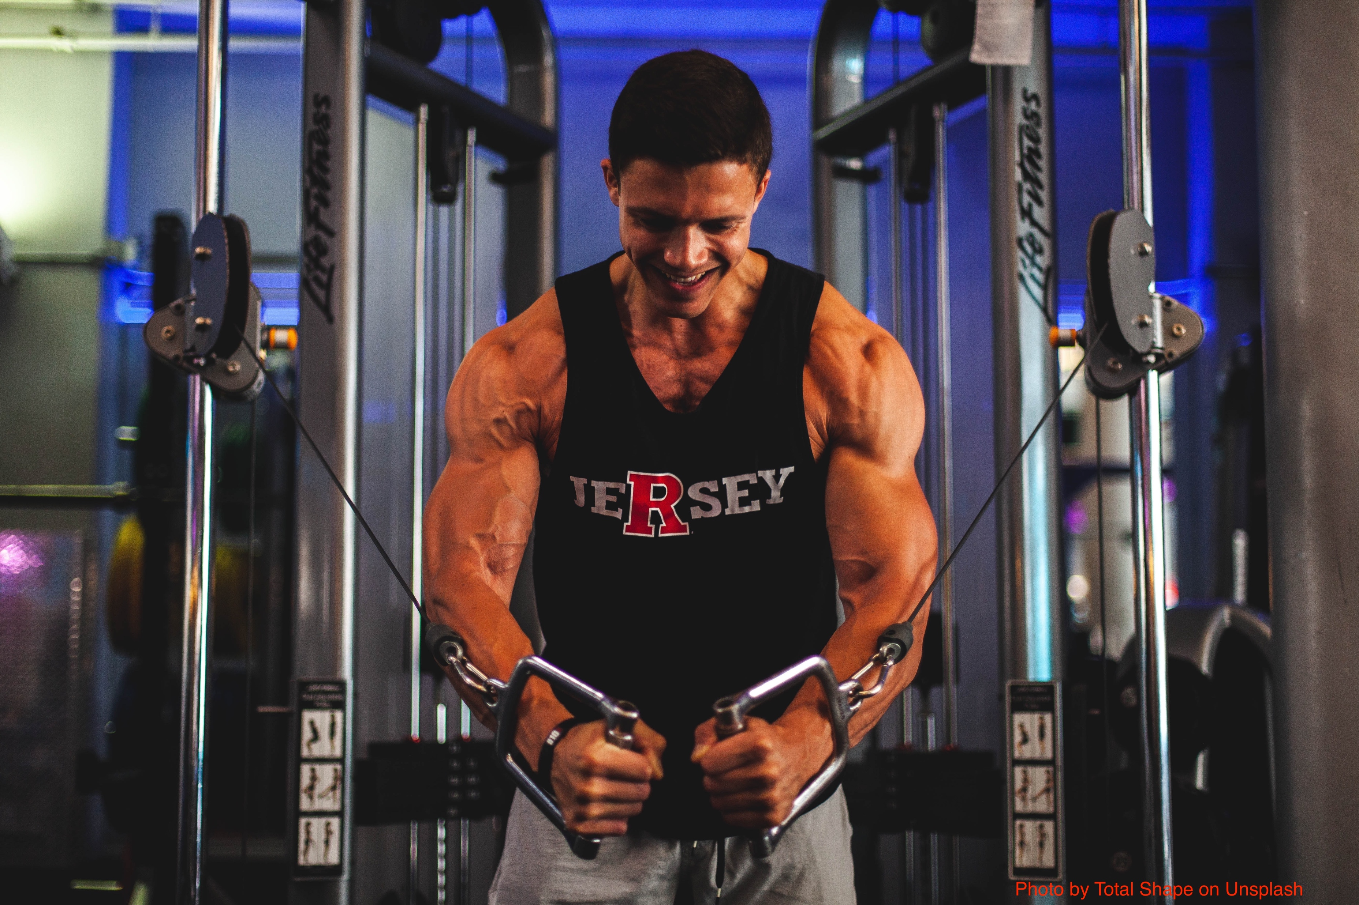
Label your answer clearly so that both you and your instructor know that you have met the requirements
In the article, the author describes three different types of people who go to the gym. Using complete sentences, identify the three types and explain them. Which type are you?
Connect your answer to the question using key words from the question.
3. The third type of person who goes to the gym is the muscle-man. This is the guy who stands in front of the mirror grunting loudly for everyone to hear.

Slide 10
Label your answer clearly so that both you and your instructor know that you have met the requirements
In the article, the author describes three different types of people who go to the gym. Using complete sentences, identify the three types and explain them. Which type are you?
Connect your answer to the question using key words from the question.
4. I am the no-nonsense exerciser. I go to the gym because I want to exercise, not because I want to impress people.

Slide 11

IMPORTANT!
Reading and understanding the directions and questions on an assignment is critical to being successful online, on tests, and in class.

