Slide 1
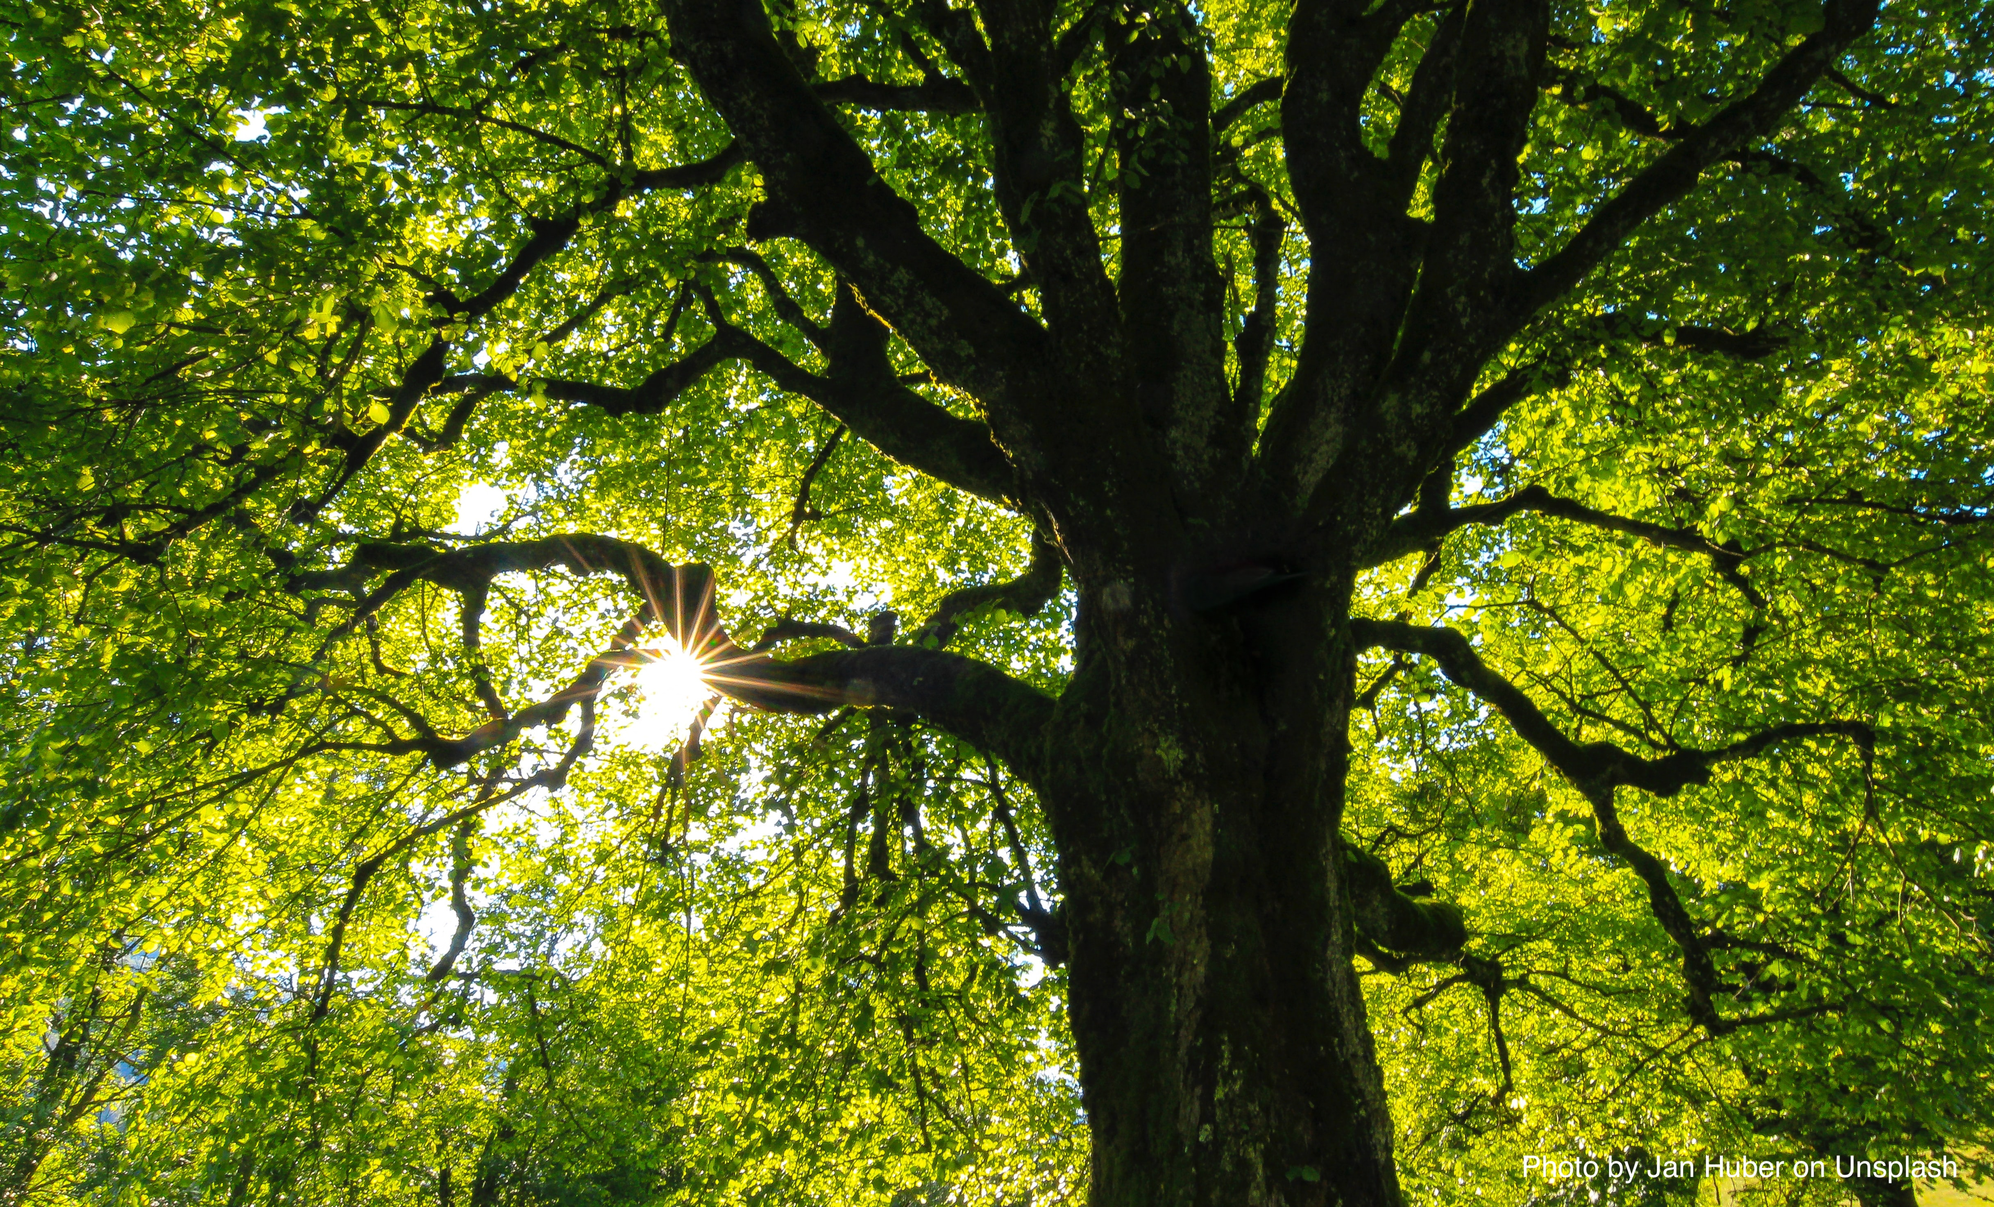
Every Sentence is a Tree
How sentences go together in English
Part 1: Clauses

Slide 2
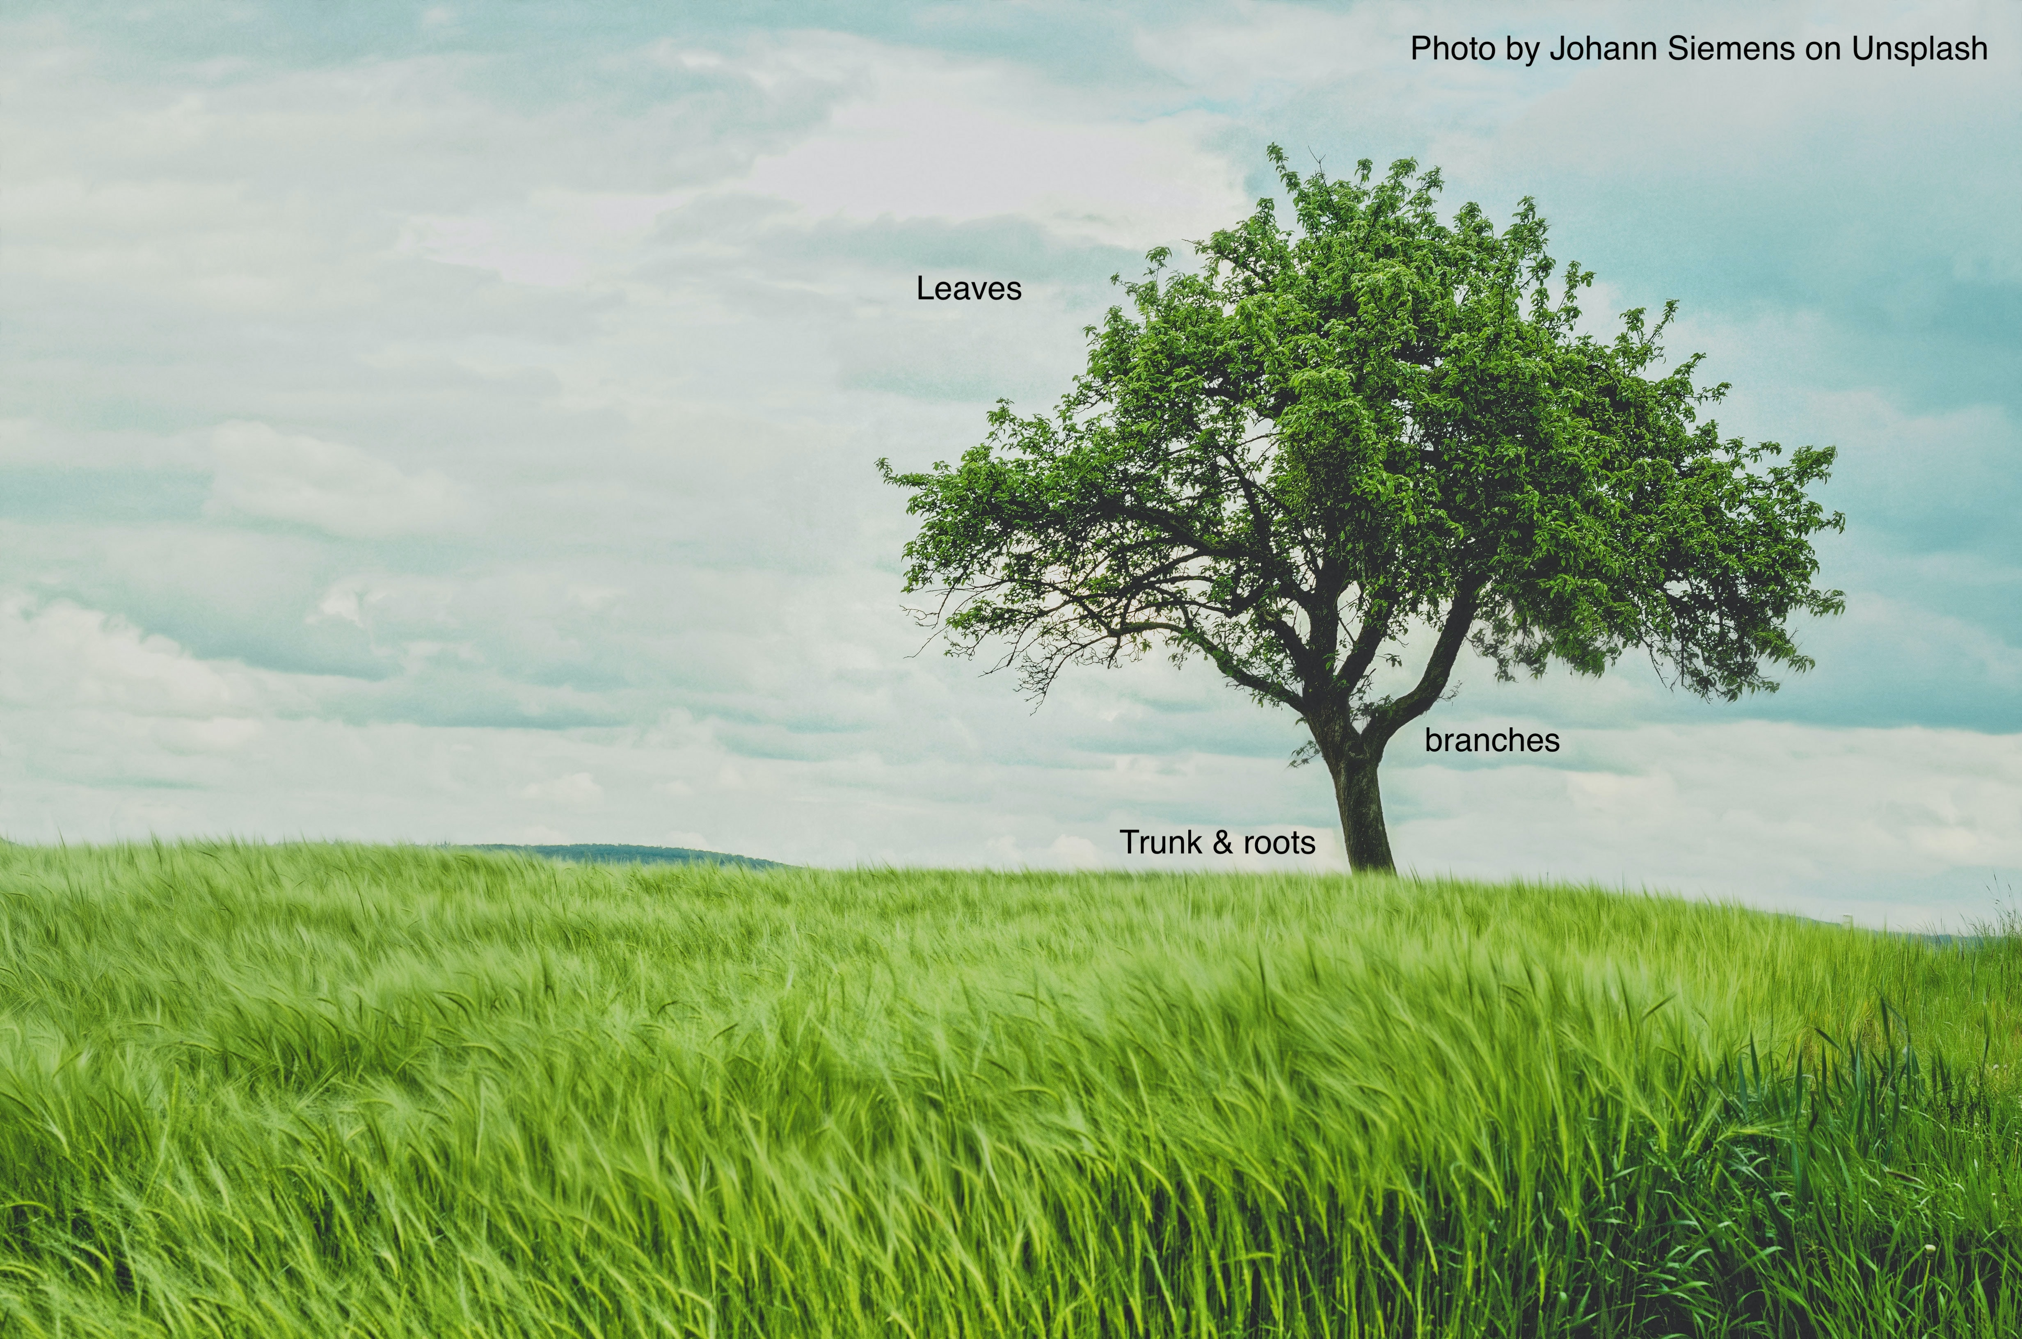
Every English Sentence is like a tree
Every tree has a trunk; every sentence has an independent clause.
Without a trunk and roots, you cannot have a living tree.
Without an independent clause, you cannot begin to build a complete sentence.

Slide 3

What is an independent clause?
An independent clause is a group of words that:
  Contains a subject and a verb
  Expresses a complete idea and can stand alone because there are no marker words attached to it

Slide 4
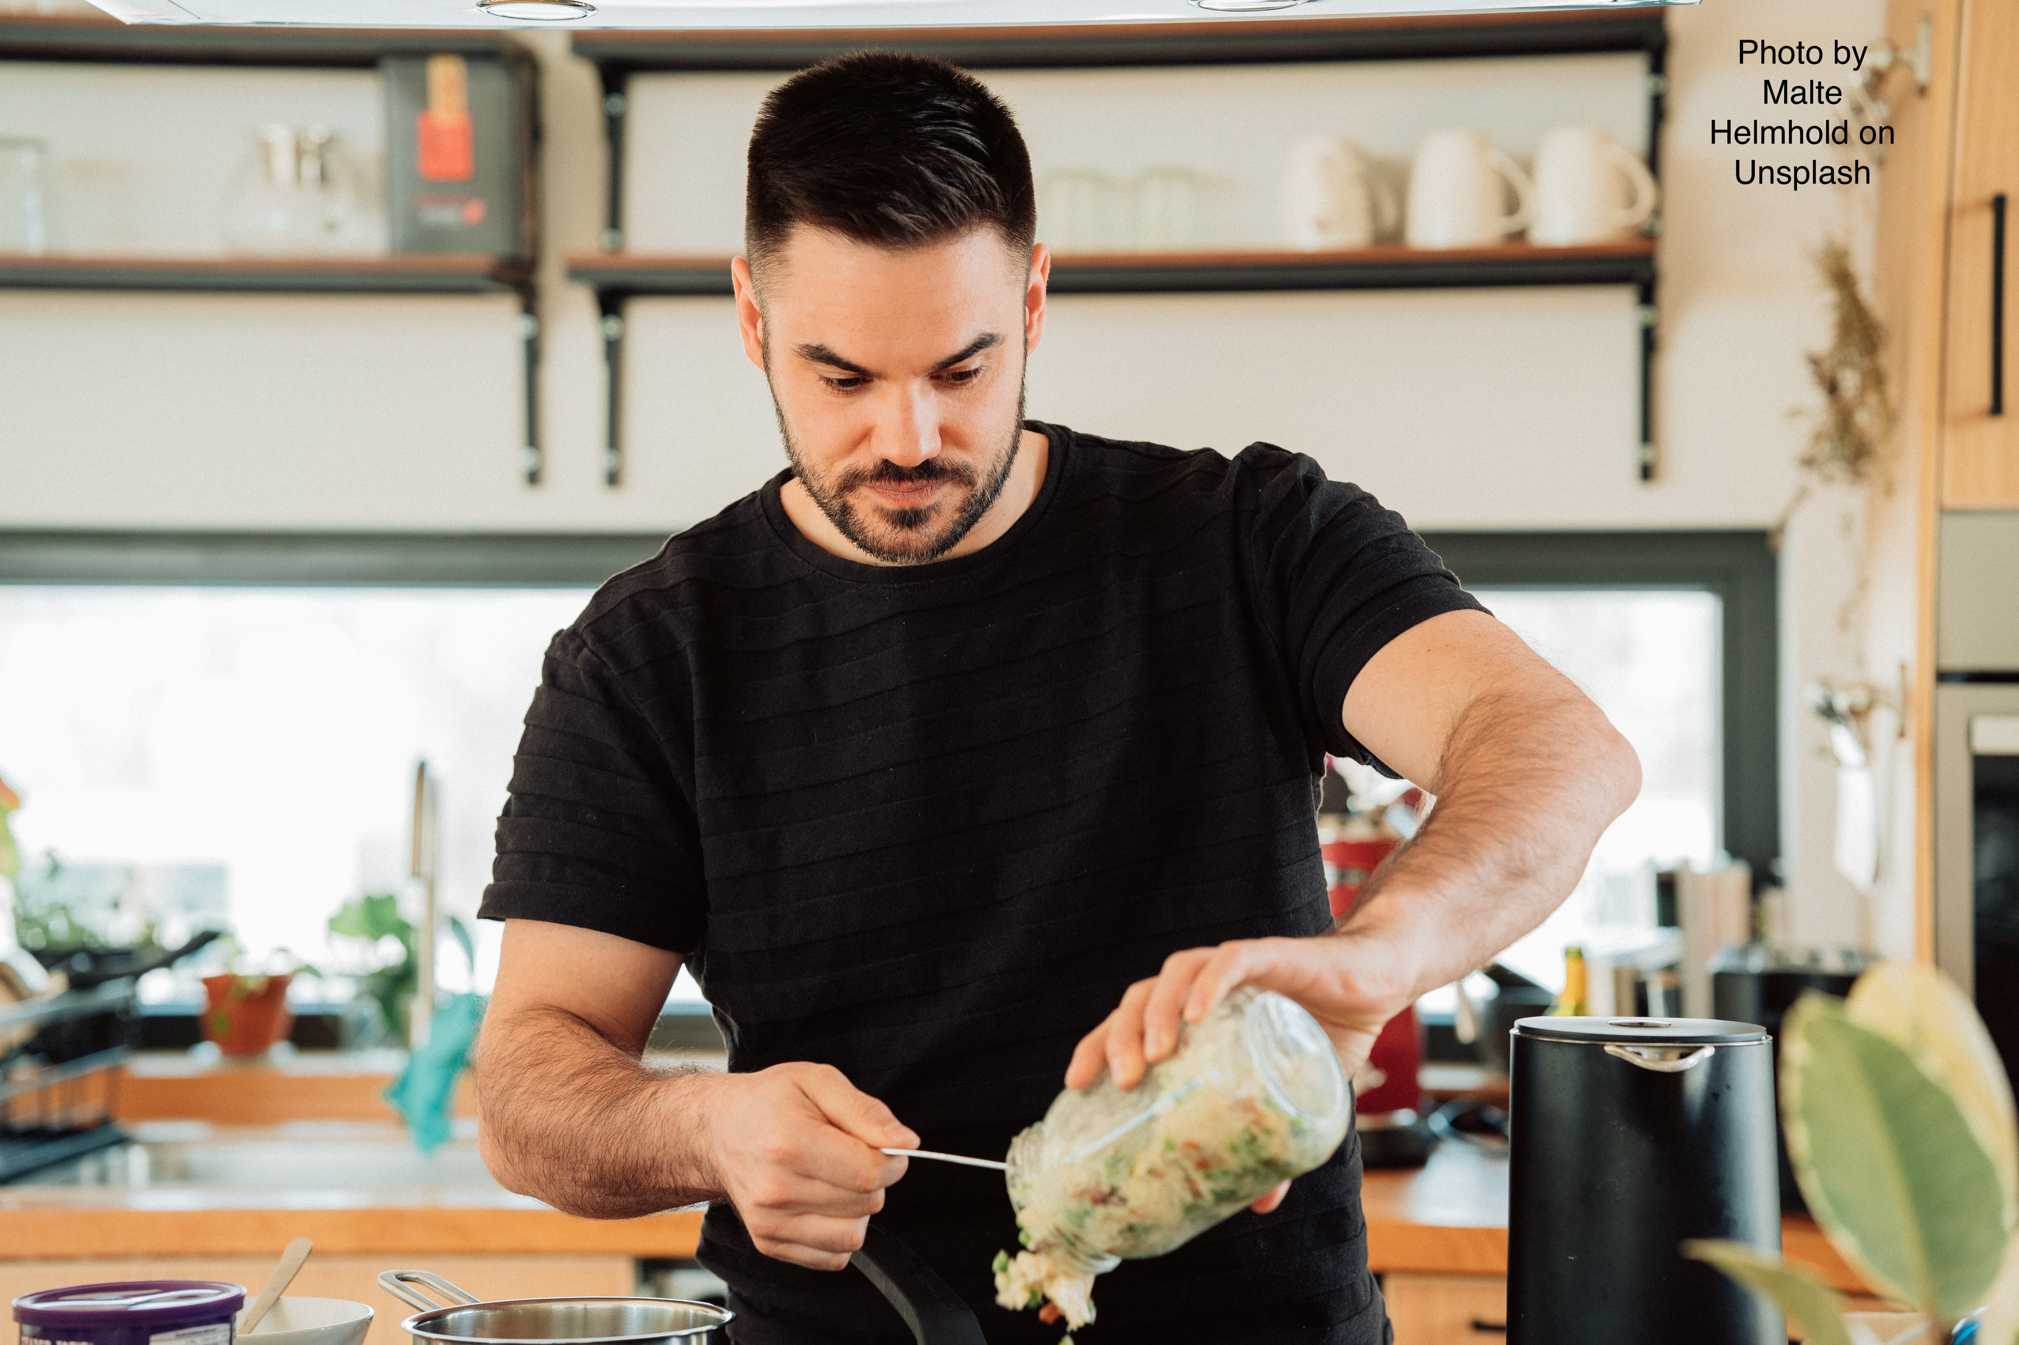
This is an independent clause:
Tom makes lunch.
Subject verb
It expresses a complete idea, does not have any marker words at the front, and it finishes with a period.

Slide 5
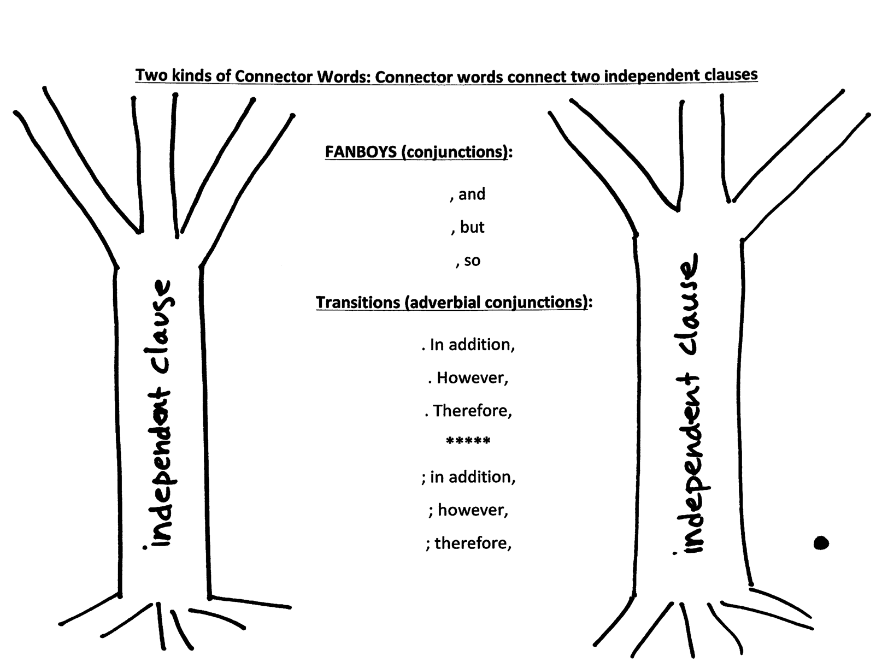
What are CONNECTOR WORDS?
Connector words connect two independent clauses

Slide 6
FANBOYS and Transitions: Same meaning, same function, different punctuation
Tom makes lunch, but he doesn’t have dessert. (FANBOYS – one sentence)
Tom makes lunch; however, he doesn’t have dessert. (Transition – one sentence)
Tom makes lunch. However, he doesn’t have dessert. (Transition – two sentences)

Slide 7
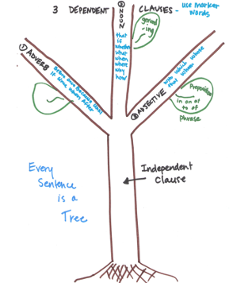
What are MARKER WORDS?
Marker words begin a dependent clause that always connects to an independent clause

Slide 8
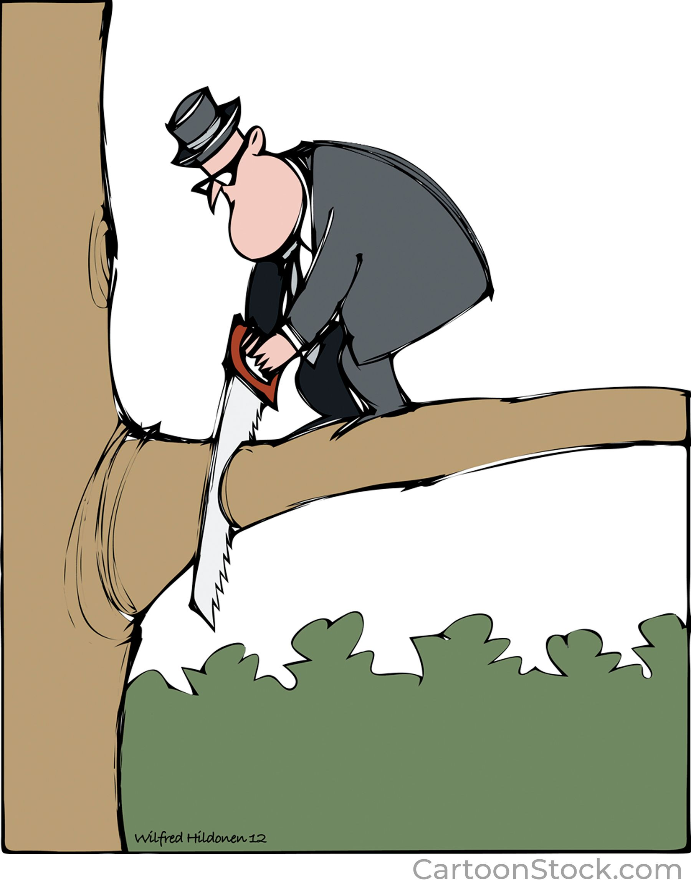
What is a dependent clause?
A dependent clause is a group of words that:
  Contains a subject and a verb
  Uses a marker word to show where the clause begins
  Cannot stand alone; they must stay connected to an independent clause

Slide 9
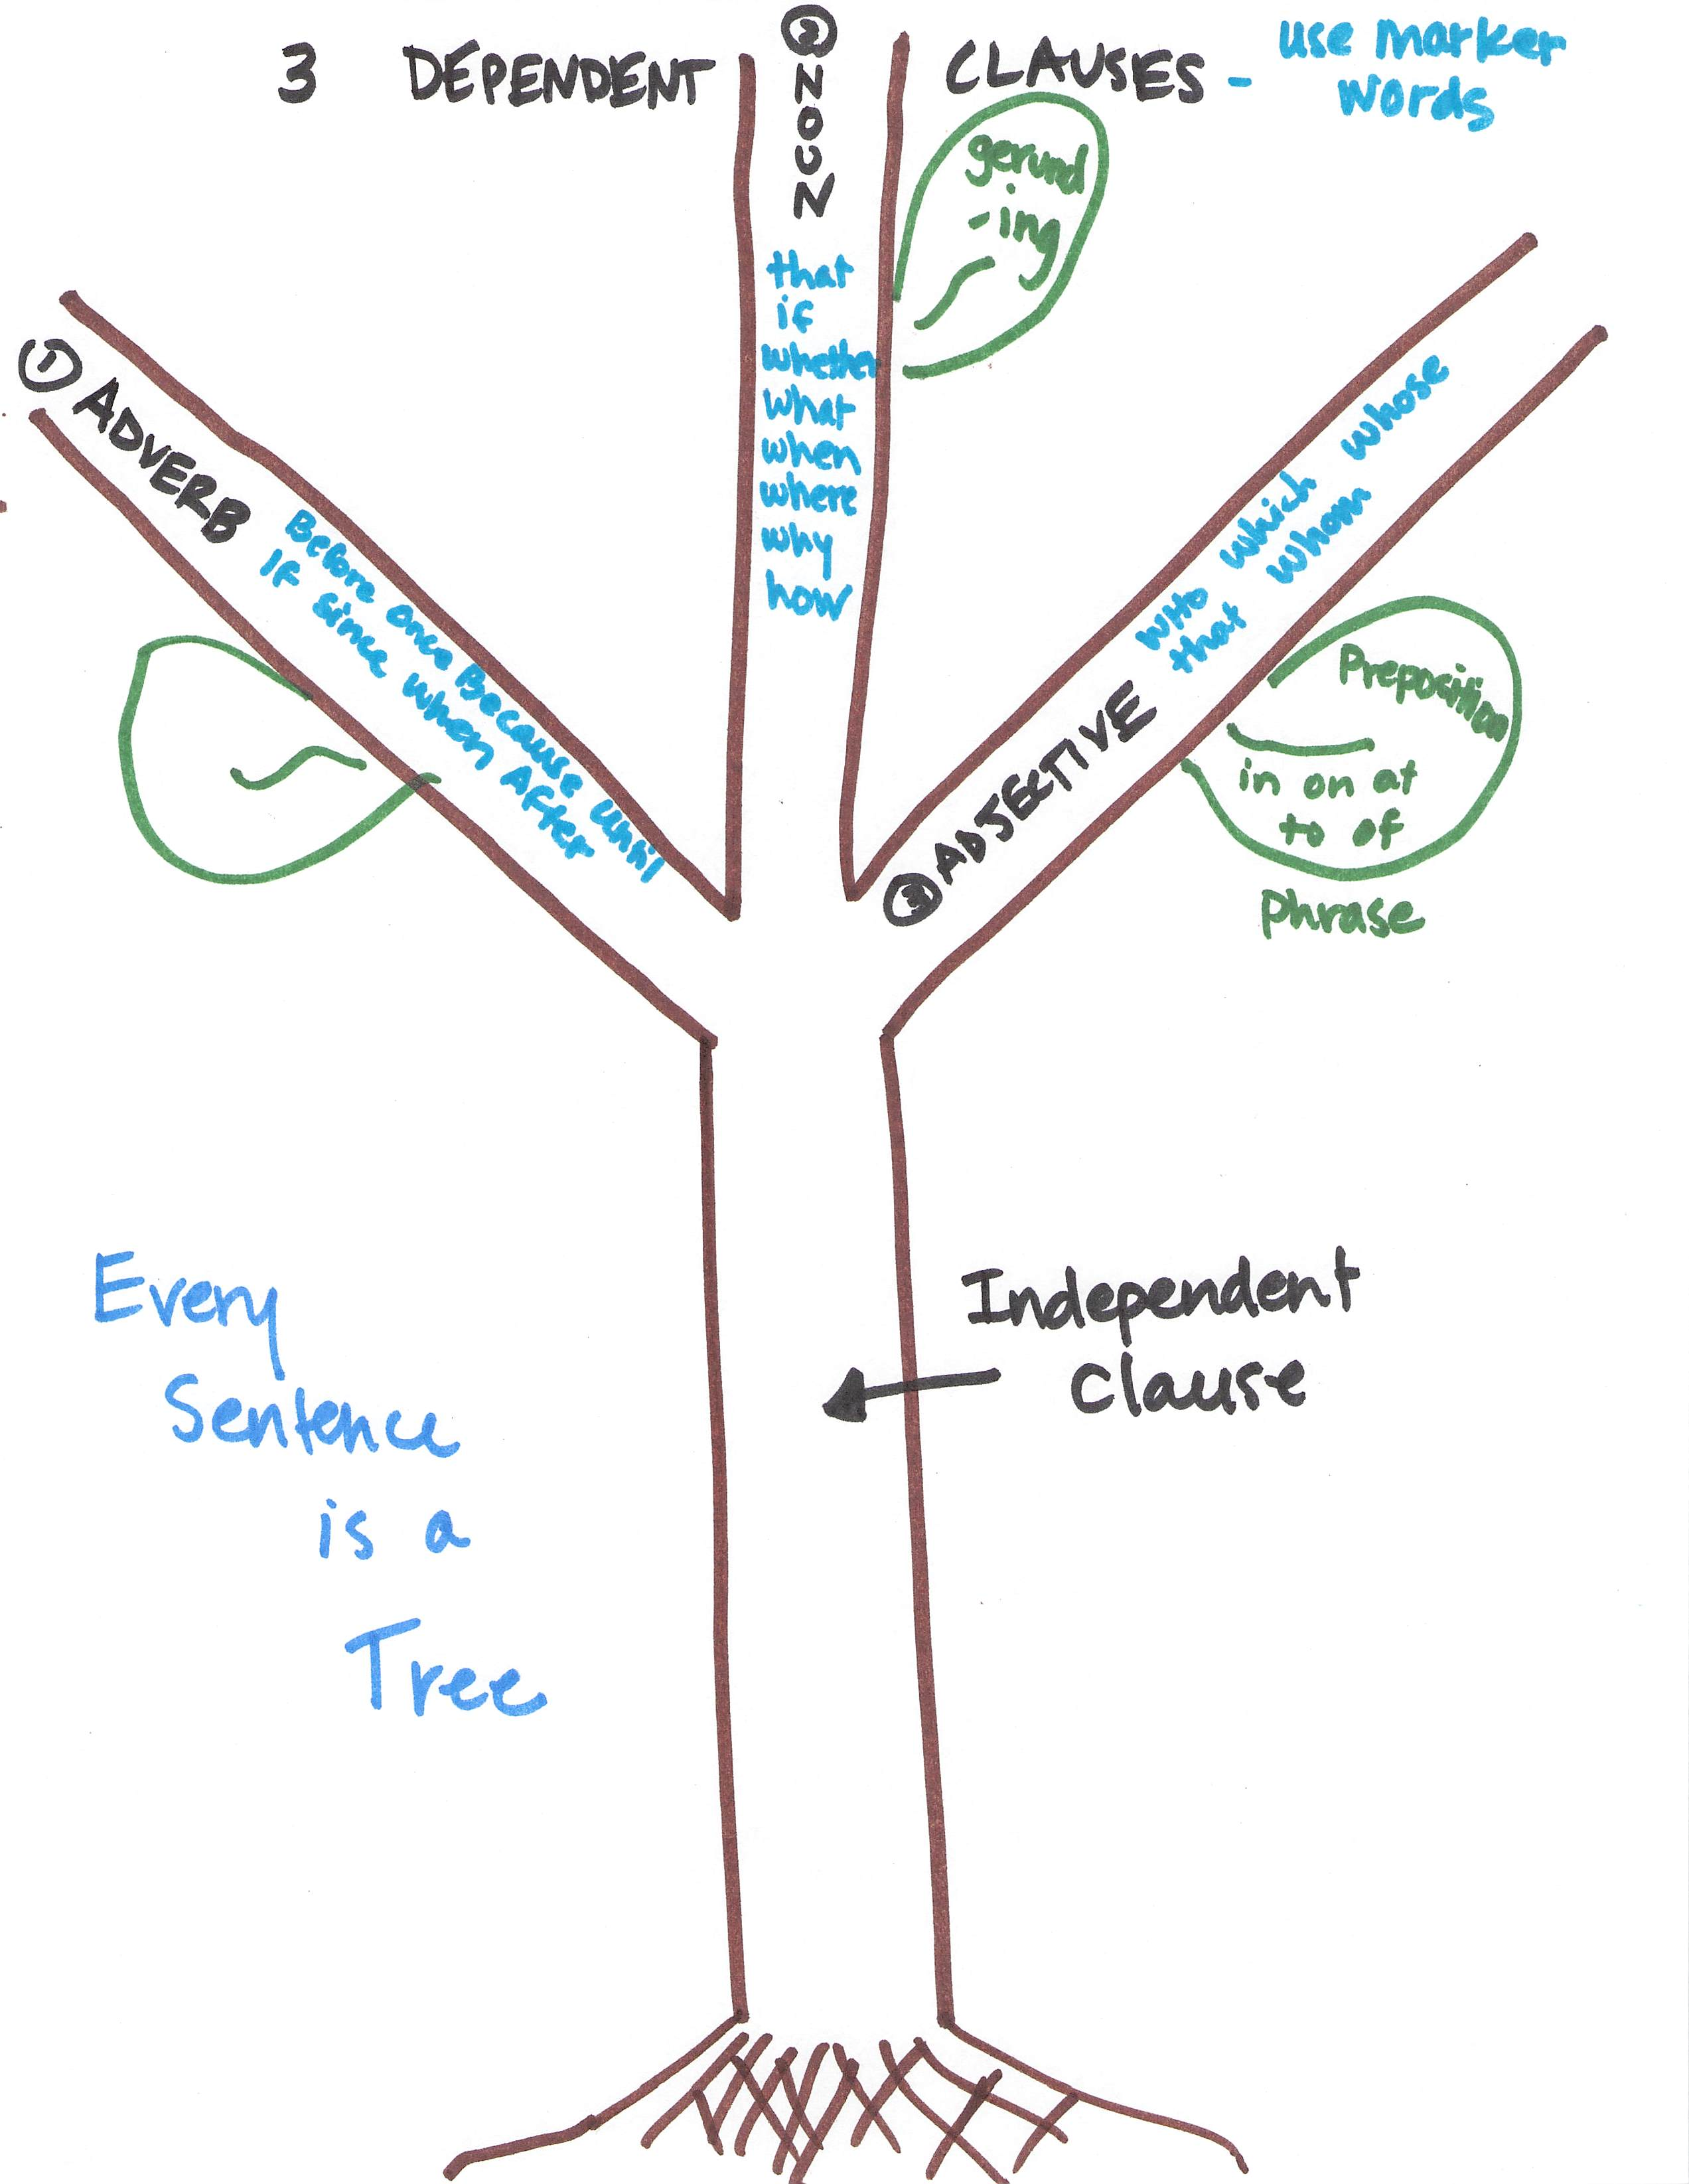
Punctuation
Each type of dependent clause has its own punctuation.
Knowing the marker words for each group will help you remember how to punctuate it correctly.

Slide 10
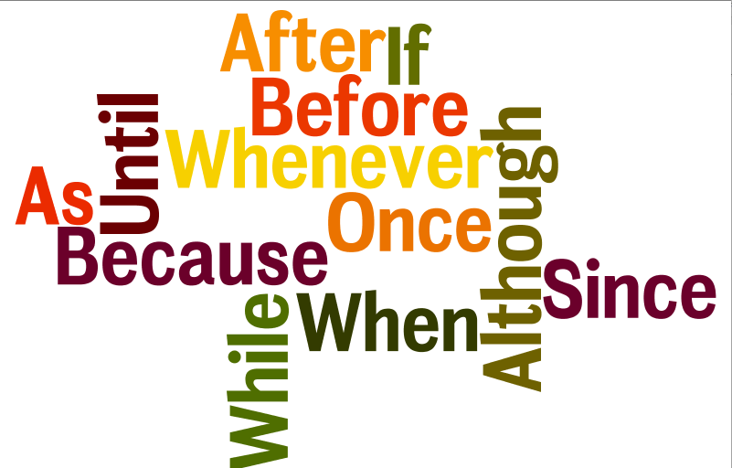
ADVERB CLAUSES
BOBUB IS WA WA WA

Slide 11
Adverb Clause Marker Words remember the acronym:
BOBUB IS WA WA WA
Before
Once
Because
Until
By the time
If
Since
When
After
While
As (These two are together because they both take progressive -- ING-- verbs)
Whenever (represents ALL -ever words: whatever, whenever, etc.)
Although (represents ALL though words: even though, though)

Slide 12
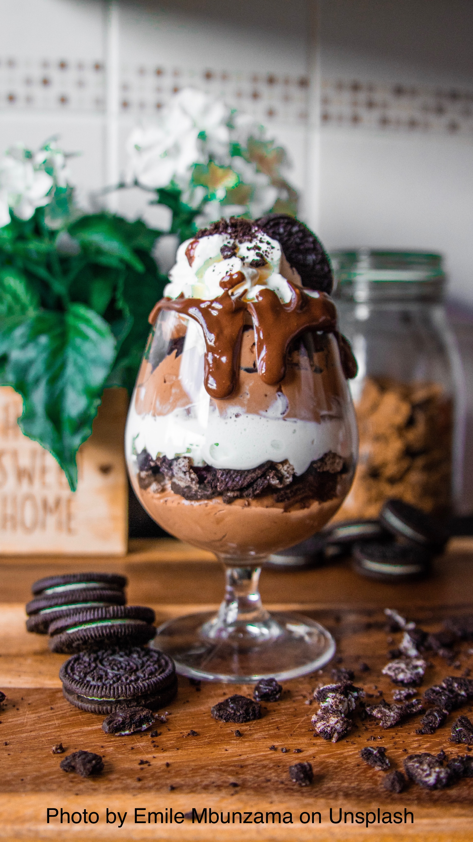
This is a sentence with an adverb (BOBUB) clause:
* After he makes
marker subject verb
lunch, Tom has dessert.
or
* Tom has dessert after
marker
he makes lunch.
subject verb

Slide 13
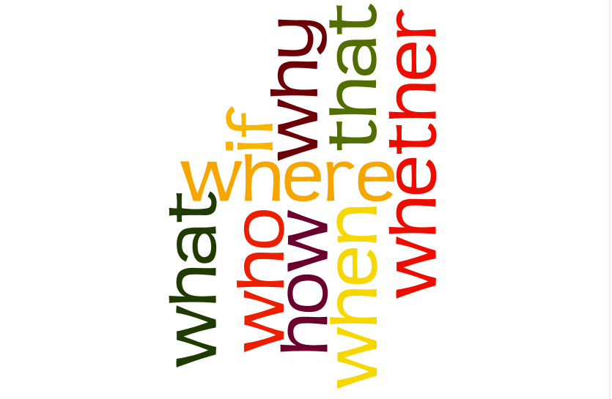
NOUN CLAUSES

Slide 14
Noun Clause Marker Words
Noun clause marker words are question words:
* Who
* What
* When
* Where
* Why
* How
* If/Whether (or not)
* That

Slide 15
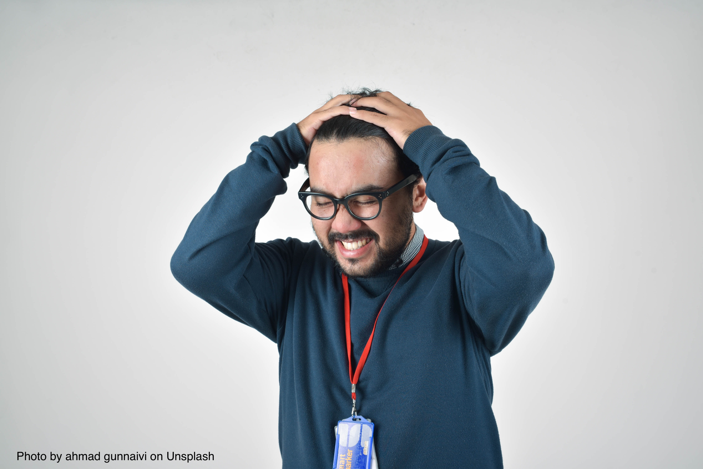
This is a sentence with a noun clause:
I can’t remember where I put my keys!
marker subject verb

Slide 16
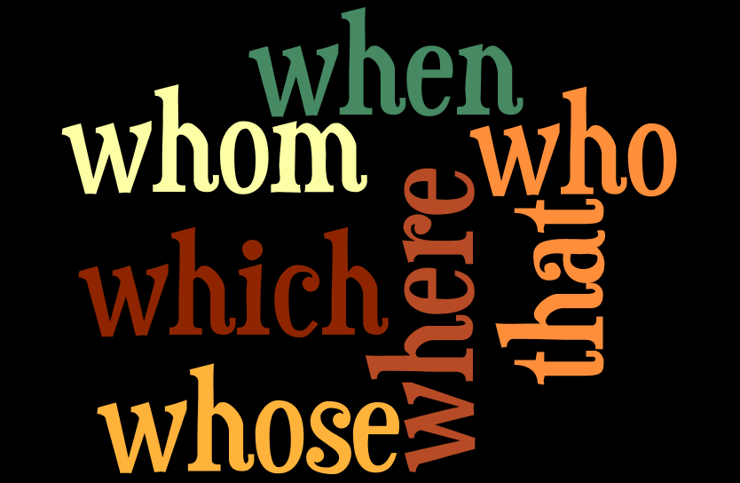
ADJECTIVE CLAUSES

Slide 17
Adjective Clause Marker Words
Whom
Whose
Which
That
Who
(and sometimes When and Where)

Slide 18
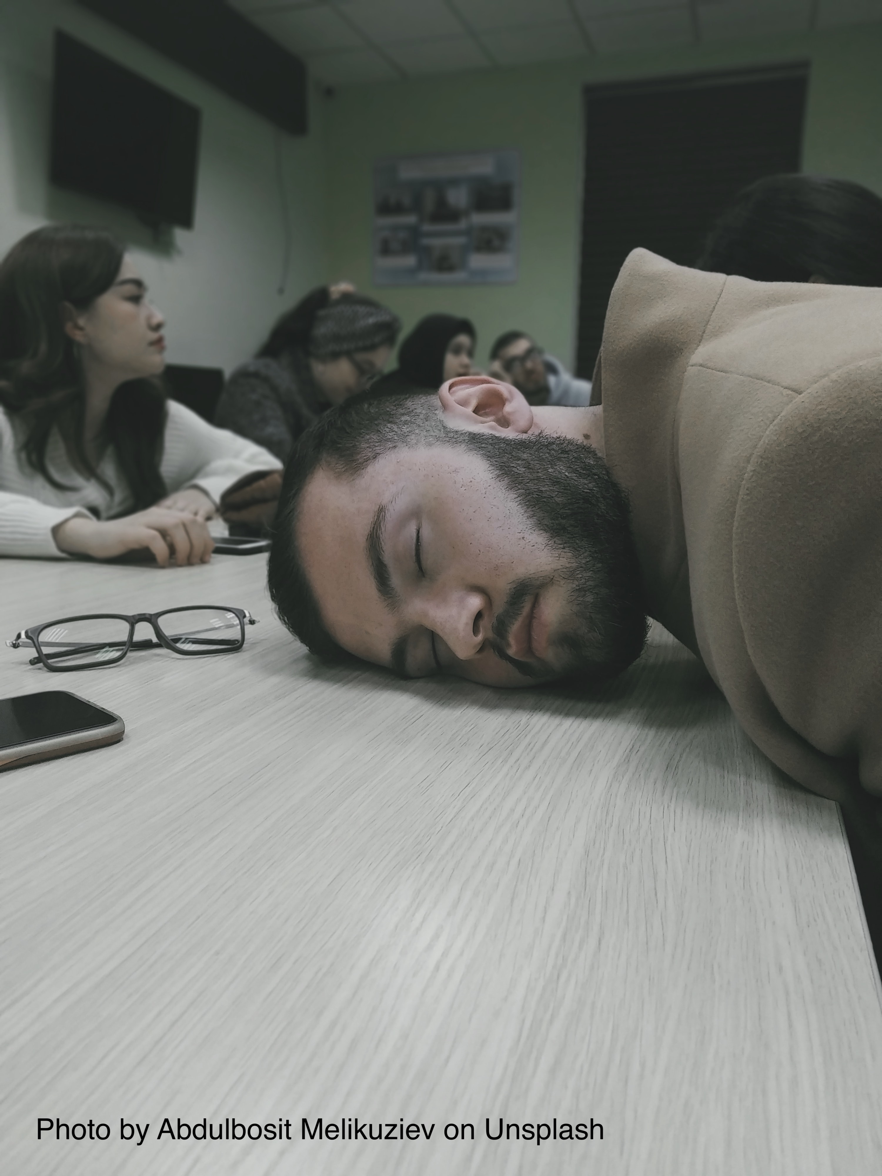
This is a sentence with an adjective clause:
The student who(m) I sit next to fell asleep.
marker word subject verb

Slide 19

In summary…
Every sentence MUST be built around an independent clause.
Dependent clauses create sentences with two subjects and two verbs.
Punctuation is based on whether you use ADVERB, NOUN, or ADJECTIVE clauses

