Slide 1
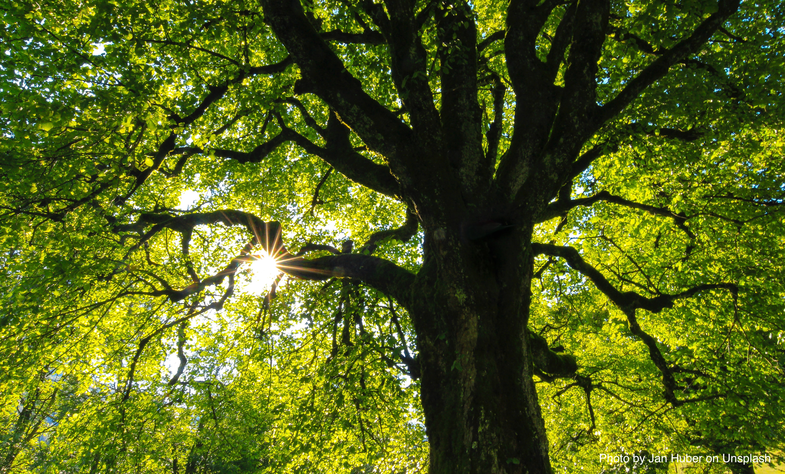
Every Sentence is a Tree:
How sentences go together in English
Part 1: Independent and Dependent Clauses

Slide 2
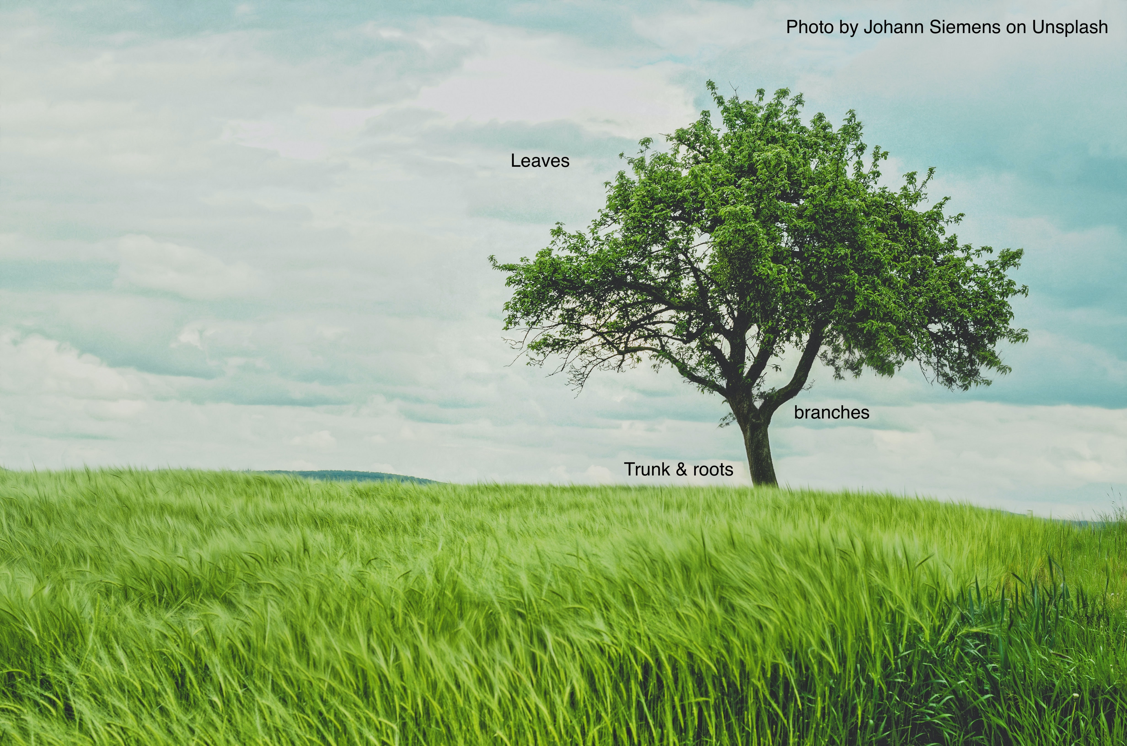
Every English Sentence is like a tree
Every tree has a trunk; every sentence has an independent clause.
Without a trunk and roots, you cannot have a living tree.
Without an independent clause, you cannot begin to build a complete sentence.

Slide 3

What is an independent clause?
An independent clause is a group of words that:
  Contains a subject and a verb
  Expresses a complete idea and can stand alone because there are no marker words attached to it

Slide 4

This is an independent clause:
Tom makes lunch.
Subject verb
It expresses a complete idea, does not have any marker words at the front, and it finishes with a period.

Slide 5

Phrases are the leaves on our sentence tree.

Slide 6
A tree can have a few leaves or a lot of leaves.
A sentence can have a few phrases or a lot of phrases.
Phrases do not have verbs and can attach in many different places in a sentence.
They should never interrupt the connection between a subject and verb or verb and object.

Slide 7
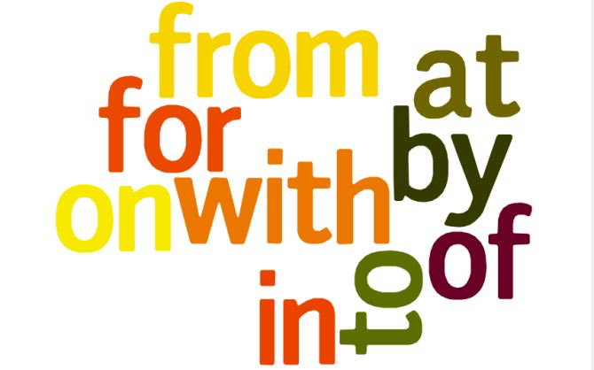
Prepositional Phrases

Slide 8
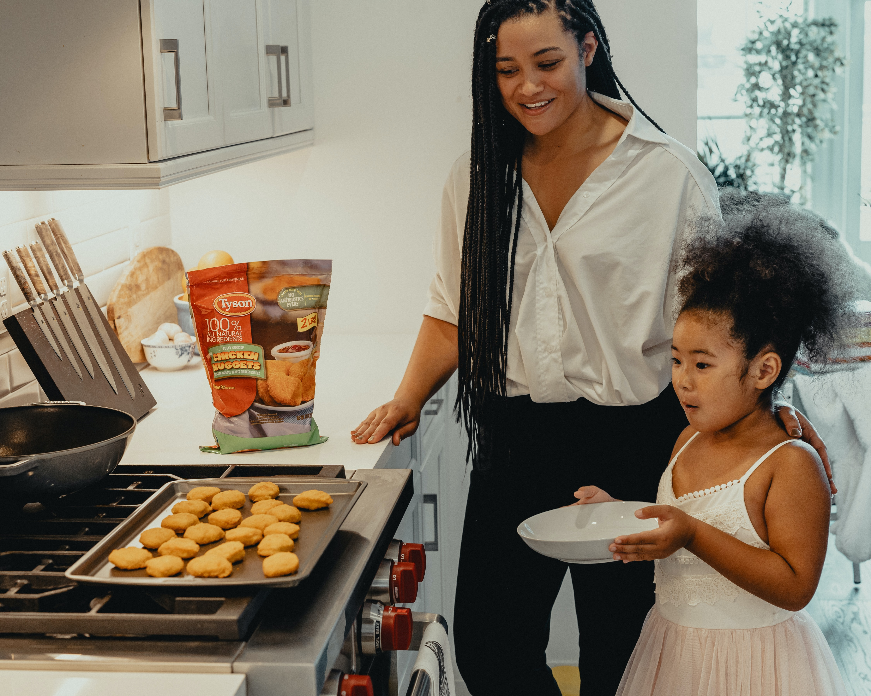
After she gets home from school, Sarah makes a snack with her mom in the kitchen.
Prepositional phrase prepositional phrase
Be careful not to interrupt the subject-verb or verb-object with a phrase:
Sarah with her mom makes in the kitchen a snack. →
SARAH MAKES A SNACK is the independent clause here.
Put the phrases around it, not inside it.

Slide 9
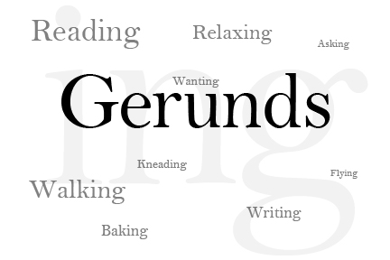
Gerund Phrases

Slide 10
Gerunds look like –ING verbs, but they aren’t!
Progressive/Continuous Verbs:
Am
Is
Are + -ING
Was action verb
Were
Auxilliary
I am studying right now.
Gerunds:
Studying every day helps you learn.
I don’t like studying.
STUDYING is the name of an activity here. Names are NOUNS.

Slide 11
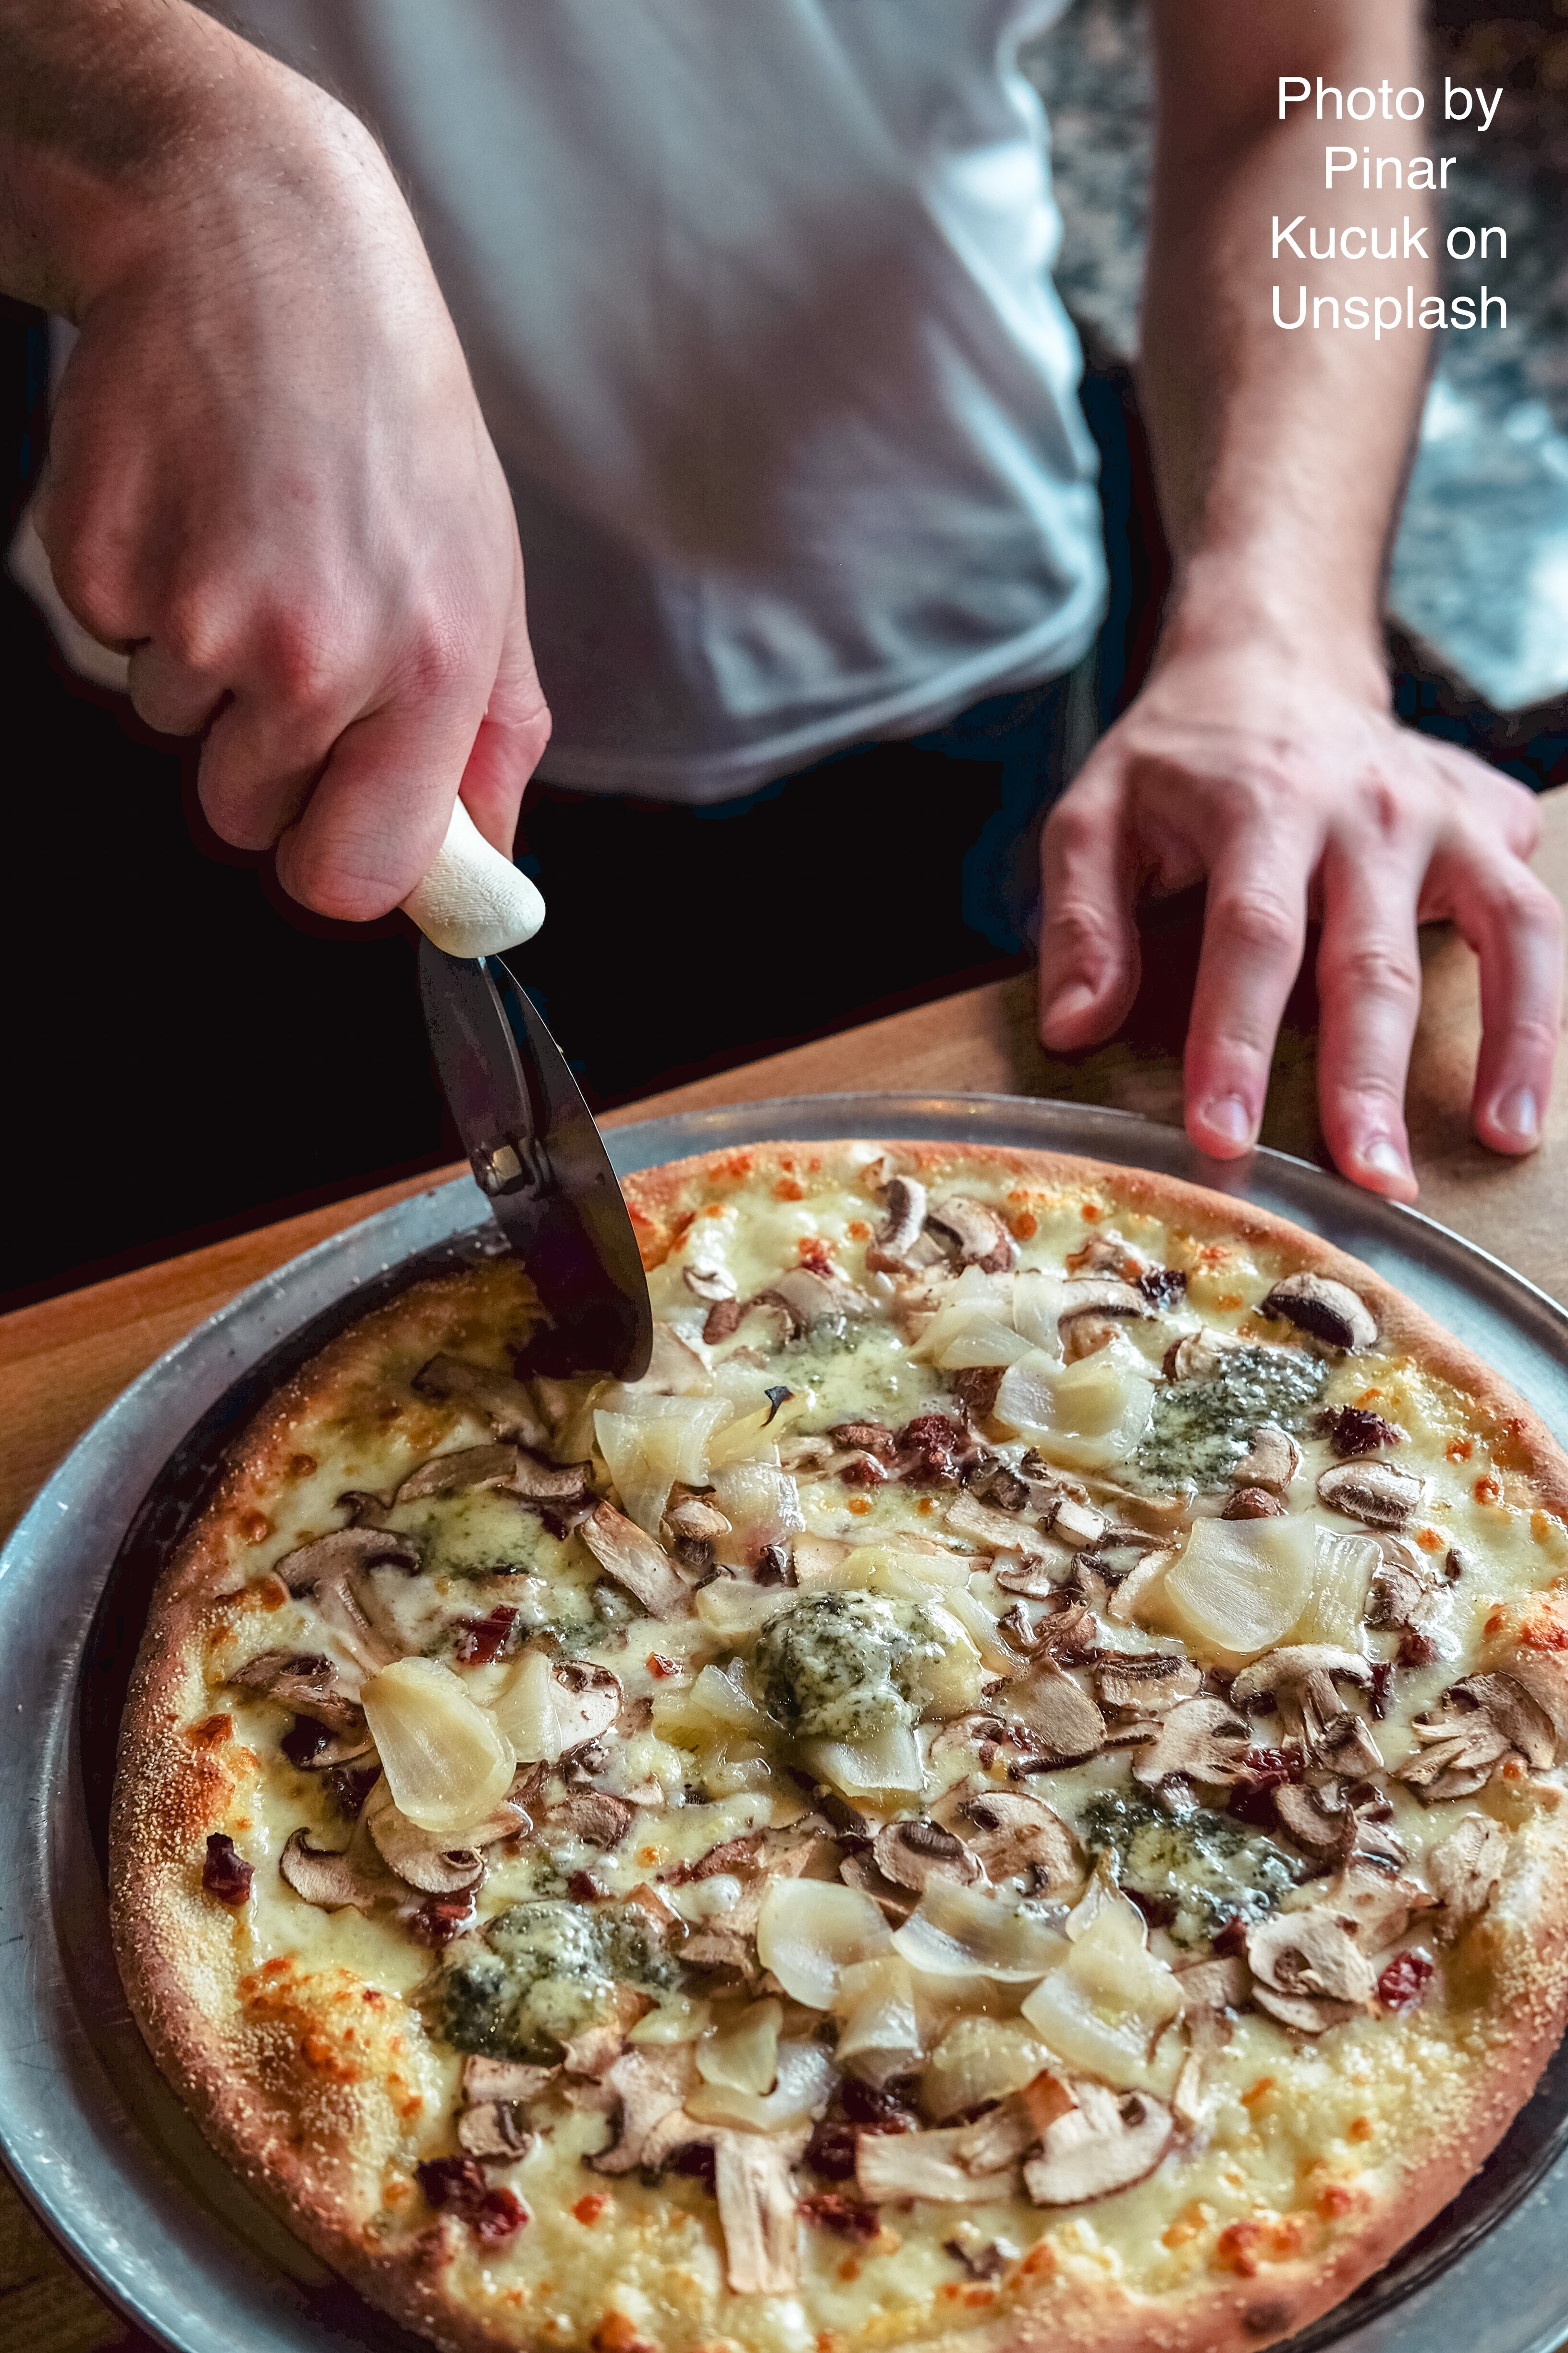
Gerund sentence:
I like pizza. → Pizza is a NOUN, a thing you like.
I like making pizza. → Making pizza is a GERUND, the name of an activity you like.

Slide 12
In summary…
Every sentence MUST be built around an independent clause.
Phrases add information and interest to your sentence but do not contain verbs.

