Slide 1
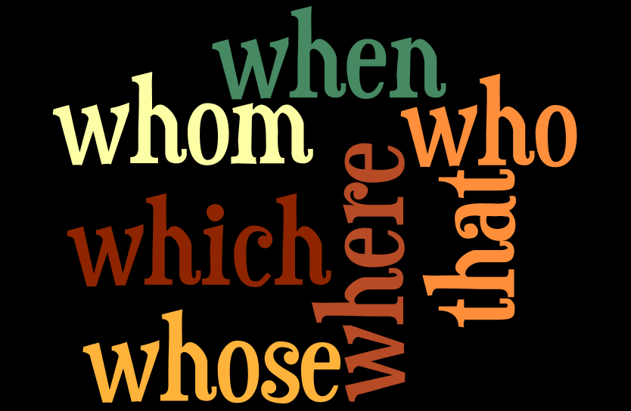
Introduction to Adjective Clauses

Slide 2
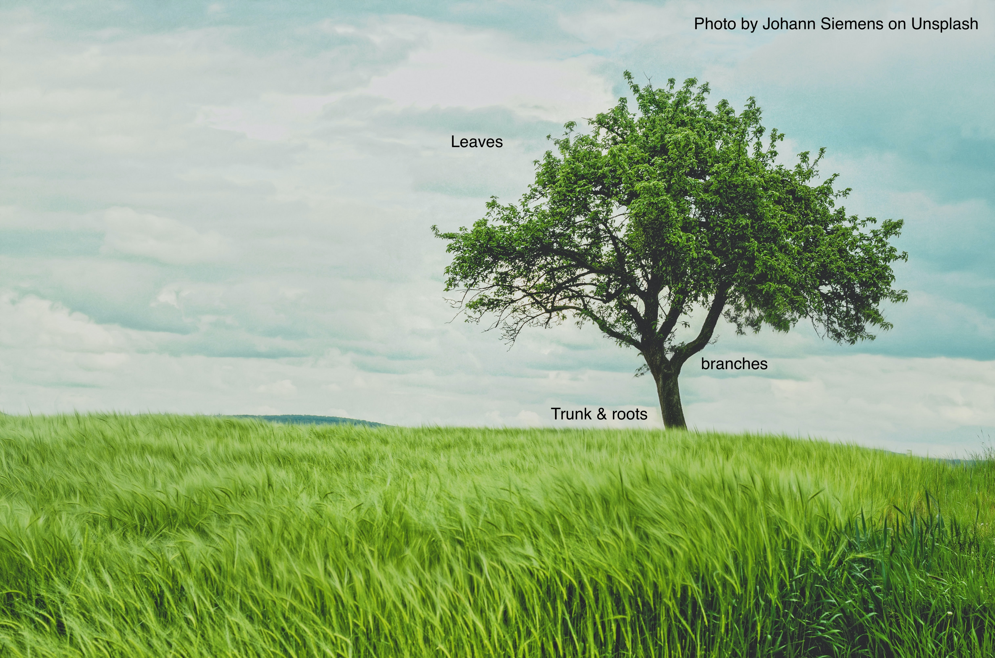
Before we talk about adjective clauses, we need to understand how sentences go together.
Every English sentence is like a tree.

Slide 3

Every tree has a trunk; every sentence has an independent clause.
Without a trunk and roots, you cannot have a living tree.
Without an independent clause, you cannot begin to build a complete sentence.

Slide 4

What is an independent clause?
An independent clause is a group of words that:
  Contains a subject and a verb
  Expresses a complete idea and can stand alone because there are no marker words attached to it

Slide 5
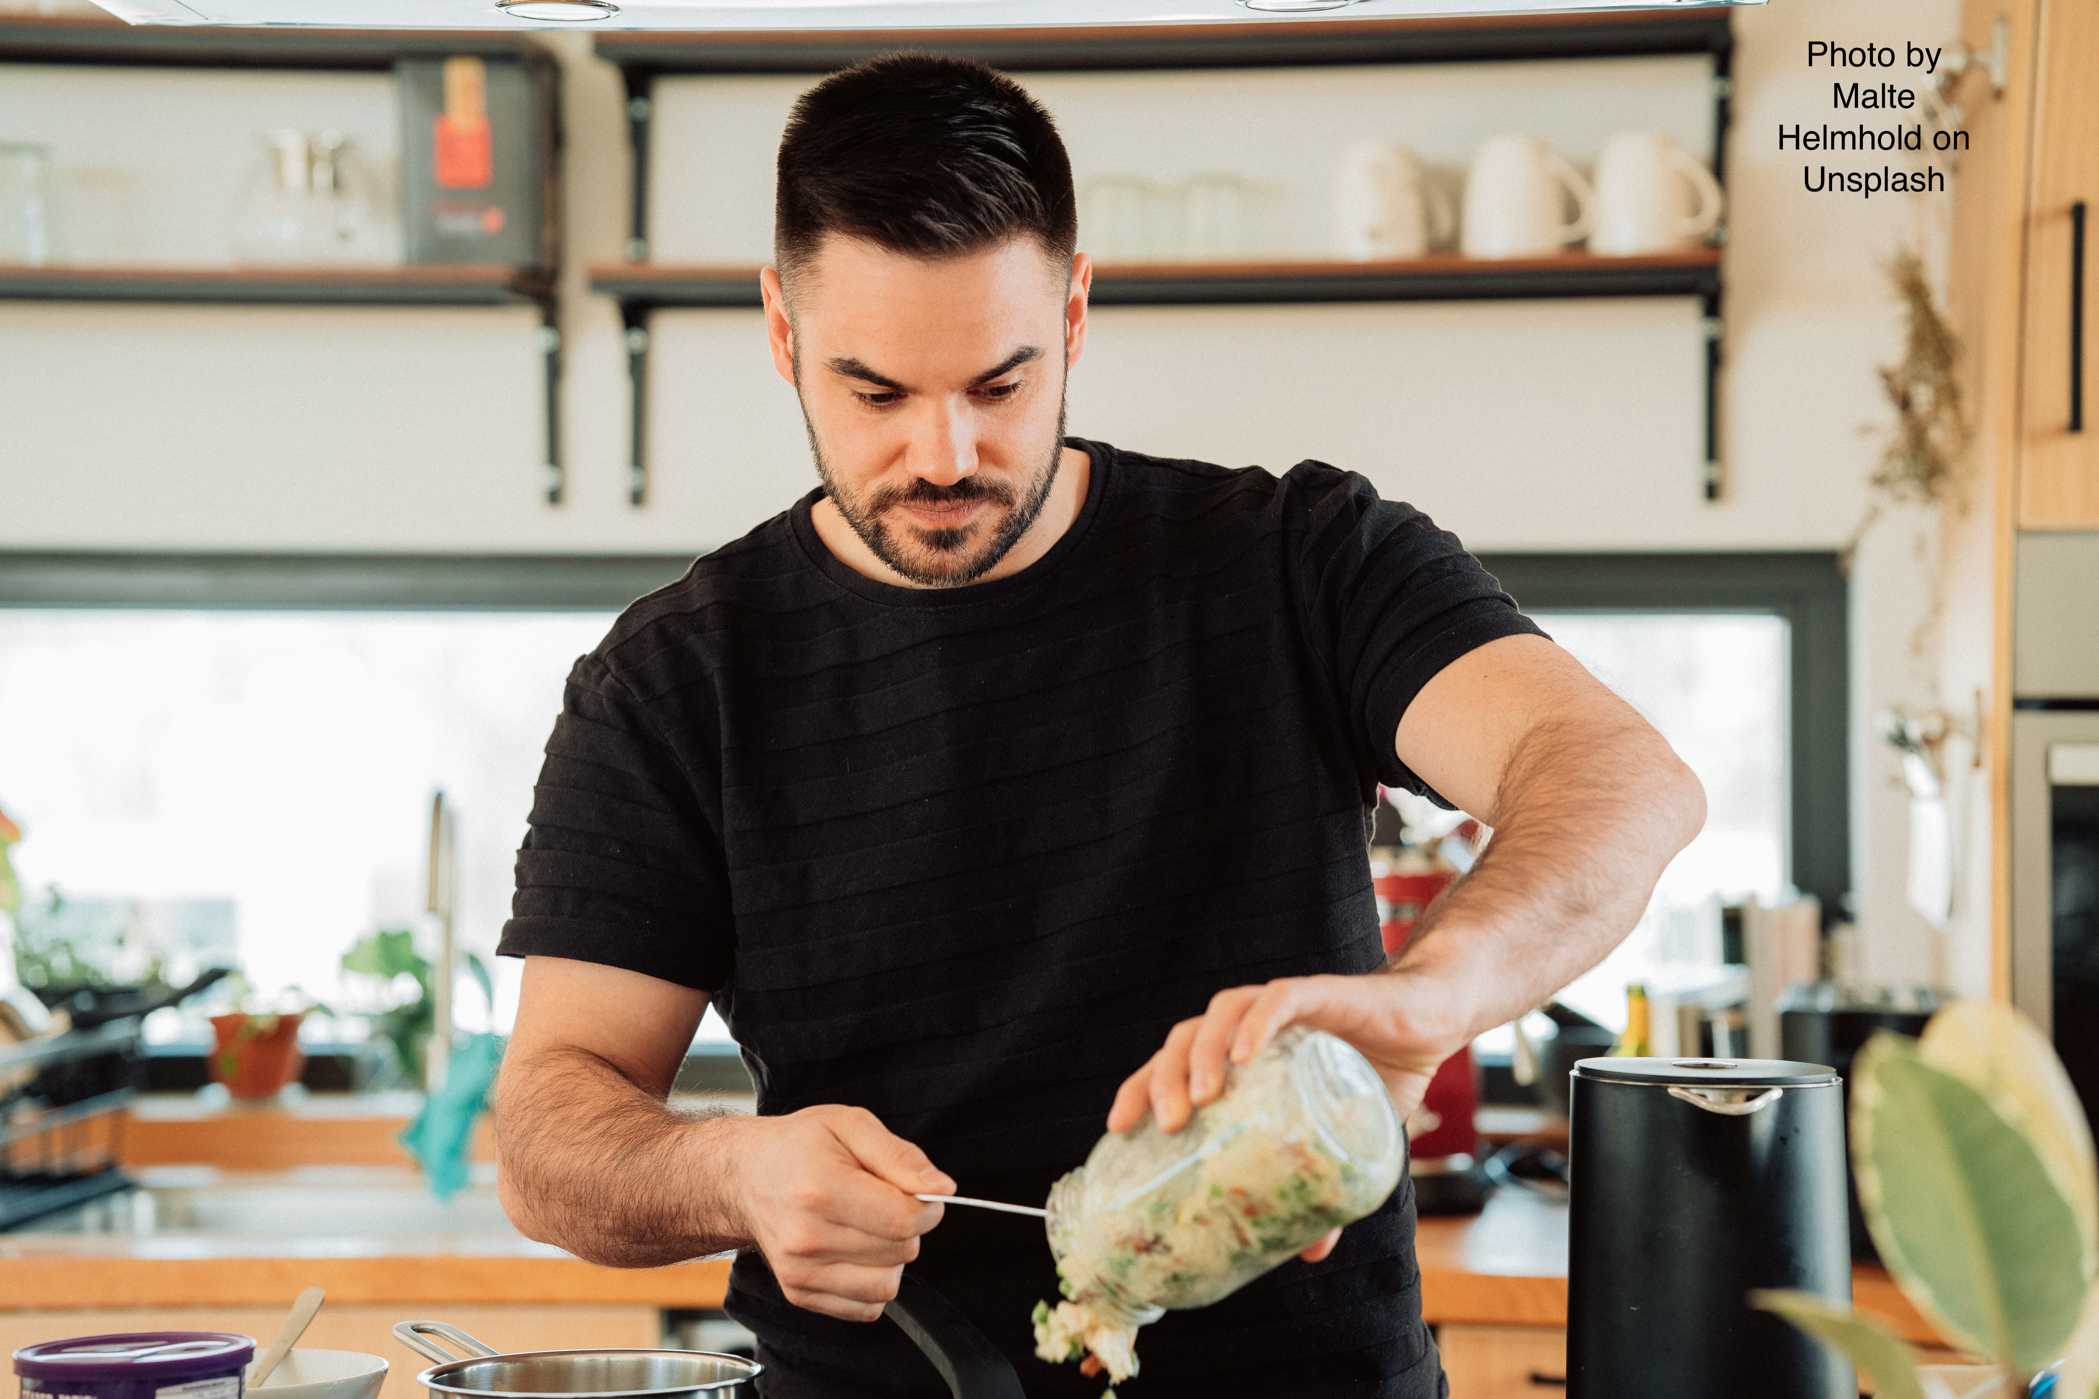
This is an independent clause:
Tom makes lunch.
Subject verb
It expresses a complete idea, does not have any marker words at the front, and it finishes with a period.

Slide 6
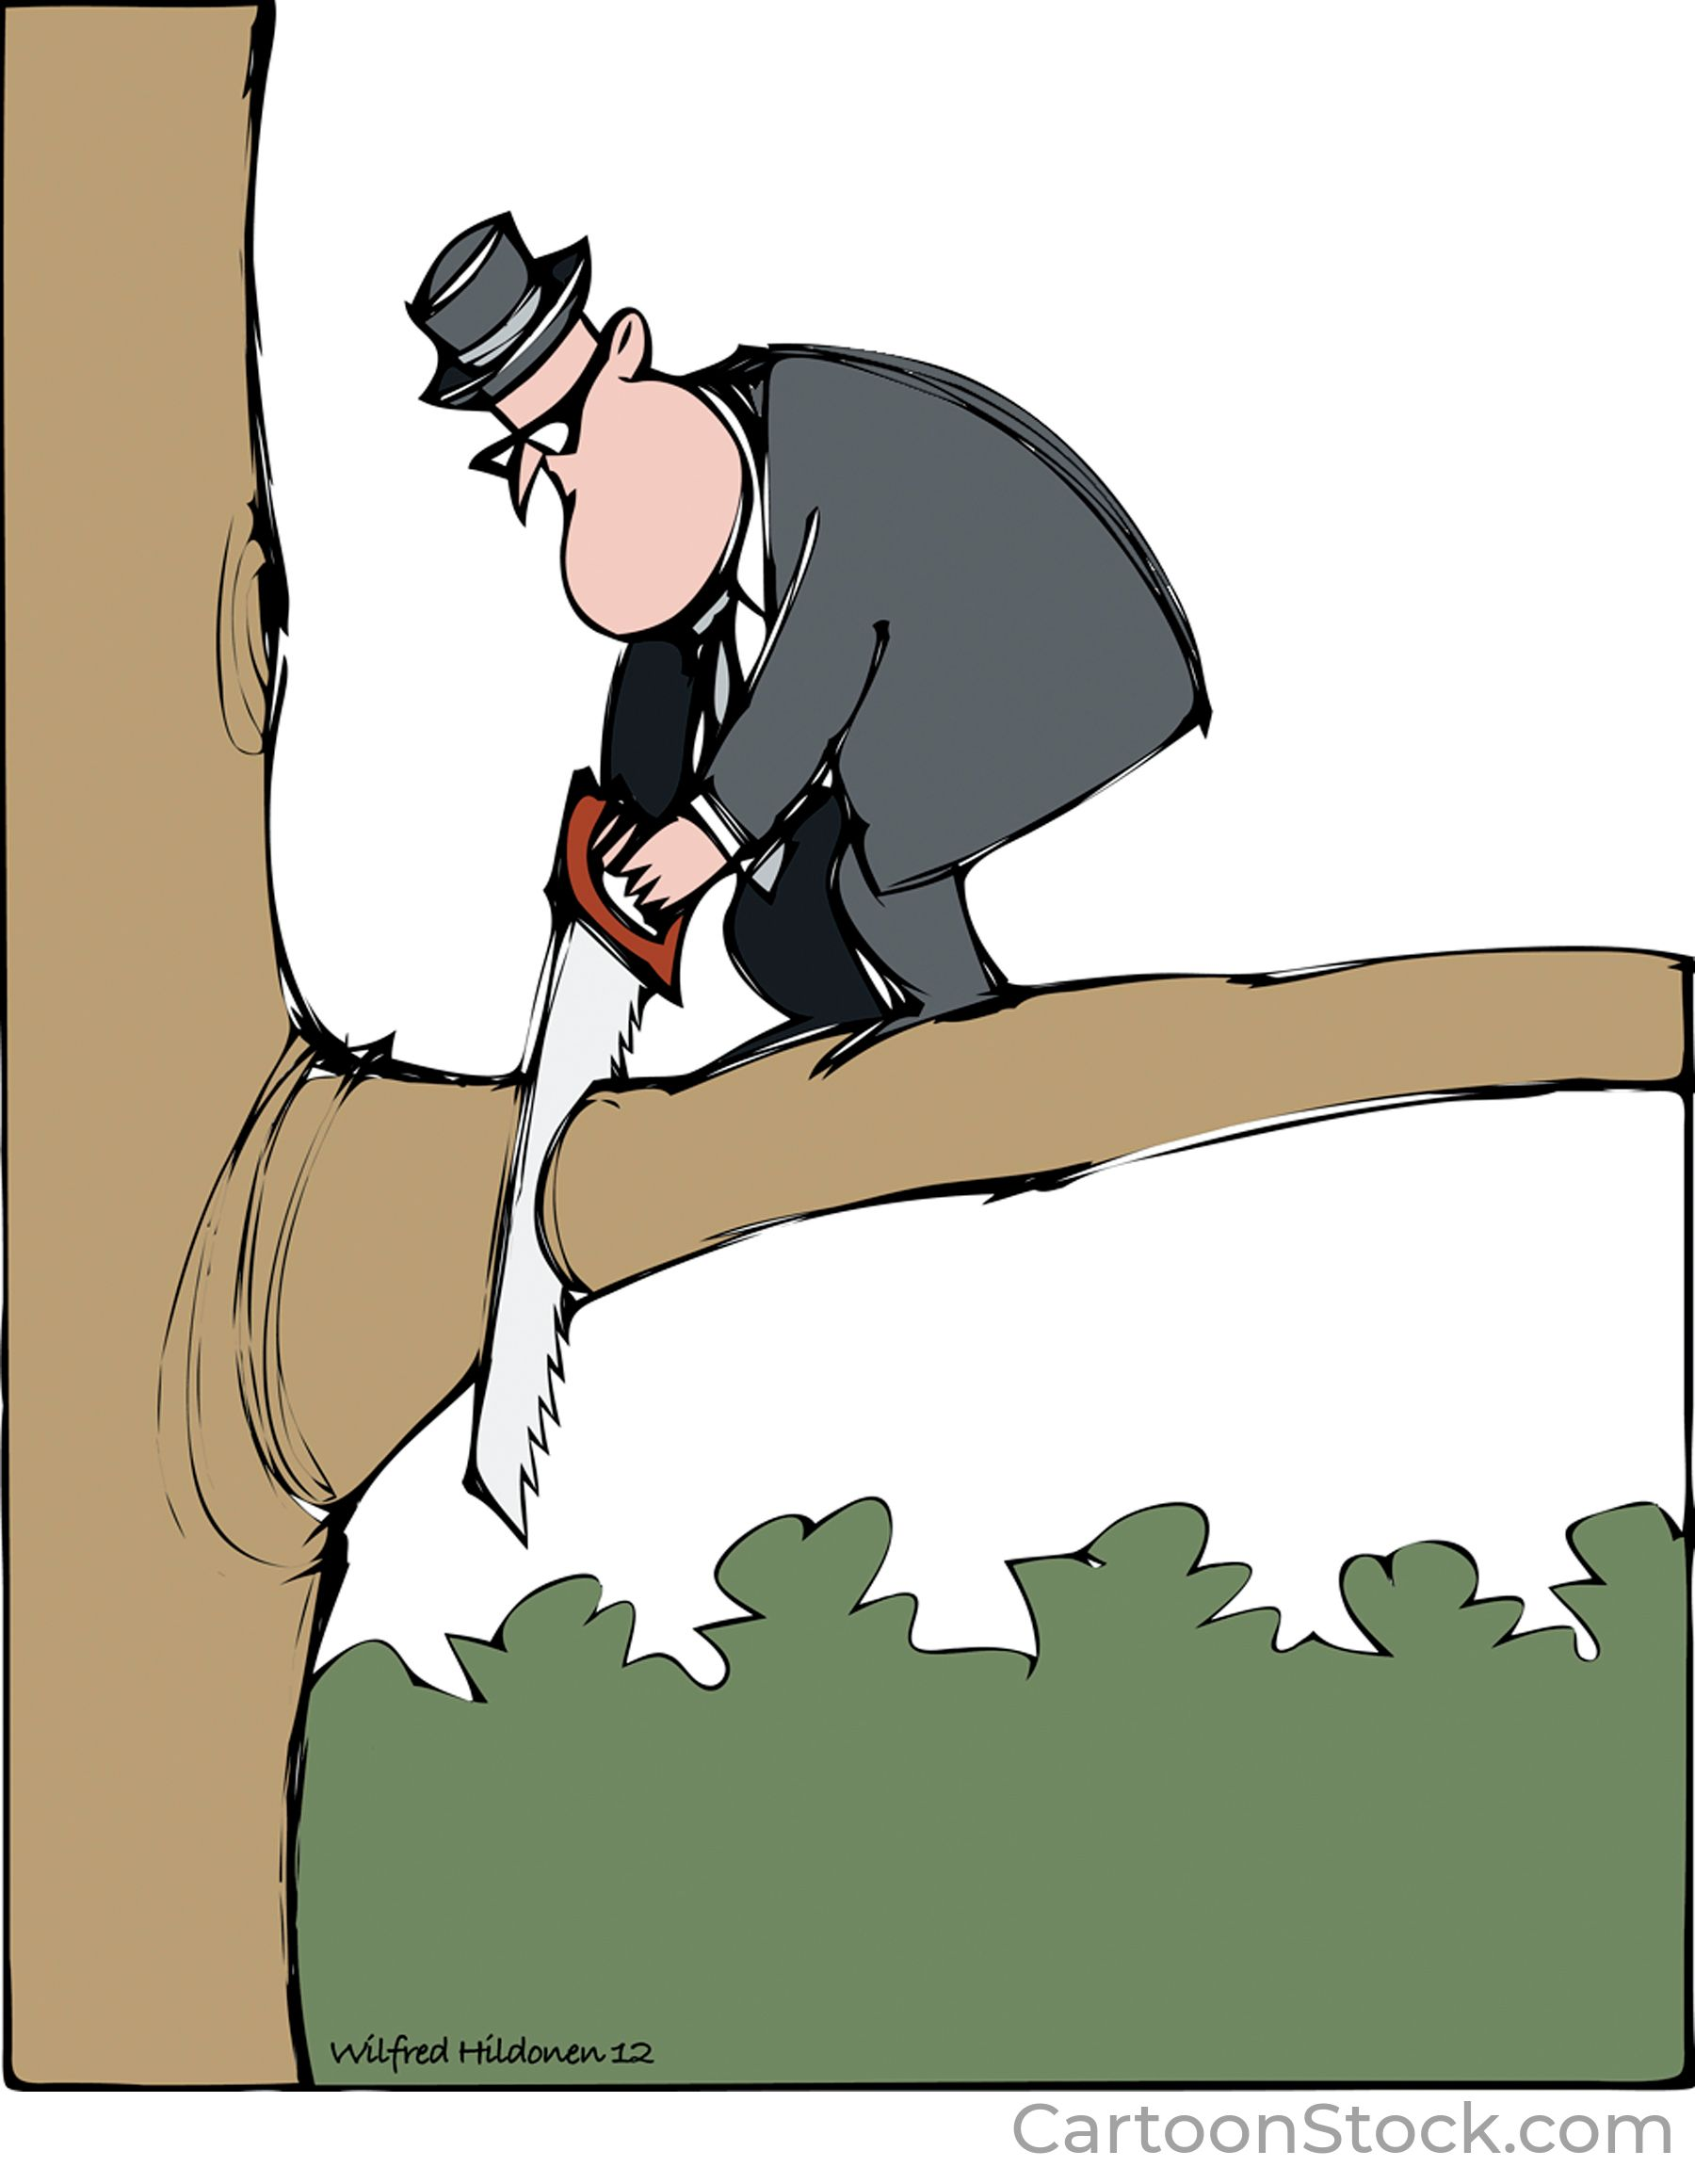
What is a dependent clause?
A dependent clause is a group of words that:
  Contains a subject and a verb
  Cannot stand alone; it must stay connected to an independent clause
  Uses a marker word at the front to show where the clause begins

Slide 7
These are examples of adjective dependent clauses
that cut the branch
who cut the branch
whom I saw in the tree
These are not sentences.
They need to be attached to an independent clause because they begin with the adjective clause marker words.
I know the man…
…that cut the branch
…who cut the branch
…whom I saw in the tree

Slide 8
Adjective Clause Marker Words:
WHO WHOM WHOSE
THAT WHICH
Each kind of dependent clause has its own marker words and punctuation rules. These are the Adjective Clause Markers.
WHO (WHOM) – for people
WHOSE XXX - for something that belongs to someone
THAT – FOR THINGS
WHICH – FOR THINGS
WHEN – REFERS TO A SPECIFIC TIME
WHERE – REFERS TO A SPECIFIC PLACE

Slide 9
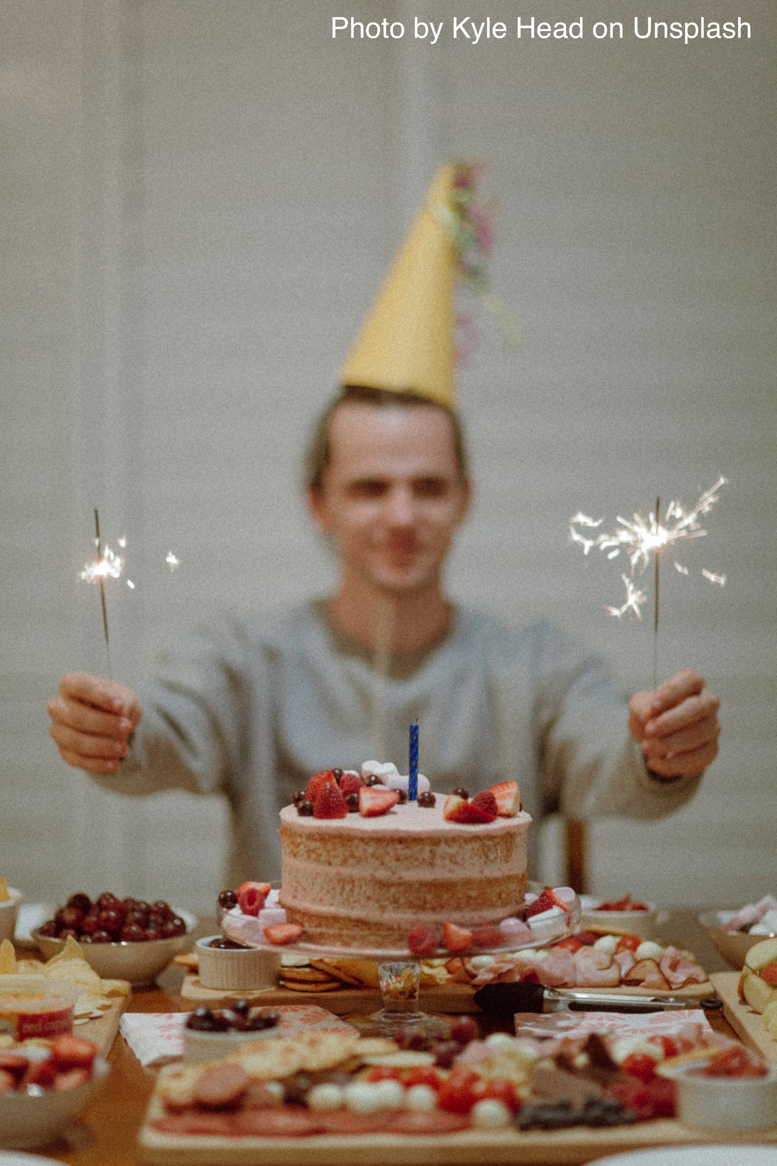
WHO or WHOM?
How is the structure of these clauses different?
The man whom I met at the party last night was the last one to leave.
The man who lives next door to me is not very friendly.

Slide 10
Check the structure of the adjective clause
SUBJECT between marker word and the verb
No subject between marker word and verb
whom I met at the
Marker word subject verb
party last night
RULE FOR WHO/WHOM:
Extra word (subject) = extra letter (whoM)
who lives next door
Marker word verb
to me

Slide 11

Adjectives describe nouns (people, places, or things)
In the picture, I see
a red car
adj noun
a hungry man
adj noun
a sad baby
adj noun
a broken car
adj noun

Slide 12
Adjective Clauses are dependent groups of words that describe a HEAD NOUN
There is a baby who is crying.
(There is a baby. It is crying.)
There is a car which is broken.
(There is a car. It is broken.)
There is a man whose leg is in a cast.
(There is a man. His leg is in a cast.)
There is a car which is red.
(There is a car. It is red.)

Slide 13
Four things to remember about adjective clauses
Position
2. Head noun + verb agreement
Do not repeat the head noun in the adjective clause
You need a complete independent clause (there must be two verbs in a sentence with an adjective clause)

Slide 14
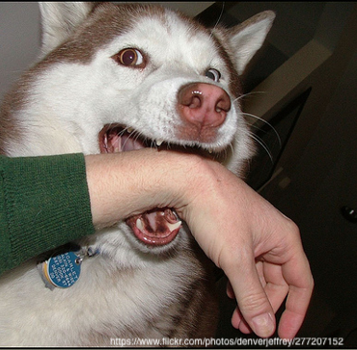
1. POSITION: Adjective clauses must be directly next to the head noun they are describing:
The dog belongs to my neighbor. It bit me.
Who is doing the biting here? Put the clause in the correct place!
The dog belongs to my neighbor that bit me.
The dog that bit me belongs to my neighbor.

Slide 15
2. AGREEMENT: The head noun and the verb must agree.
Incorrect:
  The man who live next door is rude.
Correct:
  The man who lives next door is rude.

Slide 16
3. Do not repeat the head noun in your adjective clause
Incorrect:
  The man who he lives next door is rude.
Correct:
  The man who he lives next door is rude.

Slide 17
4. You need a complete independent clause to hold your adjective clause.
The teacher who I had last year.
X
The girl who sold girl scout cookies to me. X
The book that I bought for the course was expensive.
☺
I went to the show that you recommended. ☺

Slide 18
In summary…
Adjective clauses are dependent. They must occur in the middle or at the end of an independent clause. They never begin a sentence.
Adjective clauses must be written directly next to their head noun – there can be nothing in between.
The verb in the adjective clause must agree with the head noun.
Adjective clauses begin with a marker word which replaces the pronoun – do not repeat the pronoun in the clause.
You must have a complete independent clause to hold your adjective clause. Test it to make sure.

