Slide 1

NOUN CLAUSES

Slide 2
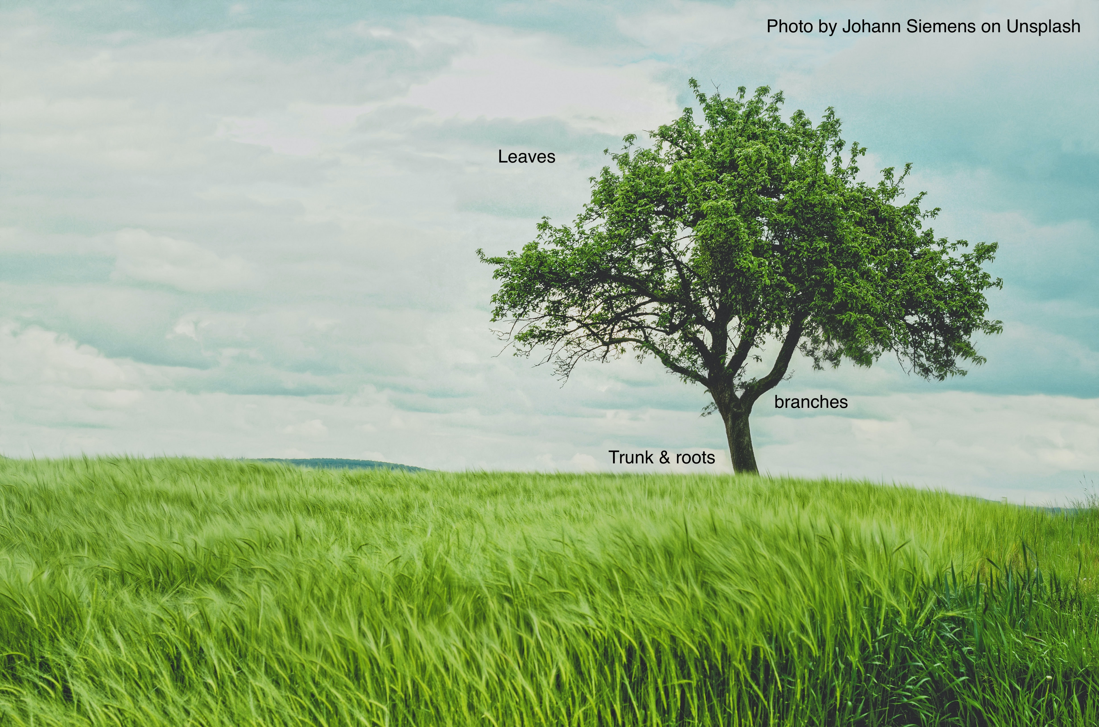
Before we talk about noun clauses, we need to understand how sentences go together.
Every English sentence is like a tree.

Slide 3

Every tree has a trunk; every sentence has an independent clause.
Without a trunk and roots, you cannot have a living tree.
Without an independent clause, you cannot begin to build a complete sentence.

Slide 4

What is an independent clause?
An independent clause is a group of words that:
  Contains a subject and a verb
  Expresses a complete idea and can stand alone because there are no marker words attached to it

Slide 5

This is an independent clause:
Tom makes lunch.
Subject verb
It expresses a complete idea, does not have any marker words at the front, and it finishes with a period.

Slide 6
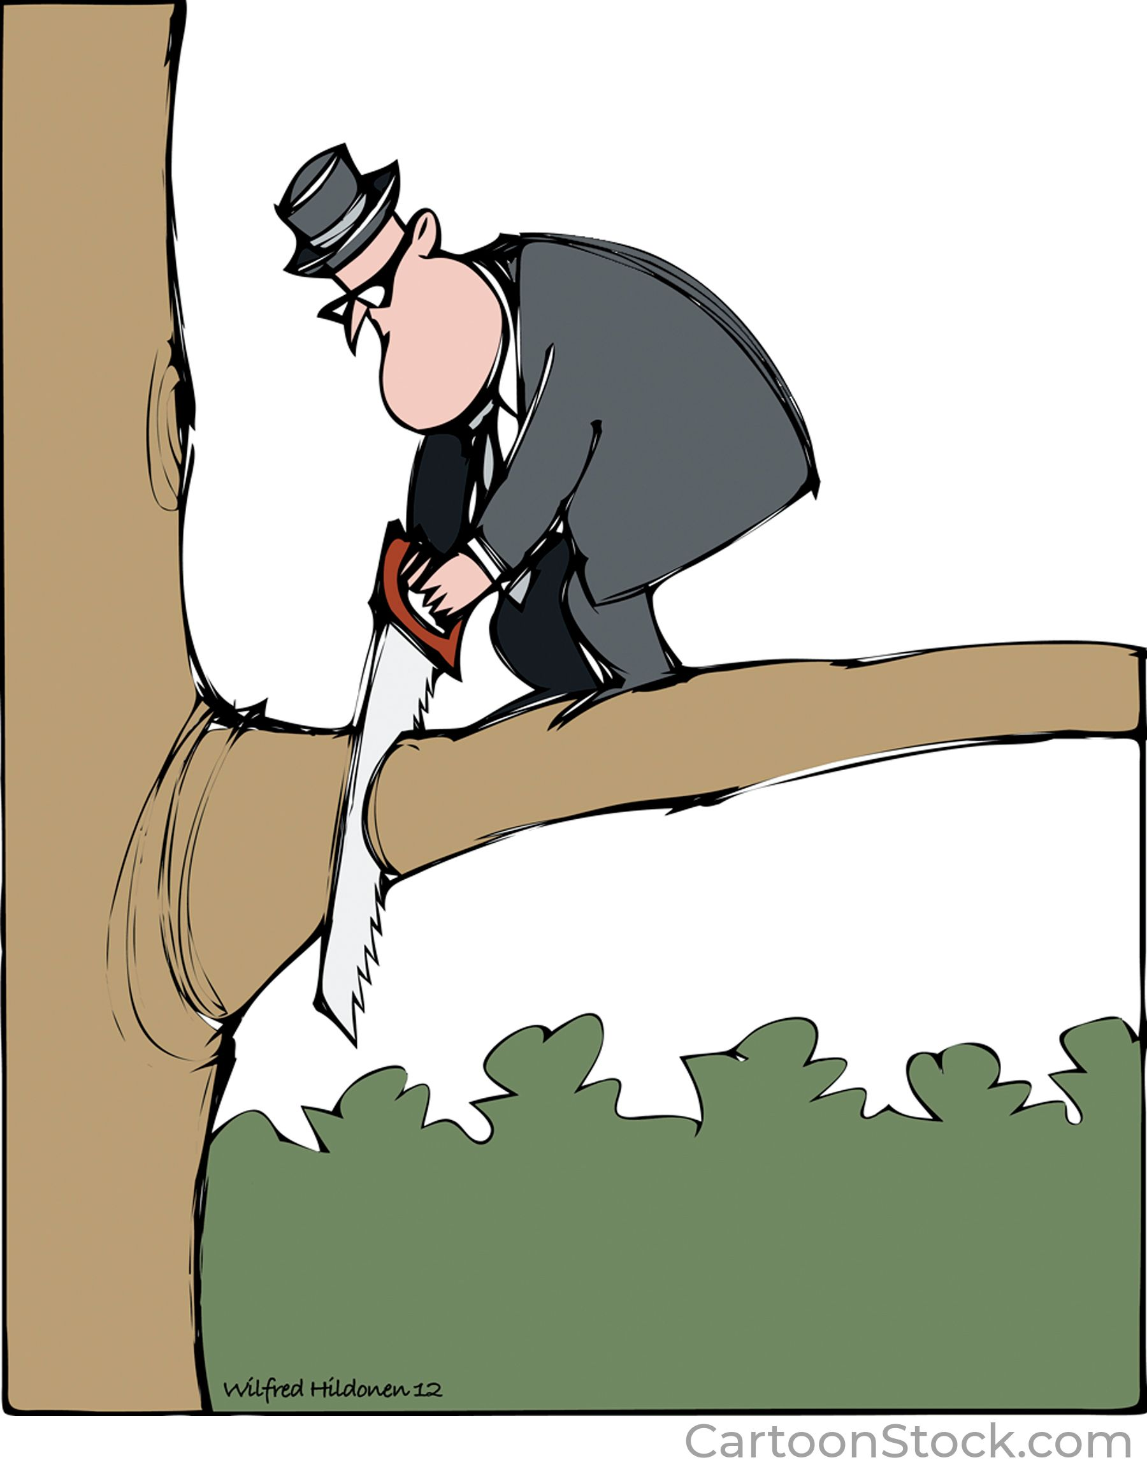
What is a dependent clause?
A dependent clause is a group of words that:
  Contains a subject and a verb
  Cannot stand alone; it must stay connected to an independent clause
  Uses a marker word at the front to show where the clause begins

Slide 7
NOUN: person, place, thing, Name
Nouns occur in the subject of a sentence:
The cat ate the mouse.
Nouns occur after the verb (object) of a sentence
Noun clauses are a group of words that occur in the same position as a single noun.
They can occur at the beginning or in the middle of a sentence.
This semester, we will look at noun clauses that go in the middle of a sentence:
The cat ate what he caught.

Slide 8
These are examples of noun dependent clauses
…why he cut the branch
…when he cut the branch
…whether he cut the branch
…where he cut the branch
…if he cut the branch
All of these need to be attached to an independent clause because they begin with the noun clause marker words.
I don’t know....

Slide 9
Noun Clause Marker Words:
WHO WHAT WHEN WHERE
WHY HOW IF WHETHER THAT
Each kind of dependent clause has its own marker words and punctuation rules.
Many of the Noun Clause Marker Words are question words.
WHO – for people
WHAT - for things
WHEN – for time
WHERE – for place
WHY– for a reason
HOW– in what way
IF/WHETHER (OR NOT) – to express a doubt
THAT – to express a fact

Slide 10
Word order
Regular Questions
NOUN CLAUSES
Regular questions use QUESTION WORD ORDER after the question word:
auxilliary-subject-verb (ASV)
When will she arrive?
A S V
Why did John cheat on the test?
A S V
Why is he crying?
A S V
Noun clauses use SENTENCE WORD ORDER after the marker word:
subject-auxilliary-verb (SAV)
I don’t know when she will arrive.
S A V
I’m not sure why John cheated on
S AV
the test.
Do you know why he is crying?
S A V

Slide 11

PUNCTUATION
Question mark or period?
Look at the independent clause; is it a question or a statement?
Question:
WHERE IS THE BUS STOP?
Noun Clauses
Can you tell me where the bus stop is?
I don’t know if I can tell you. I think that it’s down the street.
Do you know what time the bus comes?
I’m sorry. I’m not sure when it comes.
I can’t understand what you’re saying. Could you say it again more slowly?

Slide 12
PUNCTUATION
Commas or no commas?
NO COMMAS WITH NOUN CLAUSES, EVER! (easy!)
Would you put a comma here?
Mary, is a teacher.
Mary is, a teacher.
No…we do not separate subjects and verbs or verbs and objects with commas.
Since NOUN CLAUSES do the same job as single nouns, we NEVER USE A COMMA before or after a noun clause.
INCORRECT:
Do you know, whether Mary is a teacher?
I am certain, that Mary teaches at NVCC.
CORRECT:
Do you know whether Mary is a teacher?
I am certain that Mary teaches at NVCC.

Slide 13
Two places Noun Clauses occur in essay writing
Body paragraph transition sentences
Concluding ideas (subjunctive)

Slide 14
1. Body paragraph transition sentences
The first reason is honesty.
HONESTY is a noun. You don’t need a clause here.
The first reason is THAT HE IS HONEST.
HONEST is an adjective. Our key word “reason” is a noun – we need a noun clause to go in the noun space in this sentence.

Slide 15
2. Subjunctive concluding ideas: verb structure is similar to modals (base form)
You/he SHOULD do all your homework so you can be a more successful student.
I RECOMMEND that you/he do* all your homework so you can be a more successful student.
* notice that the verb is always base form, similar to a modal!

Slide 16
In summary…
Noun clauses are dependent. They must occur in front of the verb or after the verb inside an independent clause.
Noun clauses use sentence word order (SAV) even though the marker words make them look like questions.
Whether you use a question mark or a period depends on whether the independent clause is a question or a statement.
Use Noun Clauses often occur in body transition sentences and concluding ideas.
Noun clauses NEVER use commas.

