Slide 1

Connecting Independent Clauses:
FANBOYS and Transitions

Slide 2

What is an independent clause?
An independent clause is a group of words that:
  Contains a subject and a verb
  Expresses a complete idea and can stand alone because there are no marker words attached to it

Slide 3

This is an independent clause:
Tom is making lunch.
Subject verb
It expresses a complete idea, does not have any marker words at the front, and it finishes with a period.

Slide 4
There are only four ways to connect two independent clauses in English.
1. Period
.
2. Semi-colon
;
3. Coordinating Conjunctions (FANBOYS)
4. Adverbial Conjunction (Transitions)

Slide 5
But first…what is a “complete sentence”
(also called an “independent clause”)
An independent clause:
Contains a SUBJECT and a VERB
Expresses a COMPLETE IDEA
Does not have a dependent clause marker word attached
Charlie ate the cake happily.

Slide 6

What is a compound sentence?
A compound sentence takes two INDEPENDENT CLAUSES and links them together.
It creates variety and a different rhythm in your writing, and it keeps your writing from sounding “choppy.”

Slide 7
Connecting with PUNCTUATION
You can connect your two sentences with a PERIOD or a SEMI-COLON.
NEVER USE A COMMA!

Slide 8


#1: USE A PERIOD
Two independent clauses = two sentences, separated with a PERIOD.
Lucy likes vanilla ice cream.
Her sister Mary likes CHOCOLATE ice cream.

Slide 9

#2: USE A SEMI-COLON
* Lucy likes vanilla ice cream; her sister likes chocolate ice cream. (Correct)
* Lucy likes vanilla ice cream, her sister likes chocolate ice cream. (NOT correct)
You can connect related ideas with a SEMI-COLON and no connector word. You cannot connect two sentences with just a comma.

Slide 10
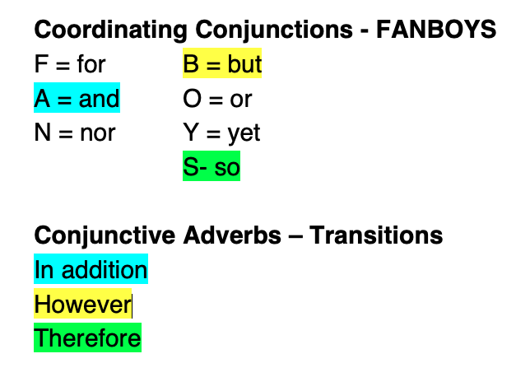
#3 & #4: Connect with CONJUNCTIONS
You can connect your sentences with
Coordinating Conjunctions
(FANBOYS)
or
Adverbial Conjunctions
(TRANSITIONS)

Slide 11
There are two groups of words that connect compound sentences. Each group has separate punctuation rules.
If you know which group it belongs to, you know which punctuation to use!
CooRdinating Conjunctions (FANBOYS)
Adverbial conjunctions
(Transitions)
For
AND
Nor
BUT (Yellow = the ones we
Or use the most)
Yet
SO
Also In addition Moreover
However On the other hand
Therefore As a result
For example For instance

Slide 12
The meaning is the same, but the punctuation is different:
* Lucy likes vanilla ice cream, but her sister Mary likes chocolate ice cream.
* Lucy likes vanilla ice cream; however, her sister likes chocolate ice cream.

Slide 13
#3 Use a Connector Word: Coordinating Conjunctions (FANBOYS)
for and nor but or yet so

Slide 14
Coordinating conjunction words (FANBOYS) link things together. They can link words, phrases, or sentences.
Only use a comma when they are linking complete sentences.
Which of these are linking complete sentences?
I enjoy hiking and swimming.
No – AND is linking two gerunds here, not sentences. No comma.
I wanted to go to the party but I had to do my homework.
Yes – BUT is linking two sentences: I wanted to go to the party and I had to do my homework. USE A COMMA BEFORE BUT.
John went to the grocery store and bought some milk.
No- The first part is a complete sentence, but bought some milk is not a sentence because it doesn’t have a subject. No comma.
Sally was very tired so she went to bed early.
Yes – Sally was very tired and she went to bed early are both complete sentences. Use a comma before SO.

Slide 15

Never begin a sentence with a coordinating conjunction (FANBOY) in academic writing.
* Jack really wanted to go swimming. But he was afraid to jump off the diving board. (not correct)
* Jack really wanted to go swimming, but he was afraid to jump off the diving board. (correct)

Slide 16
#4 Use a Connector Word: Adverbial Conjunctions (Transitions)
In addition however therefore

Slide 17
Adverbial Conjunctions link two independent clauses together. There are two ways to punctuate them.
TWO SENTENCES WITH ADVERBIAL CONJUNCTION
ONE COMPOUND SENTENCE
Two independent sentences:
Charles was extremely tired. He took a nap.
Connected with an Adverbial Conjunction to make one sentence:
Charles was extremely tired; therefore, he took a nap.
Two independent sentences:
Charles was extremely tired. He took a nap.
Connected with an Adverbial Conjunction to make two sentences:
Charles was extremely tired. Therefore, he took a nap.

Slide 18
What do they mean?
Remember: The meanings are similar, but the punctuation is different.
Knowing which group your connecting word comes from will help you with your punctuation.

Slide 19
Connect or introduce similar ideas
Coordinating conjunctions
(FANBOYS)
Adverbial conjunctions
(TRANSITIONS)
AND
ALSO
IN ADDITION
MOREOVER
FURTHERMORE

Slide 20
Connect different, contrasting, or opposite ideas
Coordinating conjunctions
(FANBOYS)
Adverbial conjunctions
(TRANSITIONS)
BUT
HOWEVER
ON THE OTHER HAND
IN CONTRAST

Slide 21
Introduce a result or consequence of something
Coordinating conjunctions
(FANBOYS)
Adverbial conjunctions
(TRANSITIONS)
SO
AS A RESULT
THEREFORE
THUS
CONSEQUENTLY

Slide 22

Show an example
Coordinating conjunctions
(FANBOYS)
(no example words!)
Adverbial conjunctions
(TRANSITIONS)
FOR EXAMPLE
FOR INSTANCE

